Slide 1
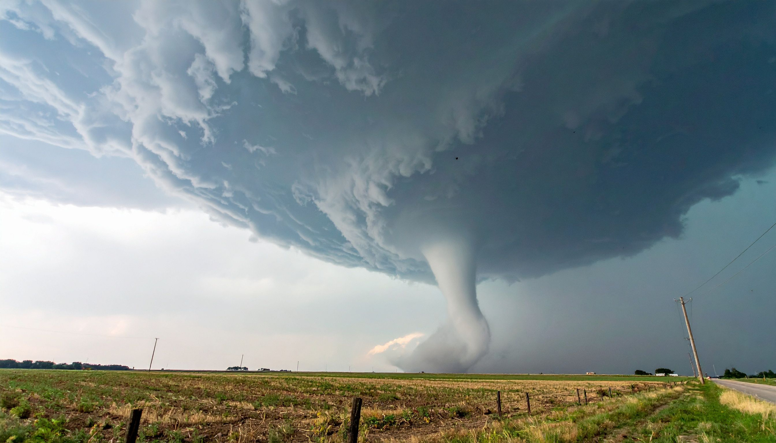
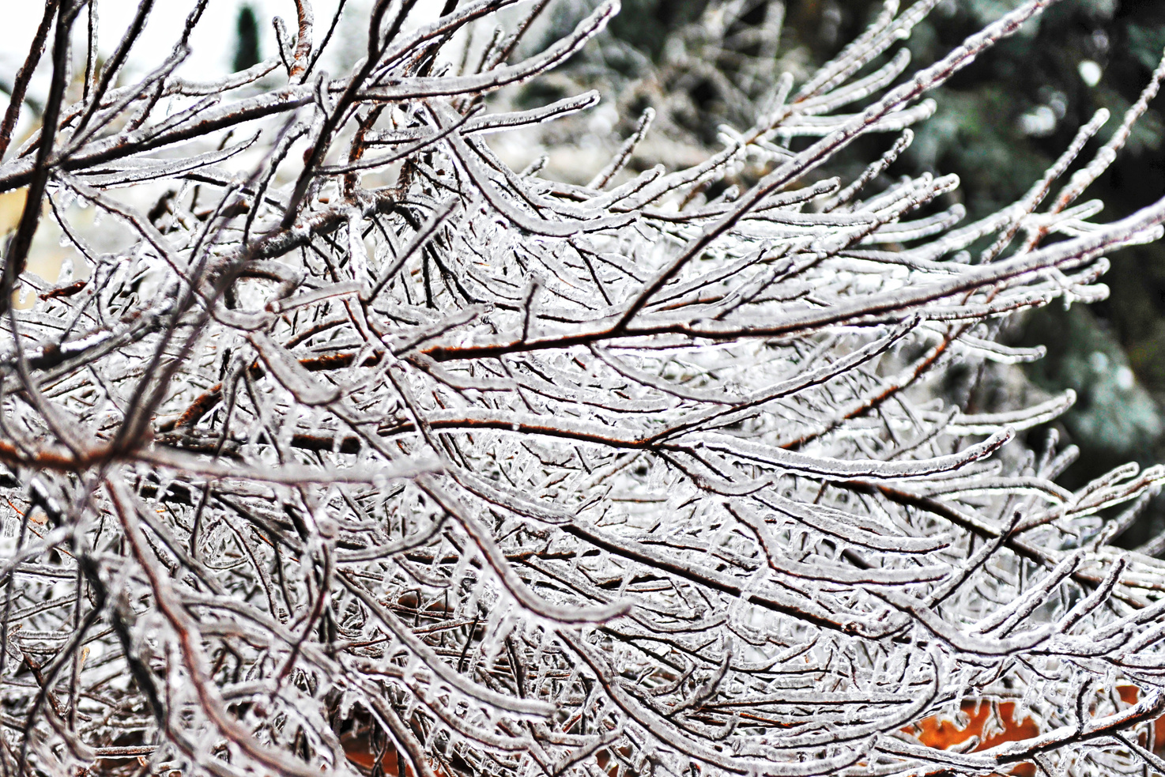

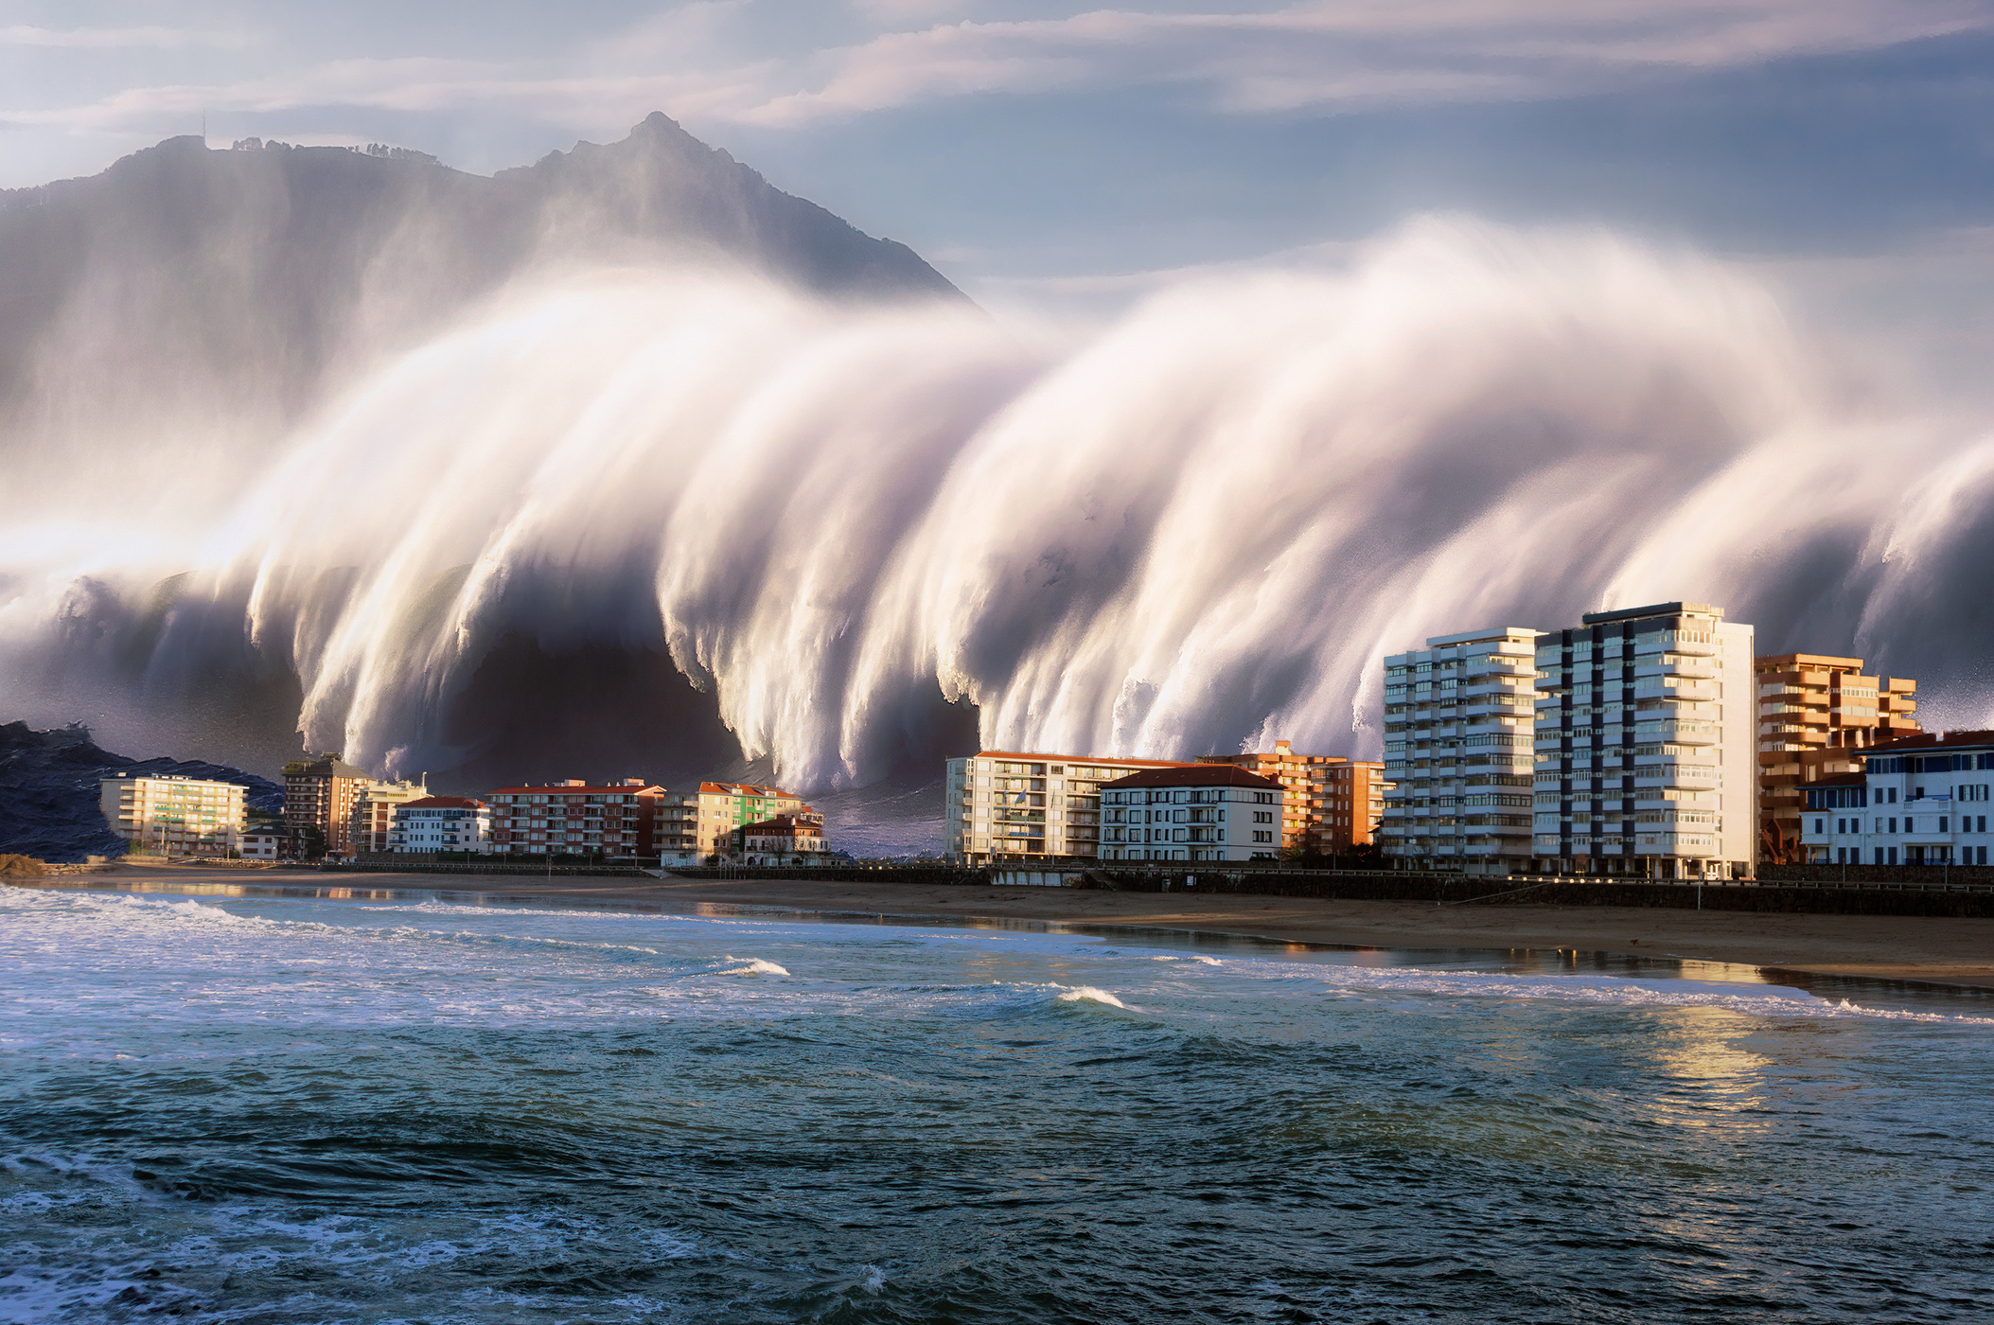
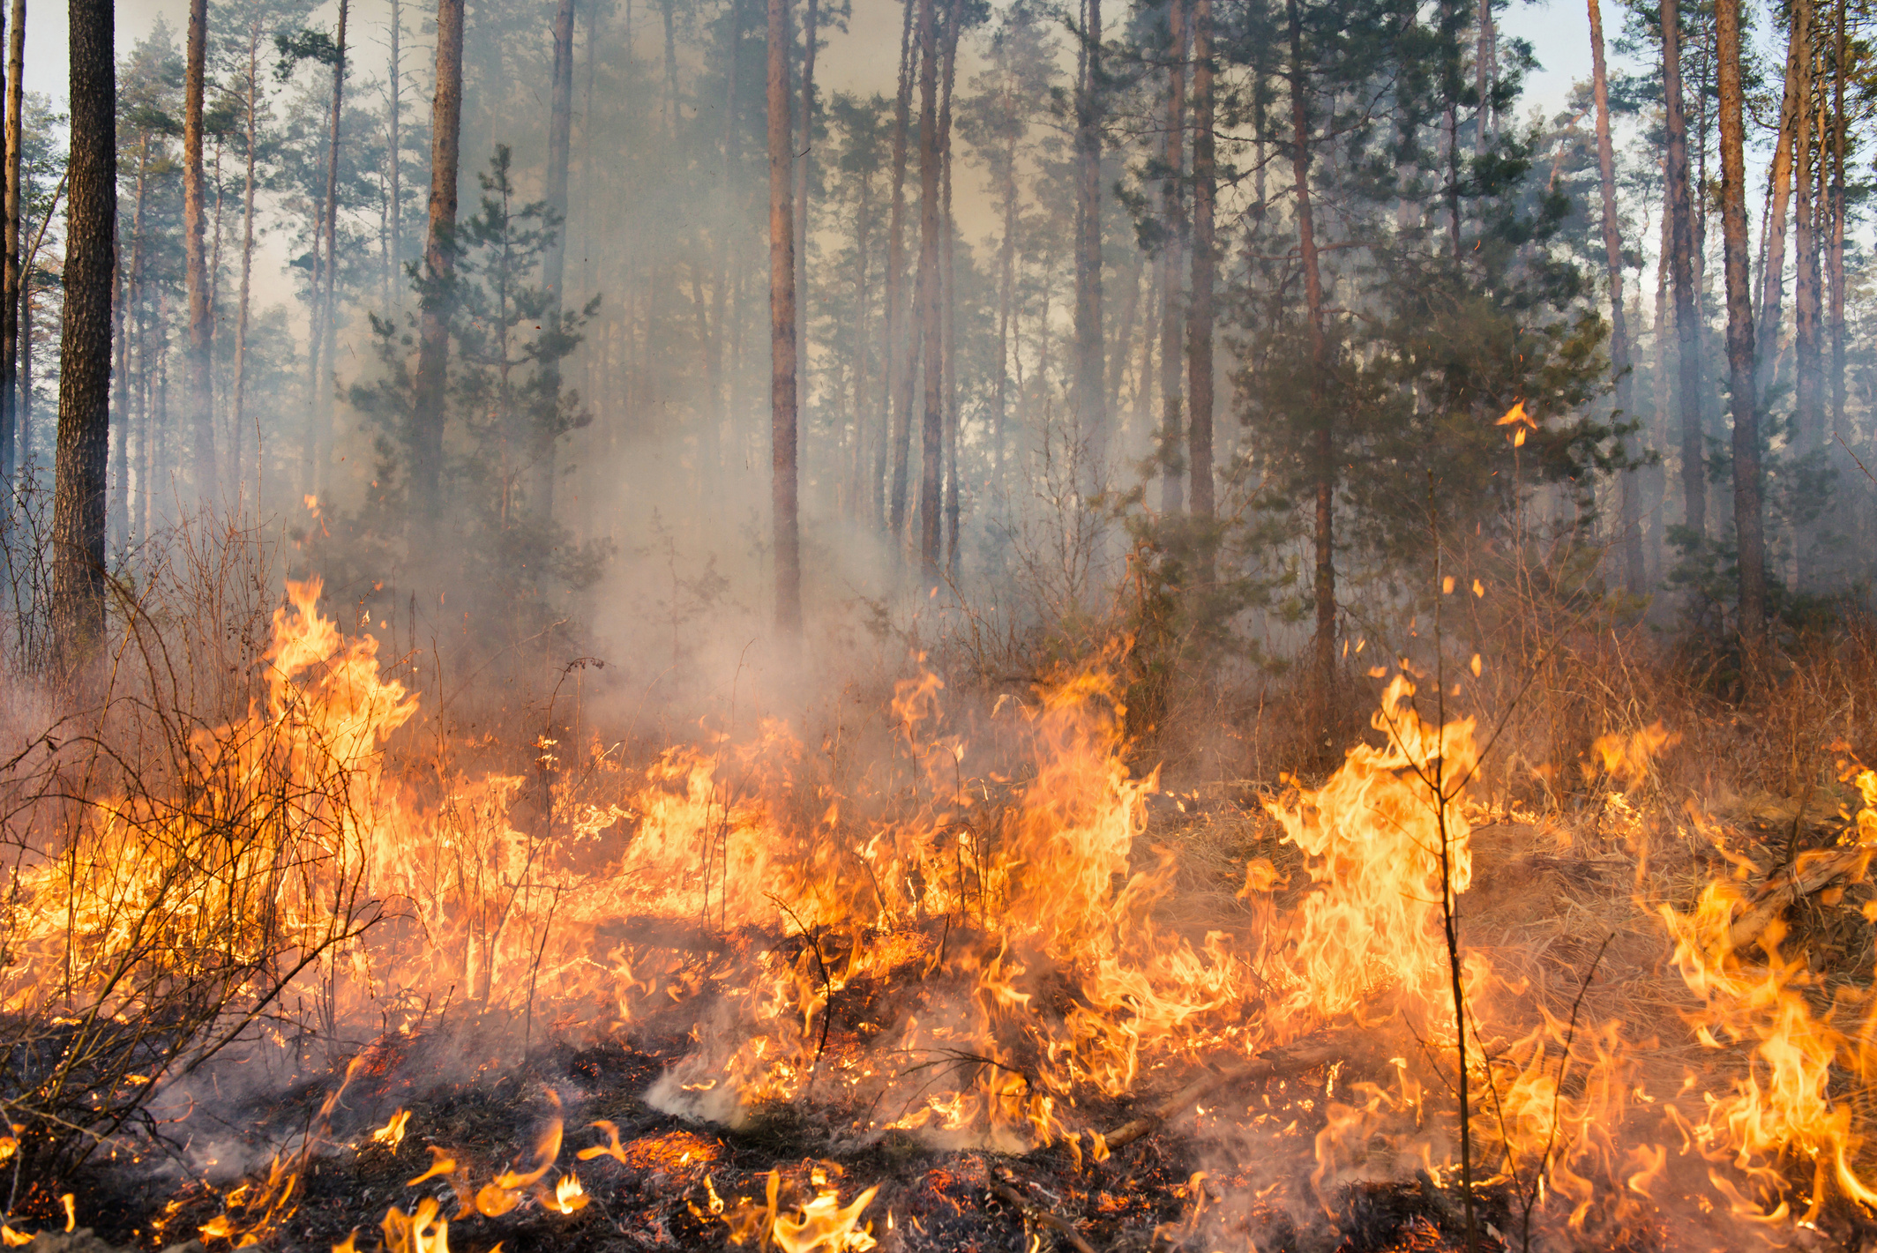
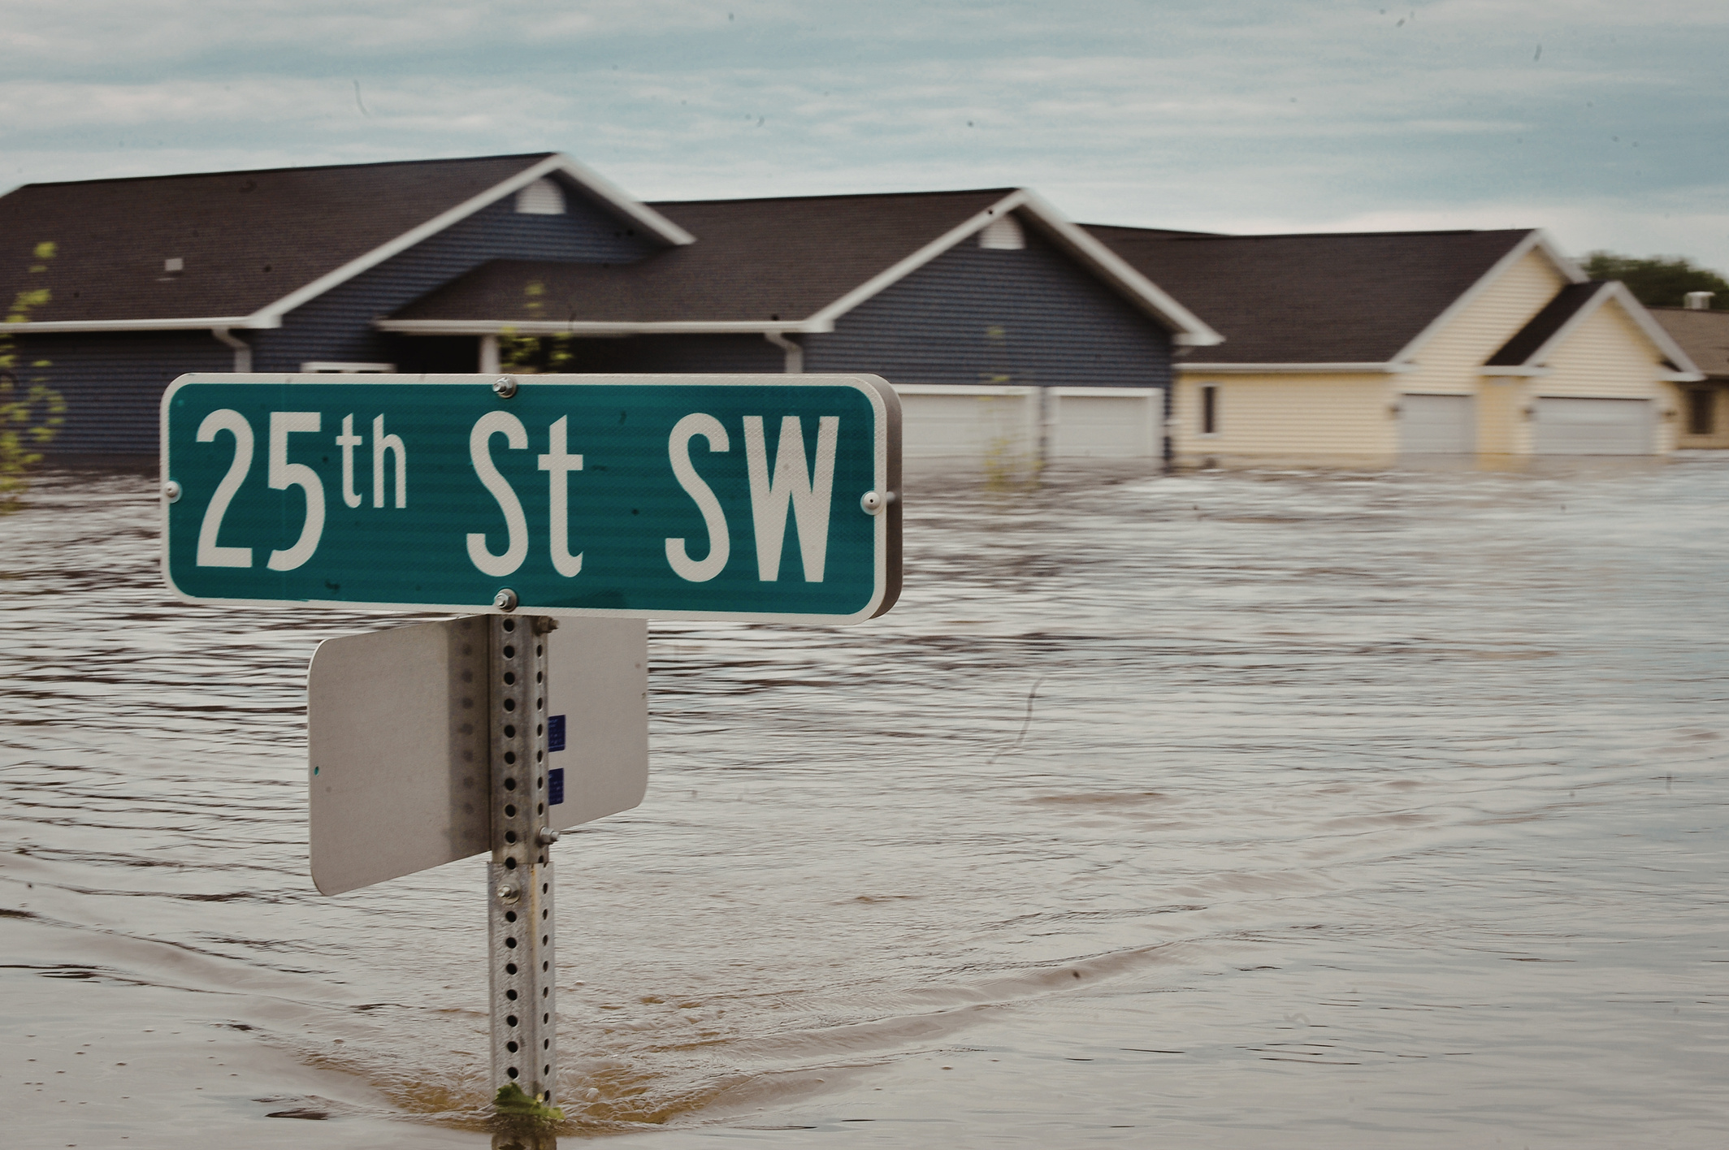
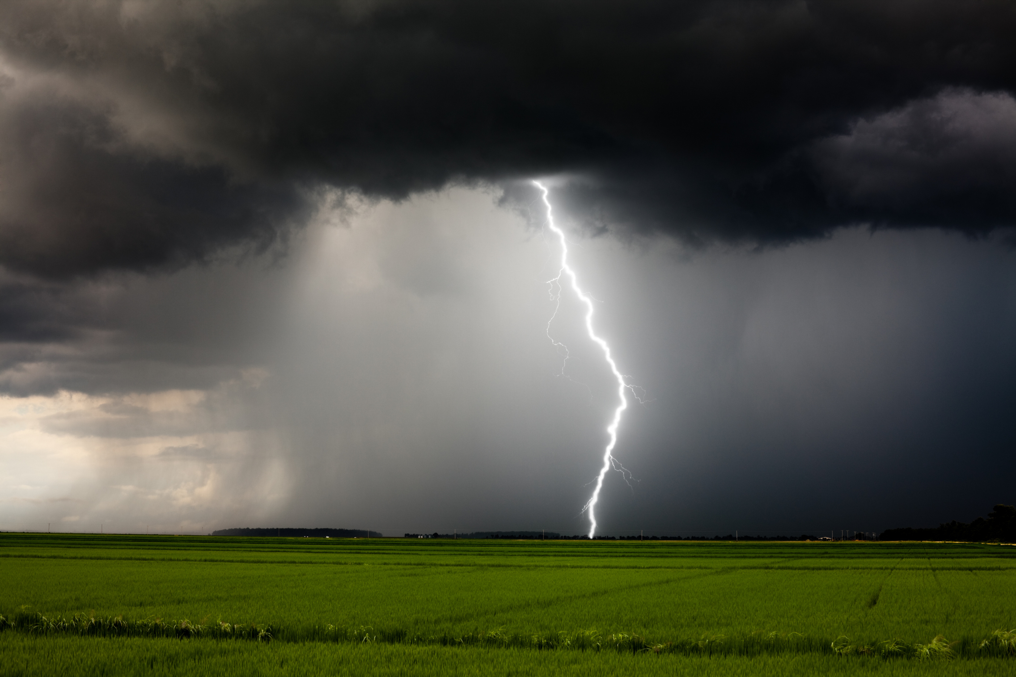
WHY JOIN EDEN?
STRENGTHENING EXTENSION’S IMPACT BEFORE, DURING, AND AFTER DISASTERS

Slide 2

DISASTERS ARE INCREASING. SO IS THE DEMAND FOR EXTENSION.
  28 billion-dollar disasters in one year
  Communities need trusted, research-based guidance
  Extension is already on the front lines
EXTENSION PLAYS A CRITICAL ROLE
  Preparedness, mitigation, response, and recovery start locally
  Extension connects research to real-world needs
  Demand for timely, credible information grows

Slide 3
A NATIONAL NETWORK BUILT FOR THIS WORK
  EDEN is a nationwide Extension network focused on disaster education
  Multi-state collaboration across land-grant institutions and partners
  Supported by USDA NIFA

Slide 4


A CLEAR, SHARED MISSION
Reduce the impact of disasters through research-based education
Coordinate and share different resources across Extension

Slide 5





WHAT MAKES EDEN VALUABLE
NETWORK
Connect directly with other EDEN delegates through our listservs and online community platform
RESOURCES
Access a wealth of disaster-related resources to support your work.
COORDINATION
Stay informed with our monthly newsletter.
CREDIBILITY
Stay informed with our monthly newsletter.

Slide 6
WHAT YOU ACTUALLY GET
  Access to disaster education resources and tools
  Direct connection to experts and peers
  Professional development opportunities
  Opportunities to collaborate and contribute
SAVE TIME. INCREASE IMPACT.
  No need to build materials from scratch
  Respond faster during crises
  Strengthen program quality and credibility
  Expand your reach beyond your state

Slide 7
A NETWORK WITH REAL REACH
50
400+
100
states
represented
extension professionals
almost disciplines represented
ENGAGE IN A WAY THAT WORKS FOR YOU
  Join as a delegate
  Participate in a committee
  Attend trainings or the annual conference
  Use and share resources

Slide 8

MORE THAN MEMBERSHIP
  Present your work nationally
  Contribute to shared resources
  Collaborate on projects and initiatives
  Build your professional profile
A BUILT-IN COMMUNITY
CONNECT
SHARE
ACCESS
with extension professionals across the country
resources, ask questions, and solve problems together
online platform and communication channels

Slide 9



RELEVANT TO YOUR ROLE
EDUCATORS
SPECIALISTS
strengthen local programming and response
expand reach and collaboration
COMMUNICATORS
ADMINISTRATORS
access vetted messaging and resources
build statewide capacity

Slide 10

JOIN EDEN
Become a delegate and strengthen your impact before the next disaster.
EXTENSIONDISASTER.NET

Slide 11
CONTACTS
Monty Dozier | Texas A&M AgriLife Extension
Chair | monty.dozier@ag.tamu.edu
Thomas Bass | Montana State University Chair-Elect | tmbass@montana.edu
Kimberly Davis | Florida A&M University
Secretary | kimberly.davis@famu.edu
Visit ExtensionDisaster.net for more info.

