Slide 1
Epidemic Preparedness for Community Organizations
Notes:
Note to Instructor: Add your name and title, as well as possibly the date and location of the presentation, to this slide. Introduce yourself, your Extension affiliation (if applicable) and the Extension Disaster Education Network (EDEN). Welcome participants, and lead introductions.
Background: The Extension Disaster Education Network (EDEN) is an affiliation of state and territory Extension programs at 1862 and 1890 land-grant universities and Sea Grant programs. The network allows representatives from the institutions to share and collaboratively develop resources to carry out its mission, which is to reduce the impact of disasters through research-based education. These resources include websites, publications, videos, curricula, templates and much more.

Slide 2
Epidemic Preparedness for Community Organizations
Reducing Illness and Death from an Epidemic
Building Hope
Putting Your Community Back Together
Notes:
This Epidemic Preparedness for Community Organizations program consists of three sections. This section provides the members of your community organization with an understanding of how a disease or virus can become an epidemic. In addition, this section will provide every member of your group with steps they can take to reduce the risk of illness and death from an epidemic.
The second section will help your group design an epidemic preparedness plan, and the third section will help you develop a strategy for assisting the community during and after an epidemic.

Slide 3
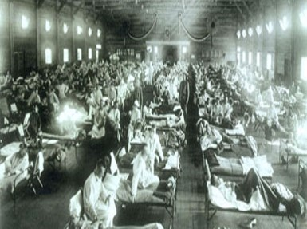
Reducing Illness and Death
Describe epidemics
Review epidemics in history
Discuss epidemic interventions
National Museum of Health and Medicine, Armed Forces Institute of Pathology, Washington, D.C., Image NCP 1603
Notes:
To properly prepare your organization for an epidemic, it is essential to first cover the basics:
What are epidemics?
Where do they come from?
What can we do to prevent them or reduce their effects?

Slide 4
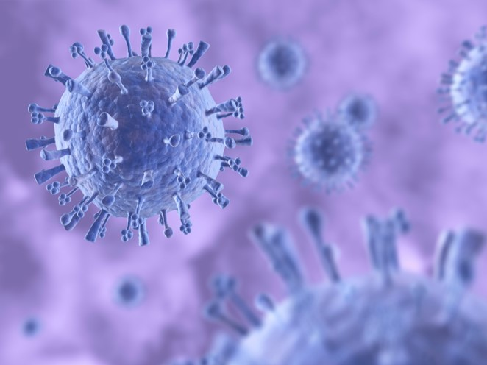
Epidemics
Geographically isolated
Increased presence
Increased severity
Change in movement and susceptibility
iStock
Notes:
Epidemics of an infectious disease are defined this way:
The disease outbreak occurs in a relatively isolated area -- a single city, country or region.
The number of cases becomes significantly higher than the normal pattern. For example, every community has a different baseline for different diseases. In some communities, the number of cases of measles is zero while other communities have a steady presence of measles over long periods of time. The presence of a disease in a community doesn’t necessarily mean that disease is considered an epidemic. However, if the number of cases increases well above the baseline, it may qualify to be an epidemic.
Epidemics also may be defined by:
Increase in the severity of the disease
Change in the way the disease spreads or how susceptible people are to the disease. A virus may mutate to change the way it moves or the conditions it thrives in. Or an environmental change may increase the likelihood that individuals will come into contact with the disease. For example, after natural disasters, responders may bring diseases to the impacted area or evacuees may take diseases to their new locations. In addition, health care may be strained or lacking, and the quality of living conditions may suddenly decrease.
Seasonal flu is not necessarily an epidemic, and an epidemic is not necessarily an infectious disease. For example, obesity and diabetes are both chronic diseases that are considered to be epidemics in the United States.
An epidemic can become a pandemic when it affects many nations on several continents. Management and containment are key to decreasing the chances that an epidemic will become a pandemic.
Reference: Centers for Disease Control and Prevention (CDC) https://www.cdc.gov/ophss/csels/dsepd/ss1978/lesson1/section11.html

Slide 5
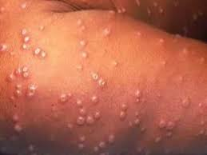
Epidemic Examples
Historic 1660s U.S. smallpox outbreak 1900s U.S. polio outbreaks Recent 2010 cholera outbreak in Haiti 2014 Ebola outbreak in West Africa
OMICS International
Notes:
Hundreds of epidemics have occurred throughout history. For example, European settlers carried smallpox to North America, infecting and killing millions of Native Americans. There were multiple outbreaks of polio in the 1900s until it was eradicated in 1979. More recent epidemics include the cholera outbreak in Haiti following the 2010 earthquake and the 2014 Ebola outbreak that primarily was in Sierra Leone, Liberia and Guinea.

Slide 6
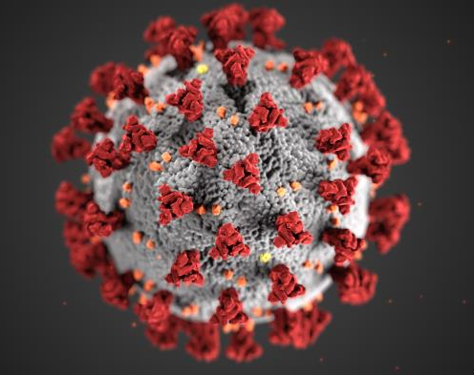
Pandemic Examples
Historic 1346-53 Bubonic plague 1918-20 influenza Recent 2005-12 HIV/AIDS 2019-20 COVID-19
CDC
Notes:
Worldwide pandemics have included the Bubonic plague of the 1300s, called the Black Death, that killed an estimated 75 million to 200 million people in Europe, Asia and Africa. The 1918-1920 influenza pandemic caused 20 million to 50 million deaths around the world. It was called the Spanish flu not because it originated in Spain but because Spain was neutral during World War I. Since it was one of the few countries where news wasn’t suppressed, much of the rest of the world read about the pandemic’s deaths in Spain so they called it the Spanish flu.
About 36 million people died from HIV/AIDS worldwide during the virus’ peak between 2005 and 2012. Of course, the virus is still active, but new infections and deaths have been reduced drastically.
In Fall 2019, a novel coronavirus was initially seen to be an epidemic in China. But the virus spread worldwide within months, and on March 11, 2020, the World Health Organization (WHO) declared COVID-19, the disease caused by the novel coronavirus, to be a pandemic.
Reference: MPH Online, https://www.mphonline.org/worst-pandemics-in-history/

Slide 7
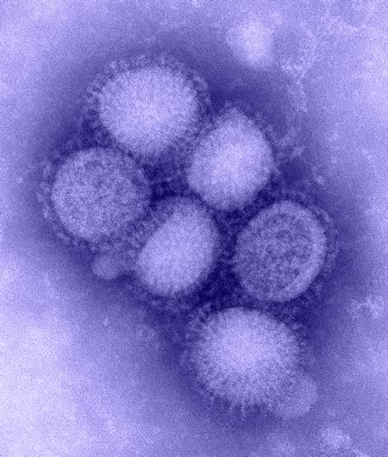
Epidemic Influenza
New virus emerges
People have little or no immunity
Causes serious illness
Spreads easily from person to person
CDC
Notes:
The information in this program is appropriate most disease-related epidemics. However, we’ll concentrate on influenza epidemics.
Note to Instructor: This program was updated in early May 2020 with some coronavirus information, but try to incorporate more details as they’re available from credible sources.
A flu epidemic occurs when a new influenza virus emerges for which people have little or no immunity. The virus causes serious illness and spreads easily from person to person. The emergence of a new and very different influenza virus that infects people can cause an epidemic.
Reference: Centers for Disease Control and Prevention (CDC) http://www.cdc.gov/flu/about/viruses/types.htm

Slide 8
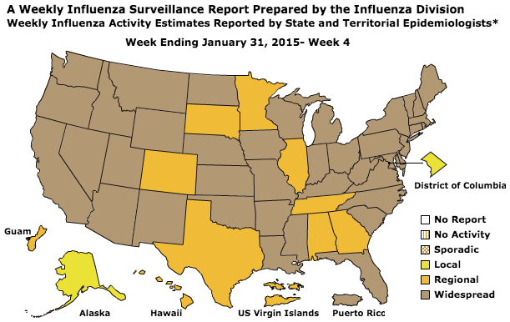
2014 Influenza Epidemic
CDC
Notes:
Every flu season, the Centers for Disease Control and Prevention (CDC) monitors the number and severity of influenza cases across the United States and releases a weekly online update. The 2014 season reached epidemic proportions largely because the flu vaccine was ineffective on the dominant flu strain.
An epidemic can quickly turn into a pandemic when it spreads to many people around the world, as we’re learning with COVID-19.
References:
http://www.cdc.gov/flu/weekly/usmap.htm
http://www.washingtonpost.com/news/to-your-health/wp/2014/12/30/this-seasons-flu-activity-has-reached-the-epidemic-threshold-the-cdc-says/

Slide 9
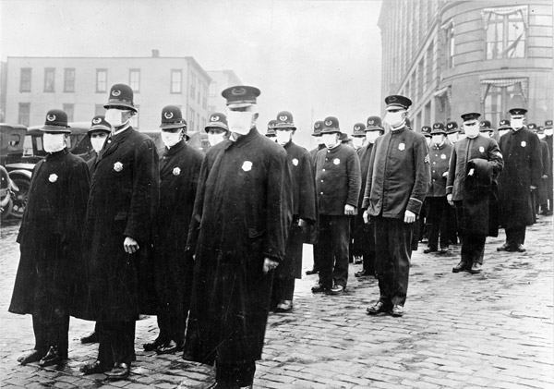
1918 Spanish Flu Pandemic
National Archives
Notes:
In 1918, the Spanish flu struck around the world and quickly swept across the United States. The following slides demonstrate the rate at which it spread across the country. This is startling, considering that transportation was in no way comparable to today’s standards. Compared to other pandemics that have occurred in the U.S., this one had a higher attack and fatality rate in previously healthy adults 20–50 years old. An estimated 675,000 Americans died.

Slide 10
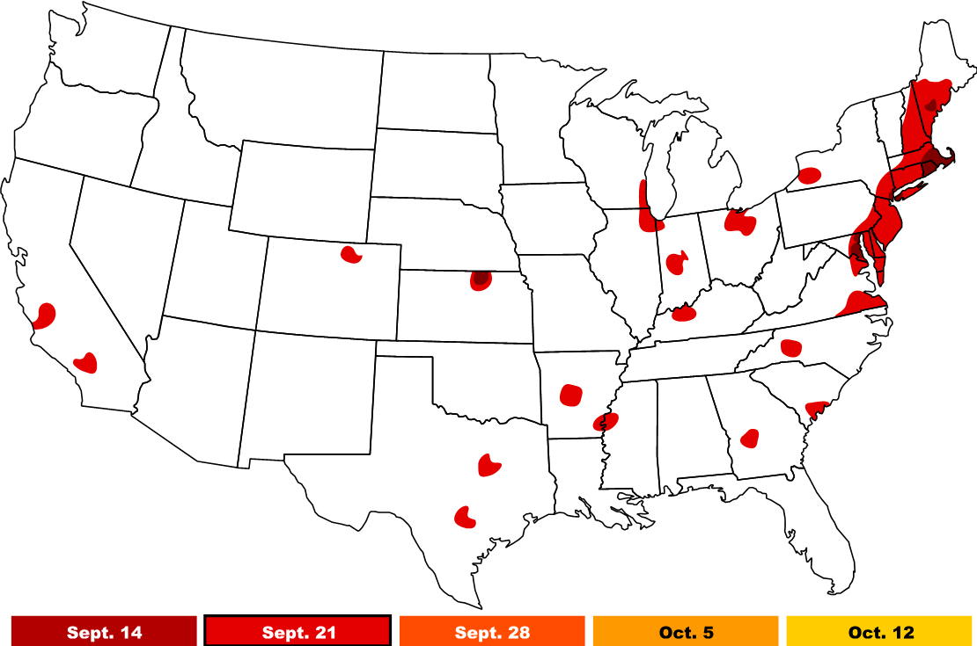
1918 Pandemic: Sept. 21
NDSU Graphic
Notes:
By September 21, cases were sporadic across the country. Soldiers returning from World War I in Europe and civilians riding across the country on the railroad spread the virus to new areas.

Slide 11
1918 Pandemic: Sept. 28
NDSU Graphic
Notes:
In just another week, cases had spread broadly, covering most of New England and other pockets of the U.S.

Slide 12
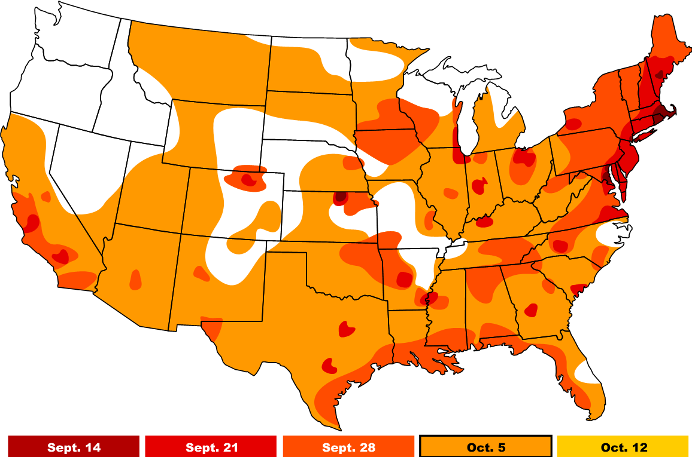
1918 Pandemic: Oct. 5
NDSU Graphic
Notes:
By early October, nearly every state had been affected.

Slide 13
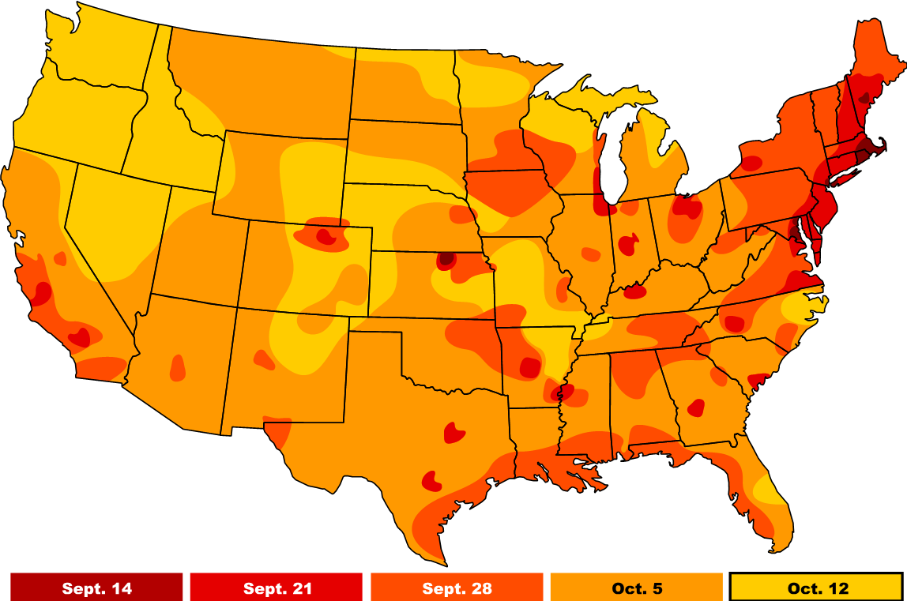
1918 Pandemic: Oct. 12
NDSU Graphic
Notes:
In just one month, pandemic influenza had engulfed the country, and every state was affected in some way. An estimated 300,000 to 350,000 people died between September 15 and December 1. The pandemic continued into 1919, ultimately killing about 675,000 people in the U.S. and 30-50 million people worldwide. This Spanish flu outbreak has been deemed the worst pandemic in American history.

Slide 14
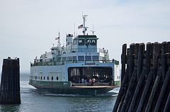

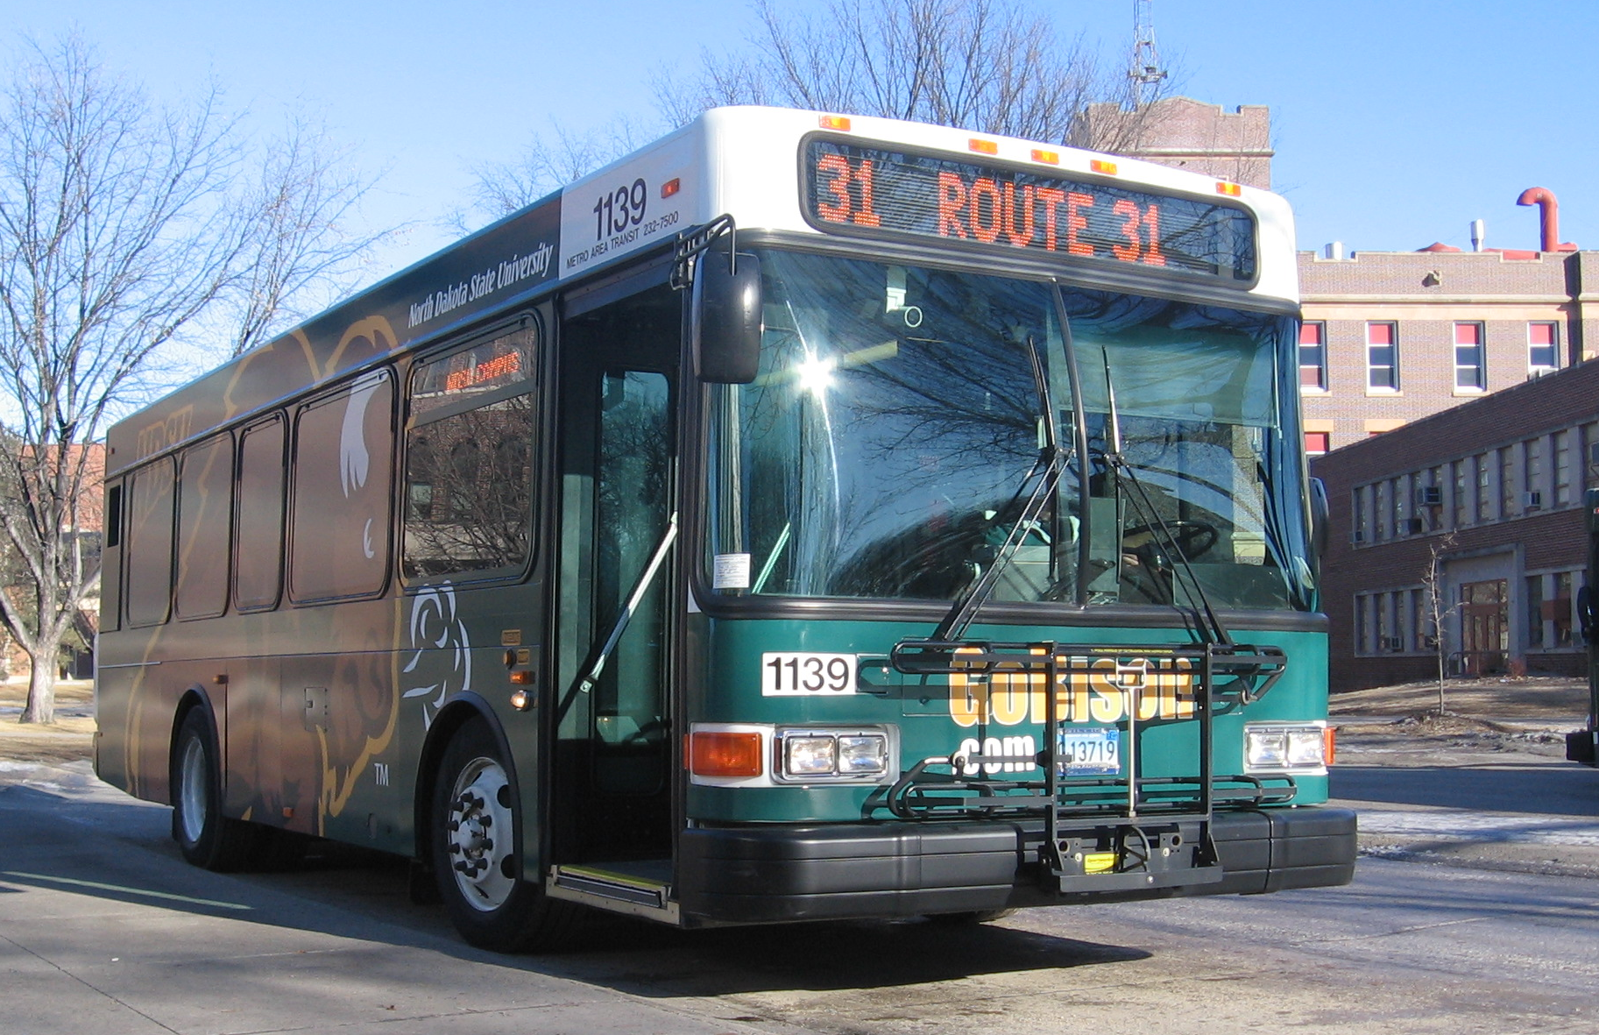

Flickr: A.Davey
NDSU
NDSU
NDSU
Notes:
Today’s society is far more mobile than in 1918. Mobility can lead to faster spread of disease. People coughing or sneezing in a confined space easily spread viruses. Pandemic flu could be one train, bus, ferry, trolley, subway or airplane ride away. A virus on the East Coast can be on the West Coast in 4 hours. A virus in Europe can be in the United States in just 8 hours.

Slide 15
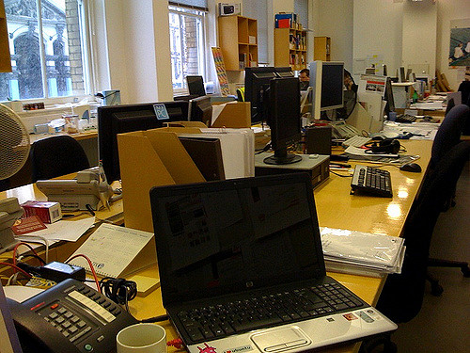
Seasonal Flu
Flickr: Iain Farrell
Notes:
Seasonal influenza occurs annually in the United States. While it is generally considered to have a modest impact on society, there is still often a significant cost to human lives and the economy. The World Health Organization estimates a $71 - $167 billion impact to the United States economy each year because of seasonal influenza.
Reference: World Health Organization http://www.who.int/mediacentre/factsheets/2003/fs211/en/

Slide 16

Influenza Transmission
Spreads through tiny respiratory droplets
Coughing, sneezing
Touching mouth, nose or eyes
Flickr: placbo
Notes:
The flu is characterized by fever, headache, tiredness, cough, sore throat, runny or stuffy nose, body aches, diarrhea and vomiting. Fever can be unusually high, tiredness extreme and cough severe. Vomiting and diarrhea are more common in children than adults. In some individuals, the flu can cause serious complications, including bacterial pneumonia, dehydration, sinus problems, ear infections and worsening of chronic medical conditions, such as congestive heart failure, asthma and diabetes.
The flu spreads from person to person through tiny respiratory droplets when infected people cough or sneeze. People also may become infected by touching an object infected with influenza virus and then touching their mouth, nose or eyes.

Slide 17
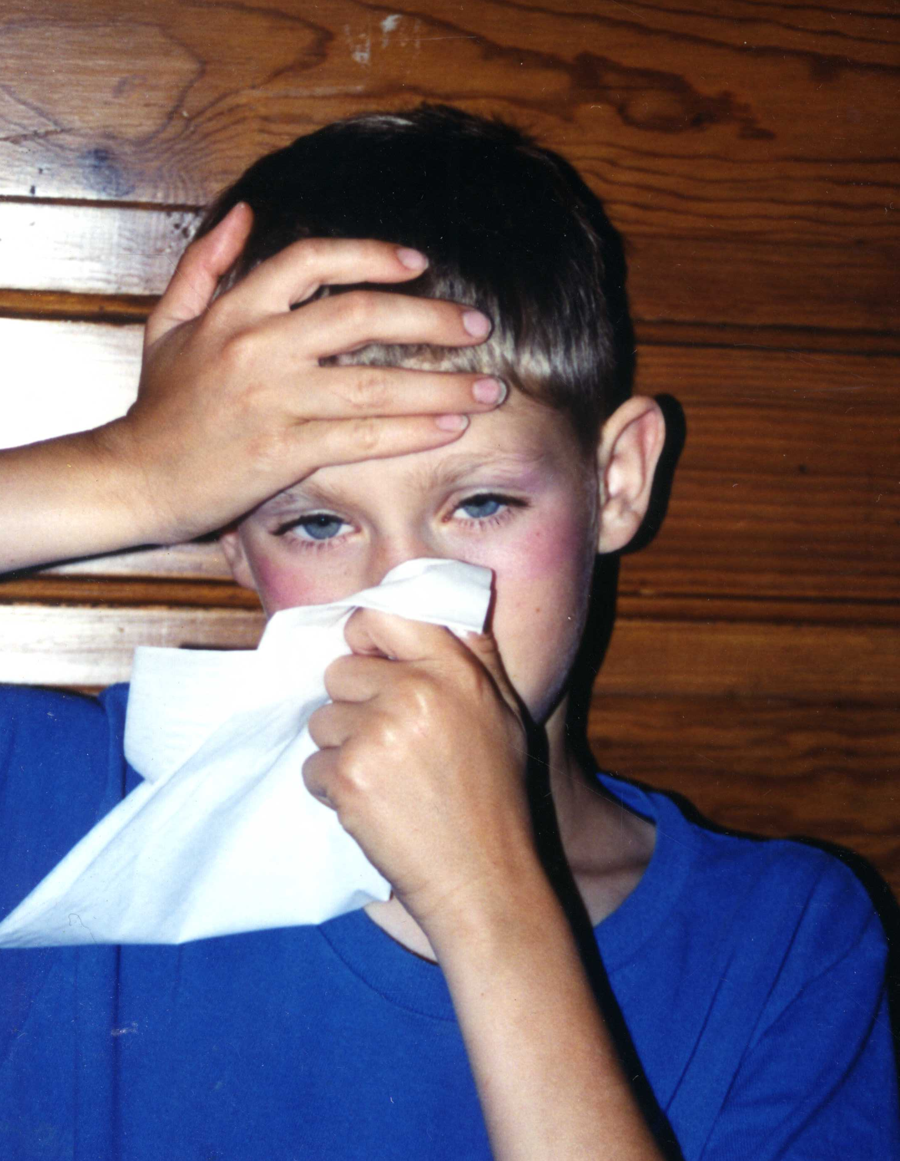
Infection Time
Contagious one day prior to showing symptoms
Contagious up to five days after symptoms appear
NDSU
Notes:
Healthy adults may be able to infect others one day prior to showing symptoms and up to five days after getting sick. That means it is possible to give someone the flu before you know you are sick, as well as while you are sick.

Slide 18
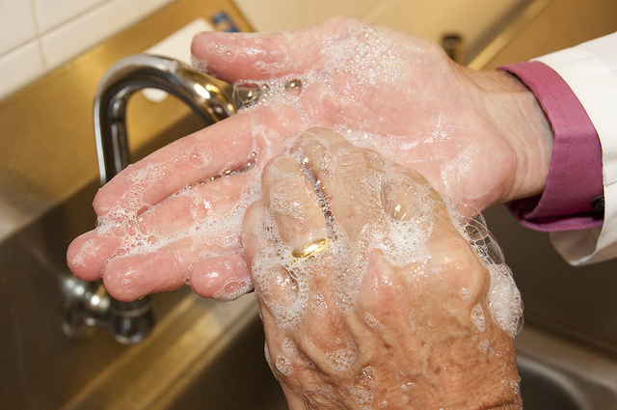
Health Interventions
Staying home
Limiting contact with others
Covering coughs & sneezes
Washing hands frequently
FDA
Notes:
Fortunately, we can stem that rapid spread of most viruses by taking four actions:
Staying home when you or someone in your household is sick. This is known as voluntary isolation or voluntary quarantine.
Limiting physical contact with others. This is known as social distancing.
Properly covering your coughs and sneezes.
Washing your hands.

Slide 19

Stay Home
Stay home when you or someone in your household is sick
Reduces spread of illness
Helps keep staff and critical functions operating
Flickr: mush m.
Notes:
During a viral outbreak, encourage staff, volunteers and members to stay at home if they or someone in their household is ill or suspects illness. Staying home can reduce the spread of illness within your community organization and the people your organization serves. This voluntary isolation protects the health of your staff and enables your organization to continue performing its core functions.

Slide 20

Organization Actions
Encourage people to stay home through conversations, flyers and other communication
Establish non-penalizing policies
Flickr: Marcin Krzyzanowski
Notes:
Encouraging people to stay home can be as easy as:
having one-on-one conversations with group members, volunteers and staff about staying home when they are sick
distributing flyers within the organization
putting “stay at home” information in bulletins, mailings and social media accounts.
In addition, consider establishing work-from-home and sick-leave policies and procedures that don’t penalize people.

Slide 21

Limit Contact
If you’re within 3-6 feet of others, you’re sharing your flu
NDSU
Notes:
Social distancing involves limiting direct contact with others. A person who has a viral illness and is standing within 6 feet of others, which is about two arm lengths away, is likely to spread the virus to them. So, if you must go out, limit close contact with others to reduce the spread of your illness.

Slide 22
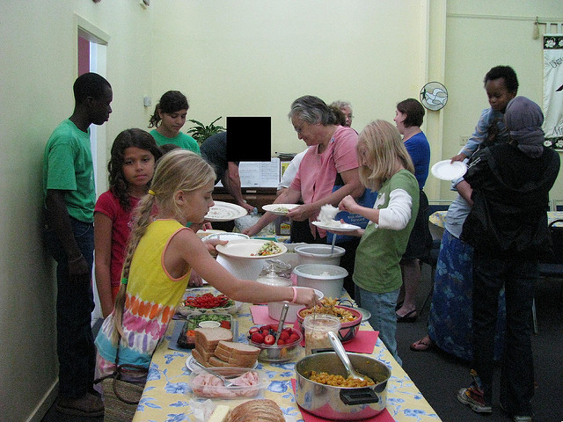
Cancel or Alter Events to Limit Contact
Recreation and education events
Worship services
Volunteering opportunities
Large meal events
Other events with large groups of people
Flickr: UUCJ
Notes:
Organizational leaders need to consider cancelling or altering some activities to help reduce transmission. This limits physical contact and will be discussed in Section 2.

Slide 23
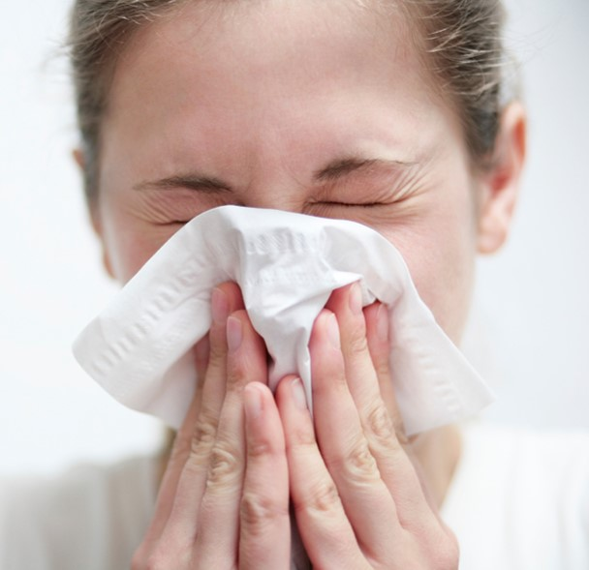
Cover Coughs & Sneezes
Best: Cover mouth and nose with a tissue and dispose immediately
Second best: Cover mouth and nose with upper sleeve
Wash hands frequently
iStock
Notes:
Covering your coughs and sneezes is one of the simplest and most effective ways to stem the spread of a virus. Remember that you are contagious a day before you show flu symptoms and may not experience any COVID-19 symptoms, so it is important to protect every cough or sneeze. The best protection is to cough or sneeze into a tissue. Throw the tissue away immediately then wash your hands. If a tissue isn’t handy, cough or sneeze into your upper sleeve. Wash your hands after coughs and sneezes and frequently throughout the day.

Slide 24
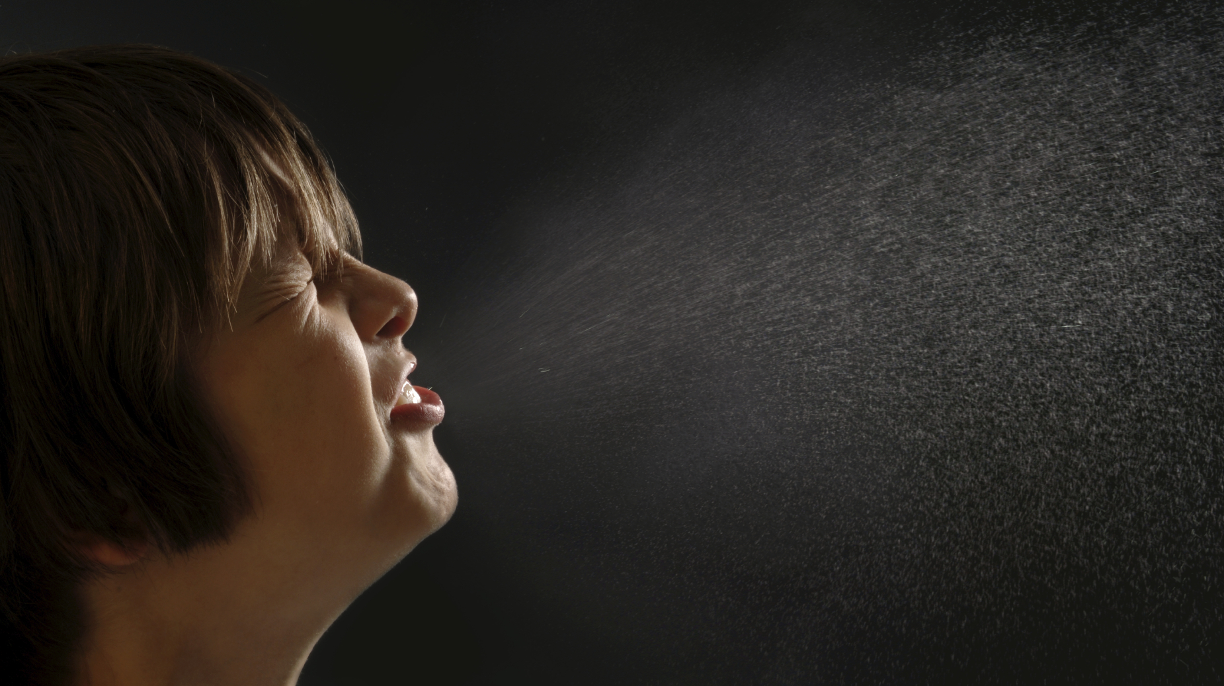
Cover Coughs & Sneezes
iStock
Cover mouth & nose with your hands rather than nothing at all.
Wash hands as soon as possible.
Notes:
The worst thing to do is not cover your mouth and nose at all. Water droplets from sneezing and coughing can travel 6 feet or more, directly affecting other people and landing on surfaces that others touch. As a last resort, cover your mouth and nose with your bare hands when you cough or sneeze. Immediately clean them with soap and water or hand sanitizer.

Slide 25


Wash Hands Frequently
iStock
iStock
Notes:
Good hand hygiene is probably the single most important behavior for reducing person-to-person spread of viruses. Frequent handwashing stops the spread of the virus that will make you and others sick.
Your community organization can help make this easy for staff and others by making hand-washing stations and hand sanitizer available in a variety of locations. Remember kitchens, eating areas, meeting rooms, classrooms and other places. Consider putting hand sanitizer in every room of your facility.

Slide 26
Summary
Epidemics are serious and can dramatically affect your organization
You can help stem the spread of an epidemic with some simple steps
Notes:
To summarize, viral epidemics are public health issues that can affect your entire community. Protect yourself, your loved ones, your organizations and your communities by learning about epidemics and using interventions. You can prepare to remain healthy.

