Slide 1
Epidemic Preparedness for Community-based Organizations
Notes:
Note to Instructor: Add your name and title, as well as the date and location of the presentation, to this slide. Introduce yourself, your Extension affiliation (if applicable) and the Extension Disaster Education Network (EDEN). Welcome participants, and lead introductions.

Slide 2

You have educated yourselves and your organization about epidemics
Now what?
iStock
Notes:
The first section of Epidemic Preparedness for Community Organizations covered the basics of what epidemics and pandemics are and how they spread.
The second section discussed how an epidemic would affect your organization and outlined the steps for developing a plan for your organization to best survive an epidemic.
Now what?

Slide 3
Section 3
Putting Your Community Back Together
What is the role of your
community organization?
Notes:
In Section 3, you will determine and document the role of your community organization after the worst of the epidemic is over and how your organization can help your community recover.

Slide 4
Community organizations
can play many roles
in time of crisis
Notes:
First, let’s examine the potential roles your organization can serve in your community.

Slide 5
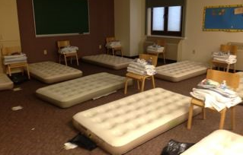
Organizations can provide:
Shelter
NDSU
Notes:
Does your organization have large spaces that could be used to shelter people displaced by the epidemic? Depending on the nature of the epidemic, people may not be able to stay in their homes. Volunteers from other cities may need short- or long-term shelter. Is your organization equipped with showers or near a facility with public showers? Do you have the facilities to feed large numbers of people?

Slide 6
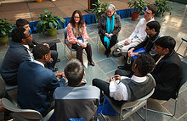
Organizations can provide:
Shelter
A gathering place
Flickr: Edison Academy FCPS
Notes:
Maybe your organization doesn’t have the facilities to provide shelter, but most have gathering spaces. Can you provide space for community meetings, volunteer meetings or perhaps space for temporary office work?

Slide 7
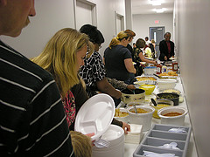
Organizations can provide:
Shelter
A gathering place
Nourishment
Flickr: Judy Baxter
Notes:
Can your organization provide meals or snacks to volunteers? Or prepare meals to be delivered to those who have recovered from the epidemic but still are not able to cook? Keep in mind that many restaurants may be temporarily out of business.

Slide 8

Organizations can provide:
Shelter
A gathering place
Nourishment
Emotional comfort
Flickr: Jlhopgood
Notes:
Does your organization have staff or members who can provide emotional comfort services? Could you provide a network of emotional support for your members?

Slide 9

Organizations can provide:
Shelter
A gathering place
Nourishment
Emotional comfort
Financial resources
NDSU
Notes:
Many people will have missed work during the epidemic. This will create financial hardship for individuals, families and businesses. Does your organization have direct financial resources that can assist members during this time? Are there indirect ways your organization can assist with financial hardship? Providing meals? Transportation vouchers? Job referrals?

Slide 10
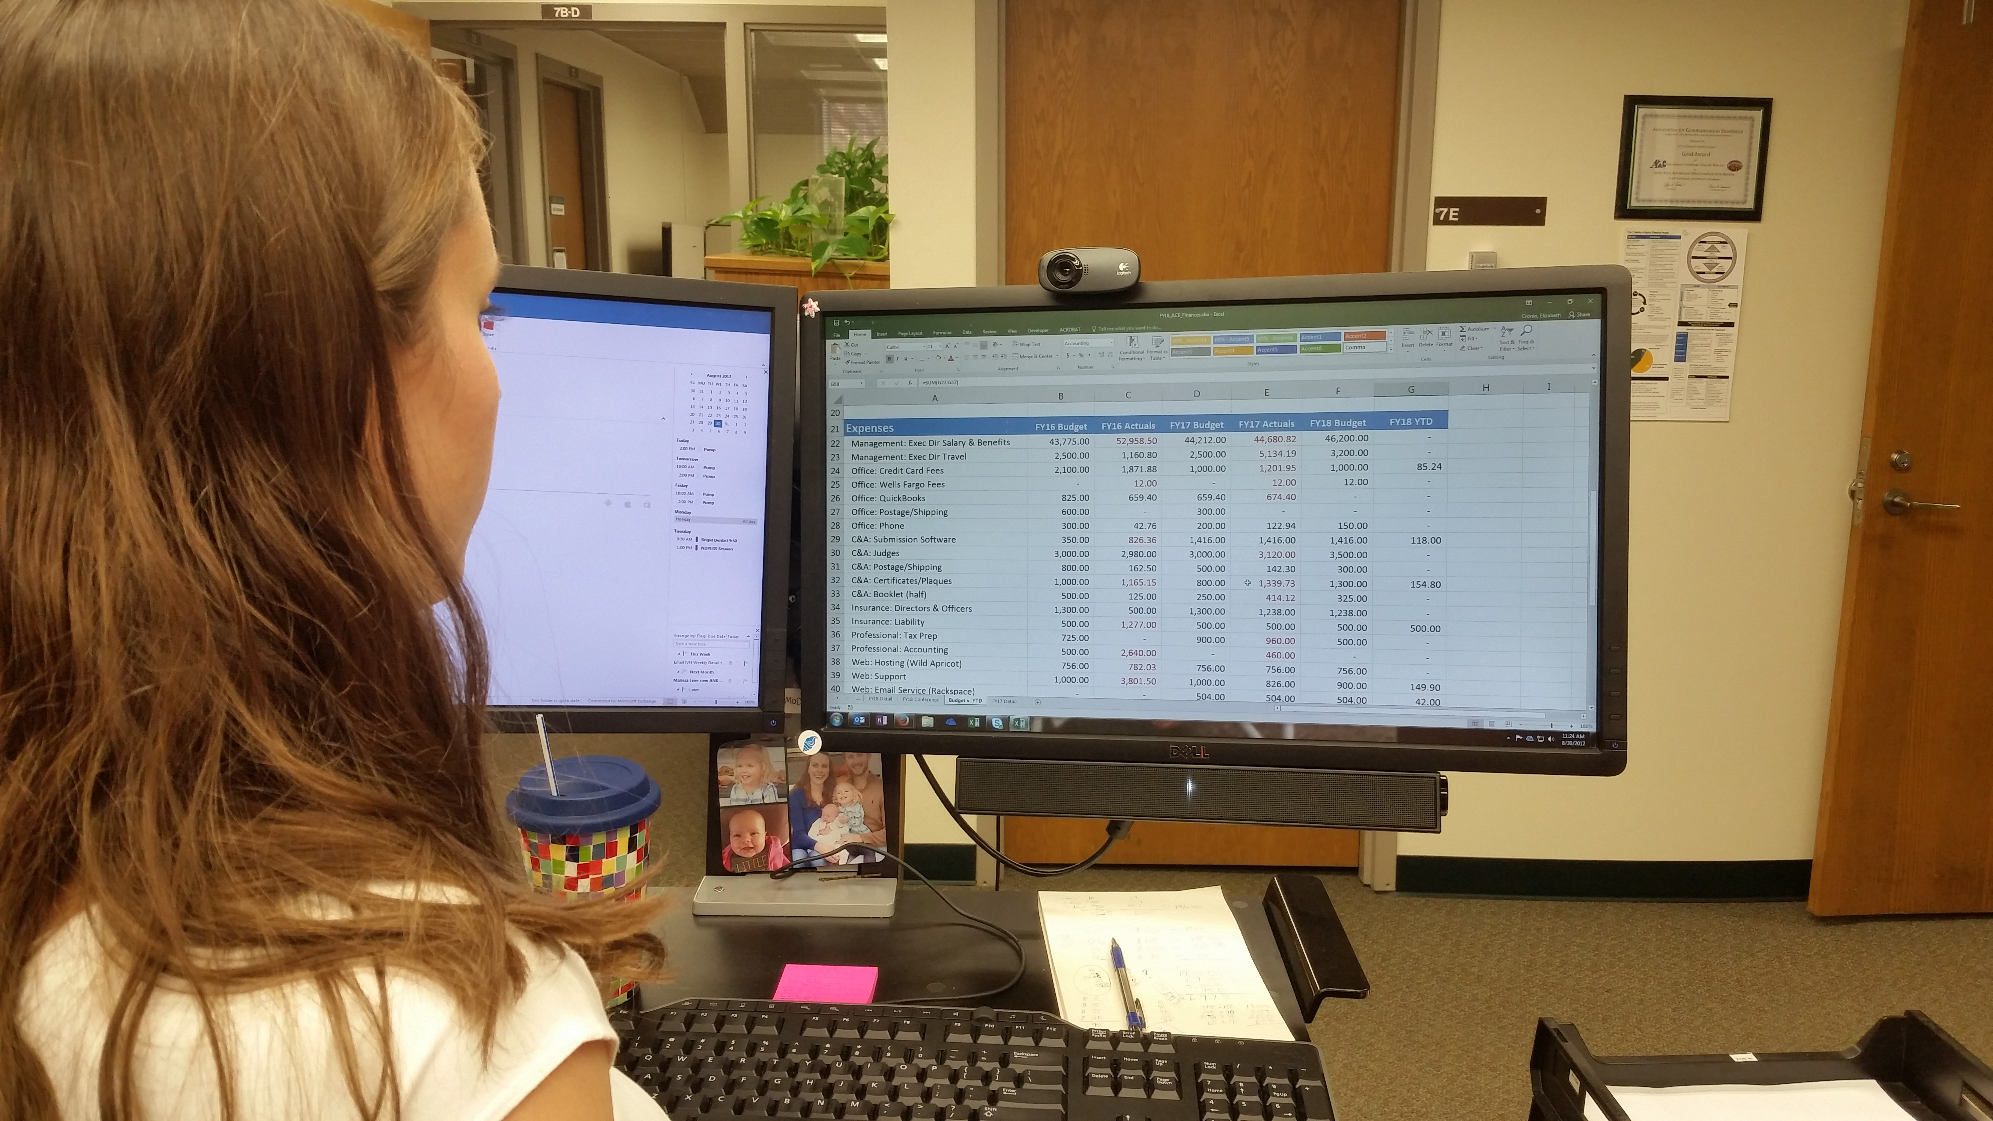
Organizations can provide:
Shelter
A gathering place
Nourishment
Emotional comfort
Financial resources
Human resources
NDSU
Notes:
Depending on the nature of the epidemic, many people may need assistance with day-to-day tasks in their homes and businesses. Can your organization provide child care free or at a reduced rate? Does your organization have a parish nurse program that could provide visitation services? Could you assist small businesses with staffing or accounting services?

Slide 11
Developing a
Community Recovery Plan for your Organization
Notes:
Now that we have identified some of the possible roles for your organization during the recovery from an epidemic, it’s time to develop a plan for your organization to play a vital role in assisting your community in recovery.

Slide 12
Primary Planning Steps
Identify existing conditions
Identify community needs
Brainstorm ideas
Develop a plan
Manage the plan
Notes:
Primary planning steps include:
Identify the existing conditions in your community
Identify potential needs in your community following an epidemic
Brainstorm ideas for meshing community needs with your organization’s resources
Develop a plan for using the most feasible of the ideas
Finally, manage the plan and update it when conditions in your organization or community change

Slide 13
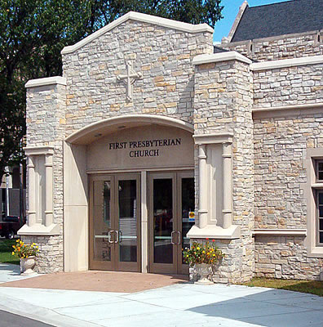
1. Identify Existing Conditions
Location in the community
Physical resources
Human resources among staff
Human resources among members
NDSU
Notes:
Note to Instructor: Refer participants to the Community Recovery Plan template, and spend some time filling in the Logistical Information and Step 1.
The first step is to identify the resources available in your organization. This will include both physical resources and human resources.
Start by taking an inventory of the existing conditions in your organization. What resources do you have to offer? This includes both your physical building and grounds and your human resources. What are your conditions today?
First, examine your location or multiple locations within the community. Are you in the middle of town? Close to a hospital? Along a major highway? What is significant or unique about your location?
Next, study each space in your physical location. Record the square footage and number of seats in each space. Also, record other assets for each space, such as proximity to kitchen facilities and bathrooms. Does the space have easy-to-clean surfaces and/or a drain in the floor?
Next, look at your staff. What skills do they possess? What are their strengths?
Finally, look at your members. What skills do they possess? Do you have an extraordinary number of members in one profession, such as education, medicine or banking?
Note to Instructors: Ask participants to attempt each section. Perhaps they will want to start by examining three primary spaces and just a couple of staff members. The focus here is to get an idea of how to develop this plan with their own organizations.

Slide 14
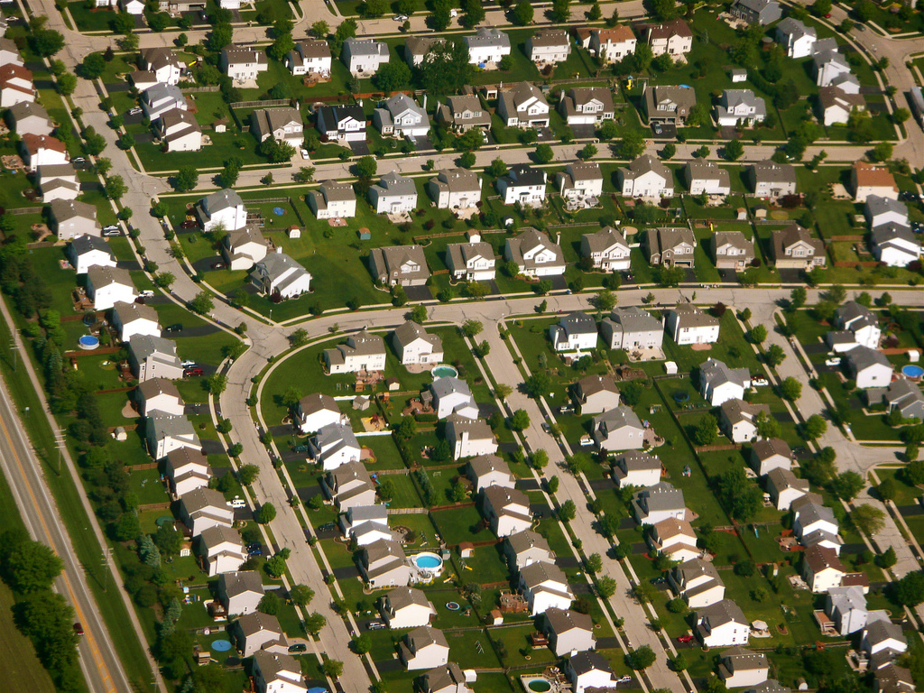
2. Identify Community Needs
Community needs
Agencies related to needs
Agency resources
Flickr: Scorpions and Centaurs
Notes:
Note to Instructor: Refer participants to Step 2 of the Community Recovery Plan template. This section may take a bit of research after the class. Organizations need to become familiar with other agencies in their community that would be involved during and after the epidemic.
The second step is to identify the needs in your community.
First, what challenges will your community possibly face following an epidemic? Will shelter be a major need? Care for the elderly? Business support?
Next, identify key community agencies related to these challenges. Start with your community website. If you are located in a large city, you should identify agency offices closest to your organization as well as two or three slightly more distant. If you are located in a small town or rural area, where are the closest agencies? Identify hospitals, medical clinics and community/public health agencies as well as city government offices and university or college facilities. What other agencies are unique to your area? Refer back to Step 7 in your Preparedness, Response and Recovery Plan for a list of some of these agencies and organizations.
Finally, check the agency websites for epidemic preparedness plans or contact them to determine what those agencies identify as areas of need following an epidemic and their resources.
Note to Instructor: If all the participants are from the same area or community, complete this section as a group. If there are several communities represented, divide the large group into smaller community groups to complete this section. If your space has internet access, you might want to demonstrate how to find agency information websites.

Slide 15
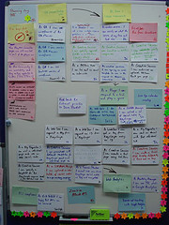
3. Brainstorm
Find a brainstorming method
Every idea is treated equally
How can your organization help your community recover?
Flickr: Jez Nicholson
Notes:
Step 3 involves brainstorming ideas to match your community needs with your organization’s resources.
The idea behind brainstorming is to put as many ideas on the table as possible. Every idea, no matter how strange or unreal, is treated equally. You can use sticky notes on a wall, large sheets of paper or any of a number of computer brainstorming programs.
The question is: How can your organization help your community recover from an epidemic? How do the resources or existing condition of your organization mesh with the potential needs of the community?
Note to Instructor: Provide a method for your participants to do some brainstorming. Sticky notes are an easy method as individuals in a group can write their own ideas as quickly or slowly as they like. Provide at least 10 minutes for brainstorming. If an organization is represented by only one person, group similar organizations together.

Slide 16

4. Develop a Plan
Develop the best of the brainstorming ideas
Identify primary and secondary ideas
Set goals for ideas
Flickr: Garry Wilmore
Notes:
Note to Instructors: Refer participants to Step 4 of the Community Recovery Plan.
Step 4 is where all your previous hard work comes together into a plan.
There are many ways to develop a plan. Each will be unique, just as your epidemic plan is unique to your organization. Developing a plan involves taking those ideas identified during your brainstorming session and developing them into a unique plan for your organization.

Slide 17
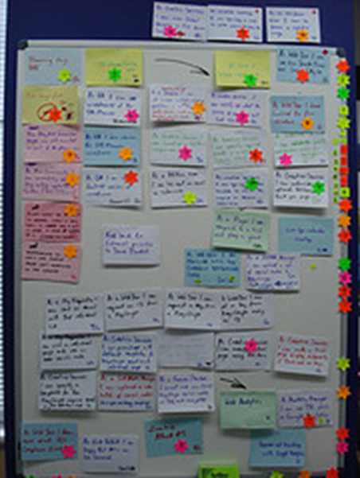
Develop Brainstorming Ideas
Examine and discuss every idea from brainstorming
Identify ideas most feasible for your organization
Arrange ideas into categories
Flickr: Jez Nicholson
Notes:
First, examine every idea from the brainstorming session. Even those ideas that at first seem preposterous may hold a glimmer of a concept that can supplement another idea. Discard ideas you are no longer considering. Discarded ideas may include those that are not financially feasible for your organization, that require more personnel than you have available or that require facilities that are not available.
Identify the most feasible ideas for your organization. For example, if your organization has an unusual number of medical professionals, you may want to concentrate on how you can help the community recover medically. If your organization has major donors, you may want to concentrate on helping your neighborhood recover financially.
Arrange your ideas into categories. For example, if you have several ideas that involve medical professionals, put them together. If you have several ideas that involve using your facilities for food and shelter, put those together.

Slide 18
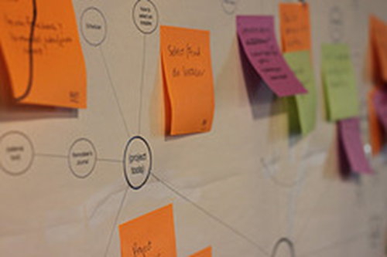
Identify Primary and Secondary Ideas
What is your most plausible idea?
What other ideas would also work?
Can any of the ideas work simultaneously?
Flickr: INPIVIC Family
Notes:
Since an epidemic holds many unknowns, you will want to develop several ideas.
First, identify the idea that is most plausible for your organization. It might be the one that best matches your staff and members or your facility or your financial limitations. Maybe you have a large kitchen area and your organization would be best suited for providing meals. Maybe you have an established strong parish nurse program so can provide follow-up medical monitoring. What is your organization best suited to provide your community during the epidemic recovery period?
If the situation doesn’t fit with your primary idea, you should identify a second primary idea, a secondary idea or even several secondary ideas.
Finally, can any of these ideas work simultaneously? Do they use different parts of your facility or different members of your organization? Perhaps one could potentially be a heavy financial burden, but another has little or no cost. You can identify a list of ideas and then match them to potential situations.

Slide 19

Set Goals for Ideas
Who will you help?
How will you help?
Who will be in charge?
What will you accomplish?
What resources will be used?
When will you be finished?
Flickr: Angie Torres
Notes:
Each idea now needs a plan. For each idea, identify who you will help and how you will do it, who will be in charge, what you hope to accomplish, what resources will be used and when you will know you are finished with your part of the recovery.

Slide 20
5. Manage the Plan
Being unprepared means your organization may not survive an epidemic.
Being prepared means your organization could thrive and remain an important part of your community.
Notes:
A plan isn’t effective if it is on a shelf, old and out of date. Share information about your plan with staff, members and people in the communities you serve. Make sure you update your plan at least yearly. Although an epidemic can occur at any time, the winter season is the most likely, so make it a policy to update your plan in the late summer or early fall. Look at both the changes that have occurred in your organization and the changes that might have occurred in your community.
Your organization’s Epidemic Preparedness, Response and Recovery Plan is only as good as you make it. By taking part in this program, you’ve done everything you can to help your community organization thrive and remain an important part of your community during and after an epidemic. Good luck as you complete your plan and keep it up to date.

