Slide 1
Epidemic Preparedness for Community Organizations
Notes:
Note to Instructor: If this is a stand-alone training, add your name and title, as well as the date and location of the presentation, to this slide. Introduce yourself, your Extension affiliation (if applicable) and the Extension Disaster Education Network (EDEN). Welcome participants, and lead introductions.
Background: The Extension Disaster Education Network (EDEN) is an affiliation of state and territory Extension programs at 1862 and 1890 land-grant universities and Sea Grant programs. The network allows representatives from the institutions to share and collaboratively develop resources to carry out its mission, which is to reduce the impact of disasters through research-based education. These resources include websites, publications, videos, curricula, templates and much more.

Slide 2
Building Hope:
Understanding the Potential Impact of an Epidemic and Creating a Plan
Notes:
In the first section of Epidemic Preparedness for Community Organizations, you learned skills to help reduce epidemic-related illness and death. In this section, you will develop a preparedness plan based on the potential impacts of an epidemic on your group. The third section will help you develop a strategy for assisting the community during and after an epidemic.

Slide 3
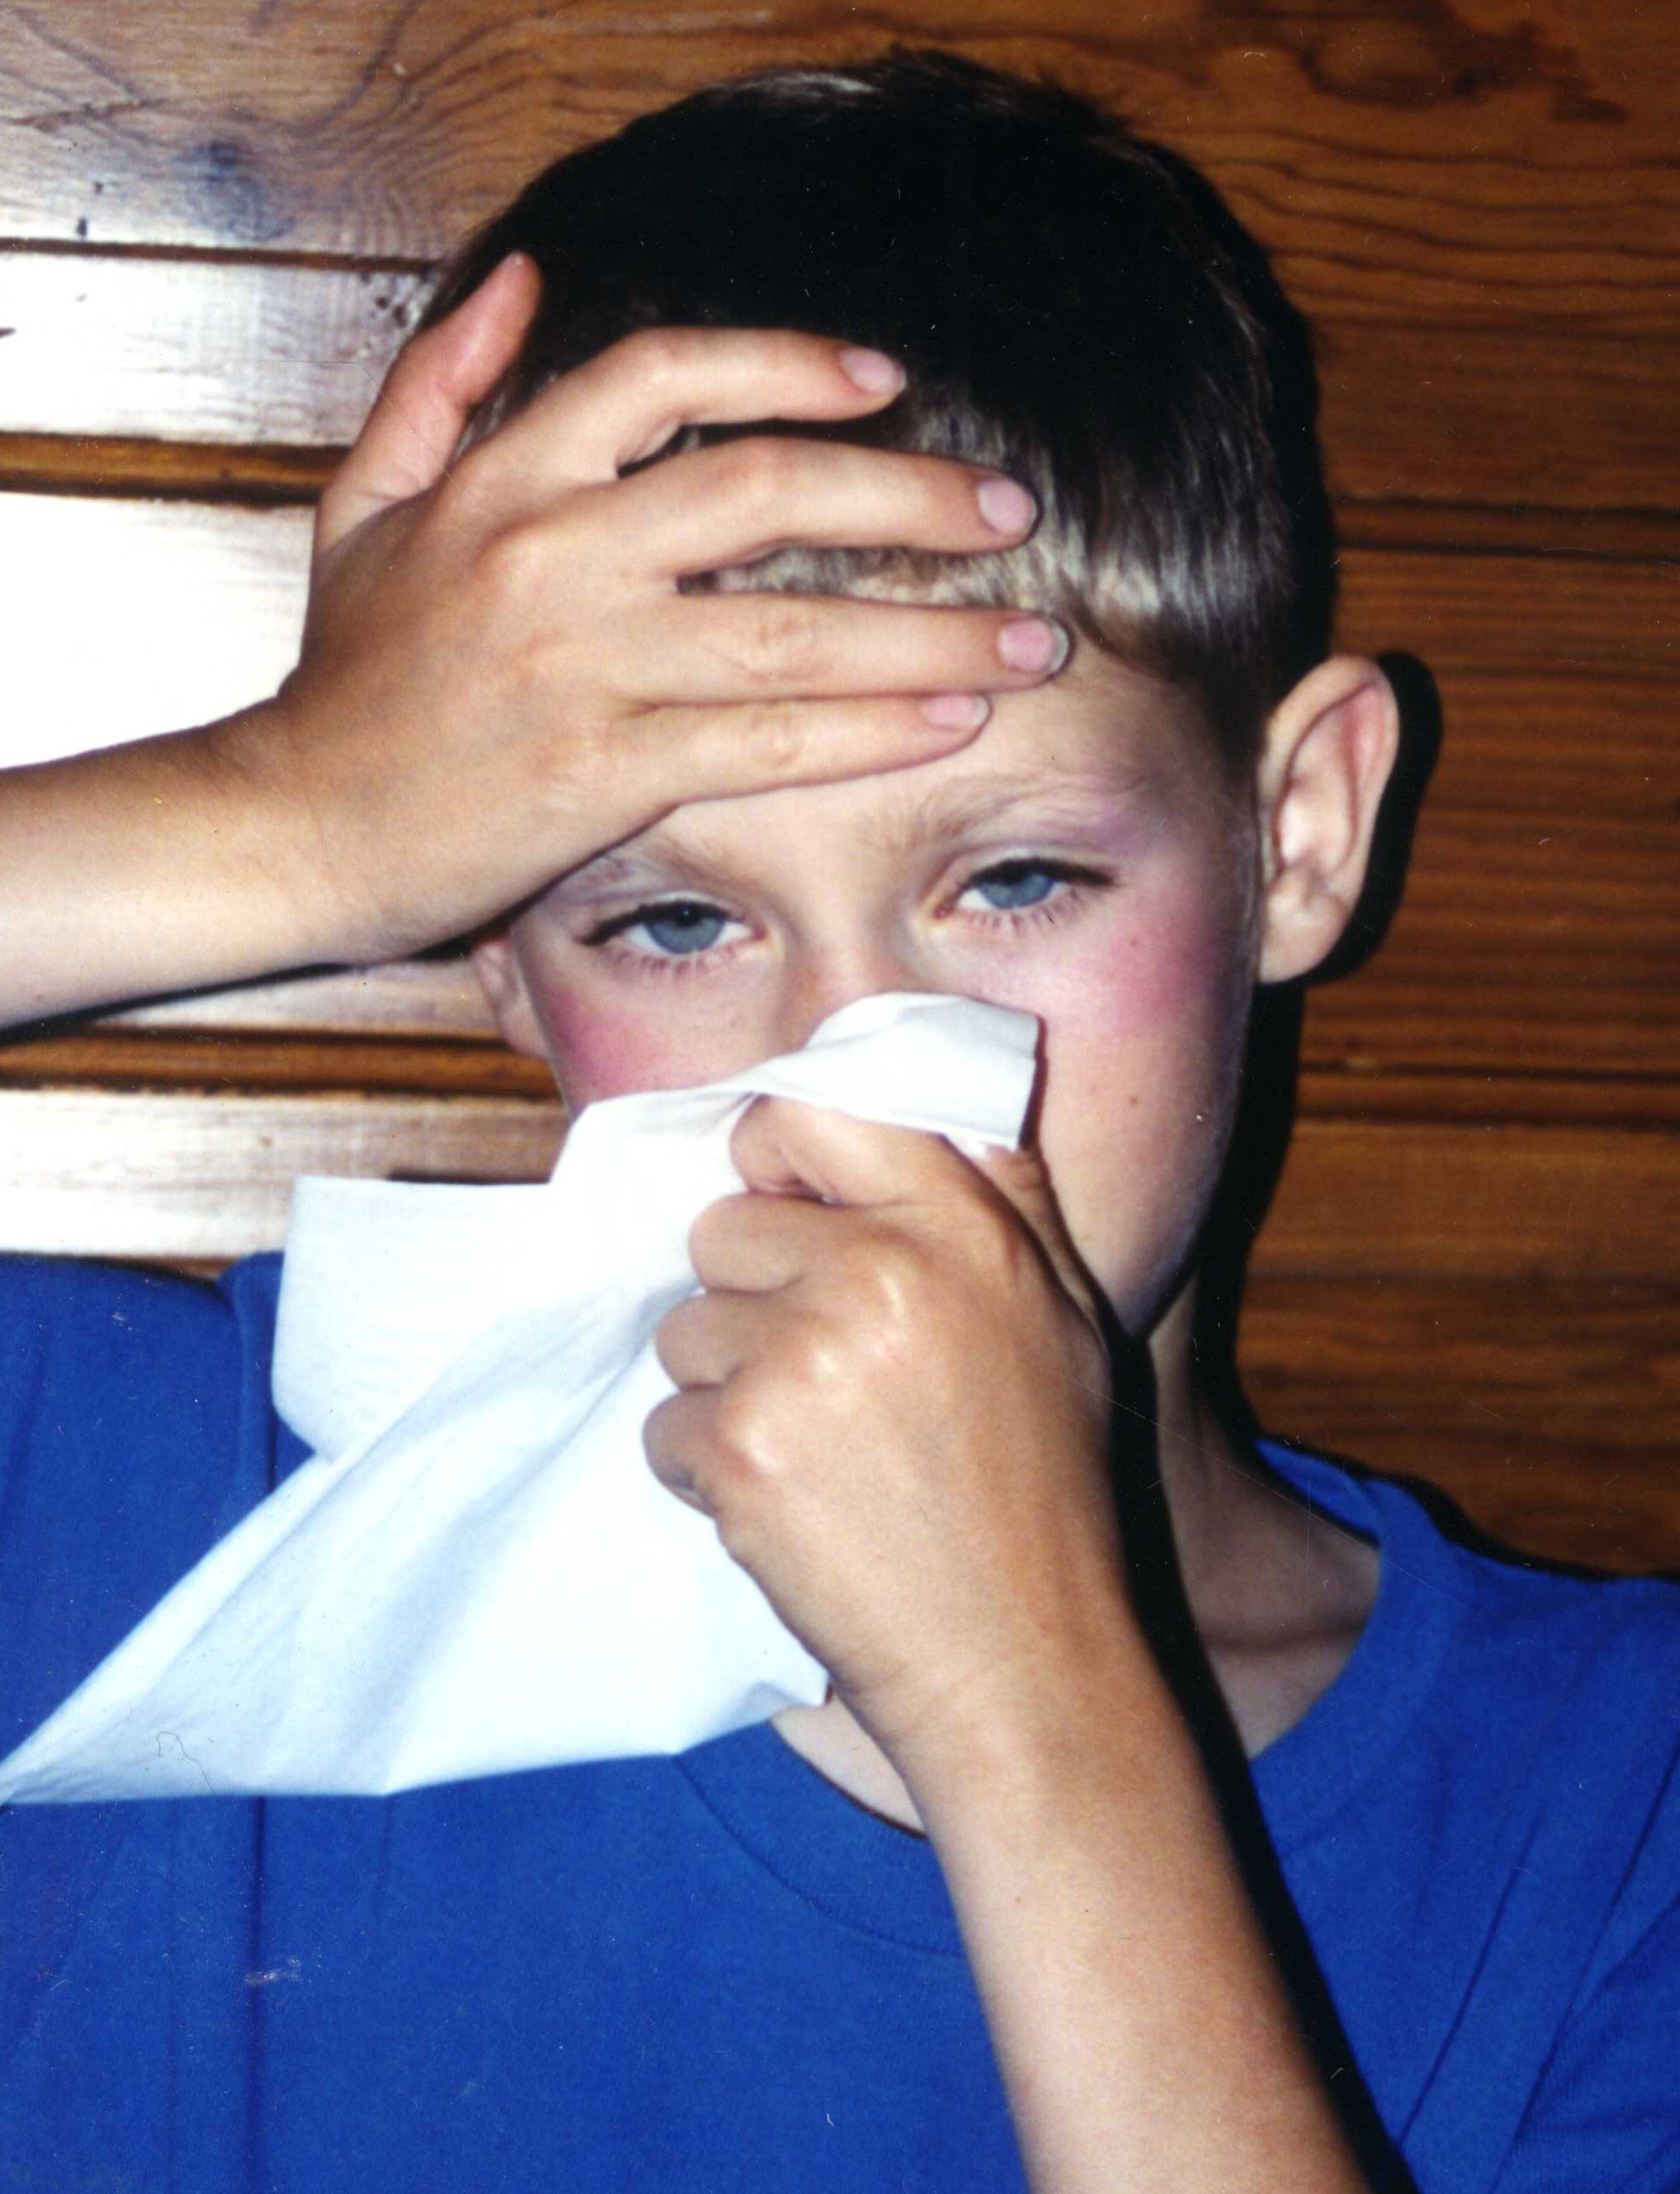
Identify & Address
List epidemic impacts
Develop a basic epidemic preparedness and response plan
NDSU
Notes:
After this session, you will be able to:
• List potential epidemic impacts on your organization and in communities that you serve
• Develop a basic epidemic preparedness and response plan to address those potential impacts

Slide 4
Potential Impacts
High levels of illness and death lead to:
Social disruption
Economic loss
Everyday life is disrupted
Notes:
With high levels of illness and death, an epidemic brings temporary social disruption and economic loss. For instance, delivery of materials and resources normally sent to your community could be halted due to a lack of labor in the transportation industry. Everyday life in your community could be disrupted because so many people in so many places become seriously ill at the same time.

Slide 5
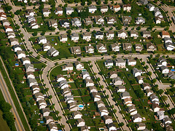
General Impacts
Issues in every state and community
Flickr: Scorpions and Centaurs
Notes:
Every community will have challenges and struggles as they face the epidemic among the families that live and work there. If epidemic influenza swept across the U.S., communities would be faced with a smaller workforce, increased need for healthcare and other disruptions to daily life. These types of issues and challenges would be the same or similar, no matter the location. Let’s look at some.

Slide 6
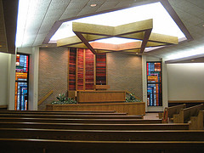
General Impacts from Disruption and Loss
Public gatherings halted
Services lost
Businesses hurt
Flickr: MTSOfan
Notes:
The community's social framework might be disrupted, halting public gatherings in schools, businesses and houses of worship. In addition, services, such as public transportation and food deliveries, may be halted.
If staff are sick and can’t work, businesses may suffer economic losses.
All segments of local community life would be impacted, including your community organization.

Slide 7

Epidemics
Geographically isolated
Increased presence
Increased severity
Change in movement and susceptibility
iStock
Notes:
Let’s revisit the definition of an epidemic. It’s:
Geographically isolated
Increased presence
Increased severity
Changes in movement and susceptibility
A pandemic, such as COVID-19, happens when a new virus emerges so people have little to no pre-existing immunity so it spreads worldwide.
Reference: https://www.cdc.gov/ophss/csels/dsepd/ss1978/lesson1/section11.html

Slide 8

Vulnerable Populations
Young children
Older adults
People with certain health conditions
iStock
Notes:
In an epidemic, many people will be affected, though some groups will be more likely to get sick. The most vulnerable populations often are young children, older adults and people with certain health conditions.
Among working adults, an average of 20% could become ill during a community influenza outbreak.
Reference: Meltzer, M., Cox, N., Fukuda, K. (1999). “The Economic Impact of Pandemic Influenza in the United States: Priorities for Intervention.” Emerging Infectious Diseases. Volume 5, No. 5, September - October. http://www.ncbi.nlm.nih.gov/pmc/articles/PMC2627723/pdf/10511522.pdf

Slide 9
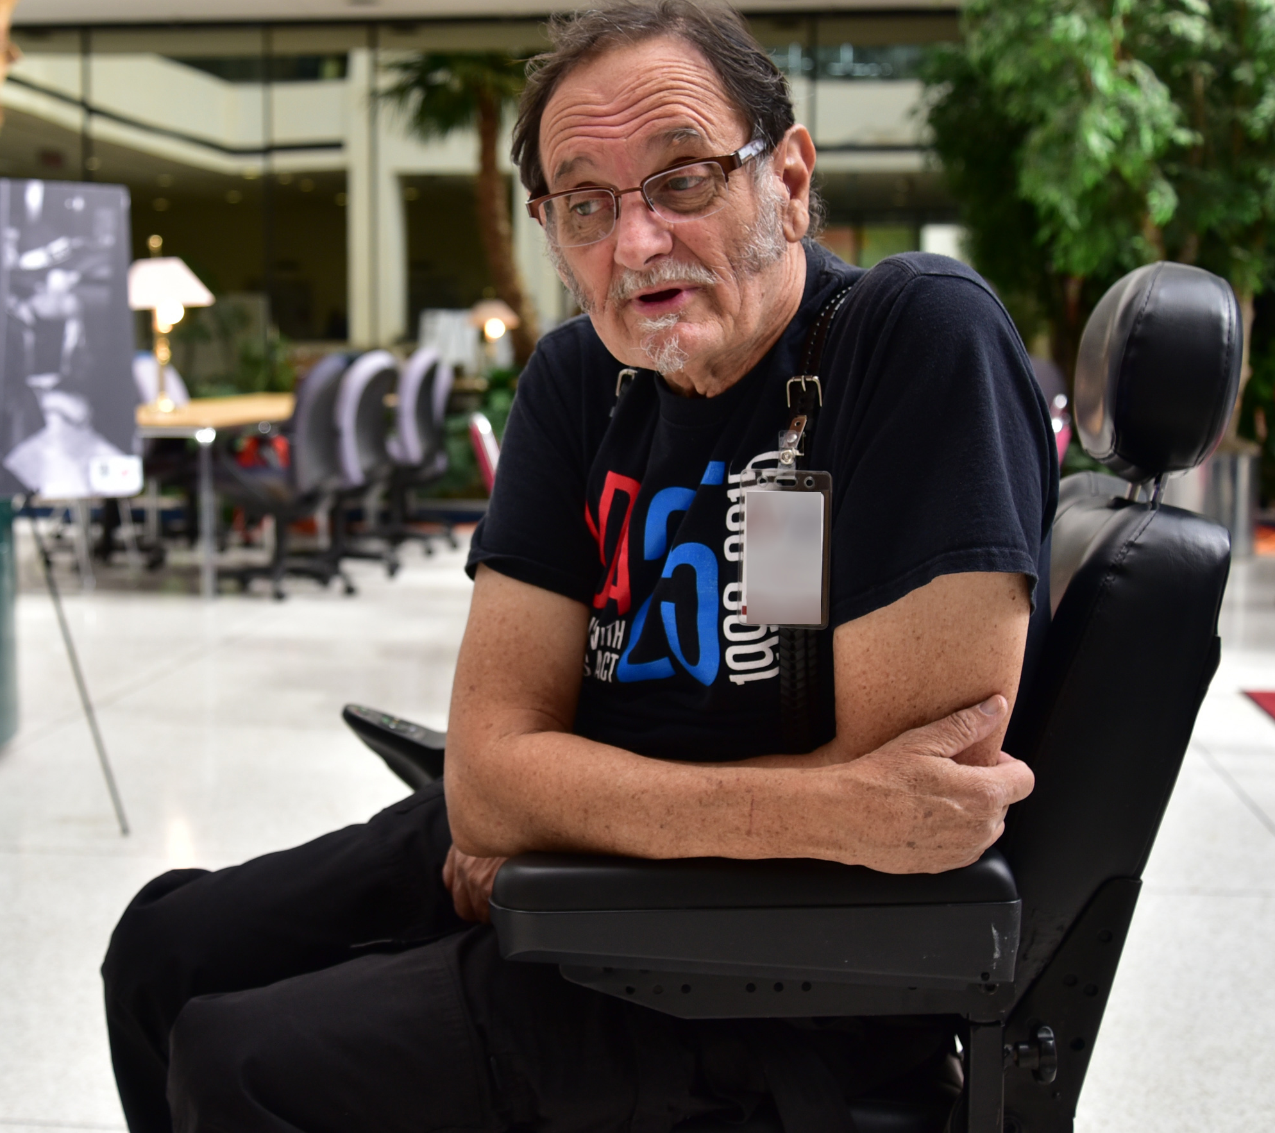
Consider the Impact
What are the demographics of your organization?
What if 20% of staff/volunteers became ill?
What if 40% of their dependents became ill?
FEMA: Bill Koplitz
Notes:
Note to Instructor: Hand out and refer participants to Handout 2.1. Give them time to brainstorm some answers specific to their organizations. Inform them that their answers to these questions will give them a starting point later when developing their specific plans. Discuss answers as a class.

Slide 10
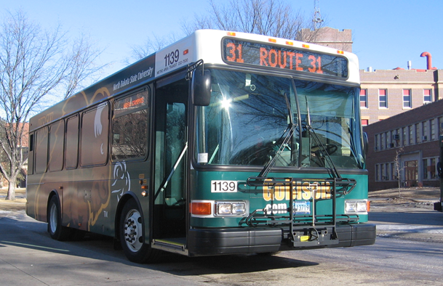
Potential Impacts
30% or more could become sick
Public gatherings halted
Public transportation reduced
Food delivery limited
NDSU
Notes:
Note to Instructor: Pass out Handout 2.2. Give participants time to brainstorm some answers specific to their communities and organizations in addition to these listed. Inform them that their answers to these questions will give them a starting point later when developing their specific plans. Discuss answers as a class.

Slide 11

Community/Organization Impacts
Unique impacts on community
Unique impacts on organization
Areas of vulnerability
FEMA: Patsy Lynch
Notes:
As you begin the planning process, acknowledge not only the general potential impacts we just discussed, but also some potential impacts that are unique to your community and organization. These will help you realize your vulnerabilities and develop your plan.

Slide 12
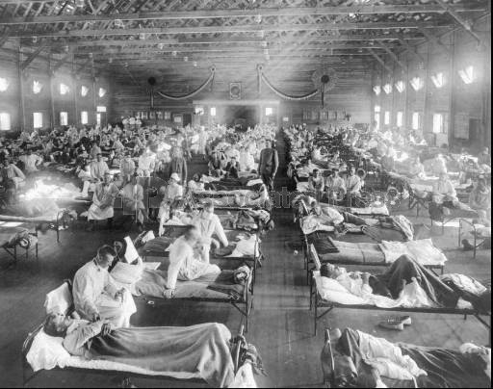
High rate of infection leads to:
Hospitalizations and deaths
Impact on high-risk groups
Infants
Elderly
Pregnant women
Homeless
Poor
People with chronic medical conditions
National Museum of Health and Medicine, Armed Forces Institute of Pathology
Notes:
The number of hospitalizations and deaths will depend on the severity of the epidemic. If infection rate is high, hospitals could be pushed to maximum capacity. High-risk groups will be largely impacted. If your community-based organization normally provides services to these groups, keep in mind that families with infants, the elderly and pregnant women may require increased assistance. Also, the homeless, low-income populations and people with chronic medical conditions may need more help.
There are exceptions to the rule, though. As we learned in Section 1, a high-risk group during the 1918 flu was adults age 20-50.

Slide 13
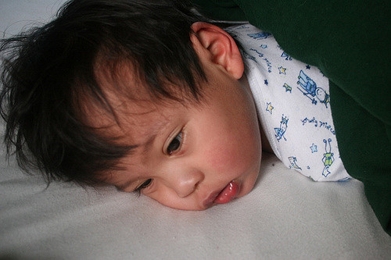
What If
Your Community:
Total population x 30%
Your Organization:
Total number of adults x 20%
Total number of children x 40%
Flickr: Fred Jala
Notes:
Under General Impacts, we discussed that there is the potential for 30% of the population to get sick during an epidemic or pandemic (or potentially 20% of adults and 40% of children). Nationally, that is a lot of people. Out of a U.S. population of 323 million, 97 million people could get sick.
Let’s talk about that at a community level. If you have a total population of 45,000, take 45,000 x 0.30. That equals 13,500 people getting sick.
Instructors: Develop examples using these figures to reflect the community.
In your own organization, what if you serve 250 adults? That would be 250 x 0.20, which equals 50 adults sick. Those 250 adults have 200 associated children. That would be 200 x 0.40, which equals 80 children sick.

Slide 14
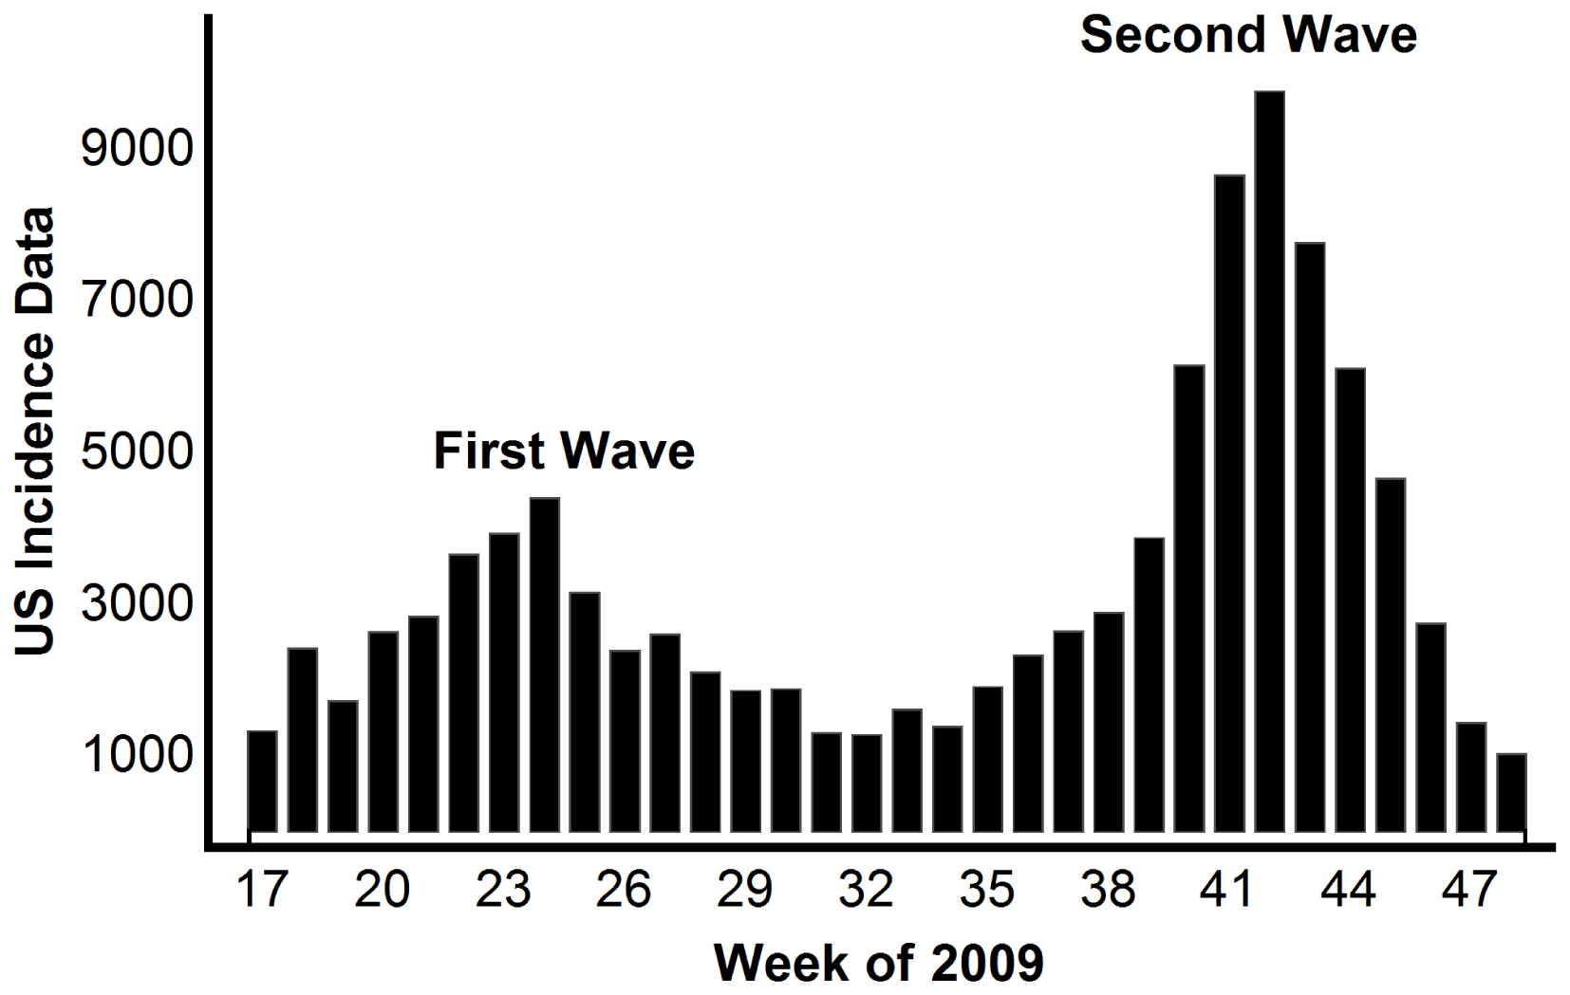

Waves of a Pandemic
Each could last 6-8 weeks
Occur any time of year
Take place multiple times throughout a year or more
CDC
Notes:
An epidemic may not be just a one-time occurrence. A community probably will experience waves of the illness over the course of a year or more with each wave lasting six to eight weeks. Like any other place of business or service, your organization could potentially experience weeks of severe employee and volunteer shortages or even a public health mandate to close your doors to public gatherings for a time.

Slide 15
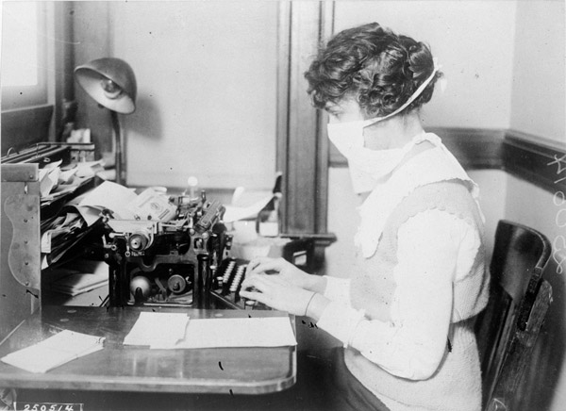
Your Organization
40% absenteeism during peak weeks
Sick employees
Sick family members
Fear of illness
National Archives at College Park, MD Record #: 165 WW-269B-16
Notes:
In an epidemic, absenteeism will be caused by illness, the need to care for ill family members or fear of infection, all of which may reach 40% during the peak weeks of a community outbreak. Lower rates of absenteeism will happen during the weeks before and after the peak.
How many people do you have on staff? Your number of employees x 40% = number absent. For example, 20 staff members would be reduced to 12.
In addition, certain public health measures (such as closing schools, quarantining household contacts of infected individuals and other social distancing measures) are likely to increase rates of absenteeism.

Slide 16
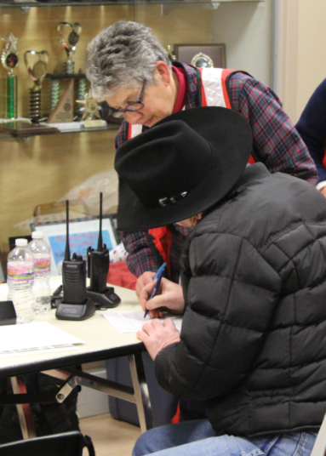
Your Organization in an Epidemic
Many members affected
Counseling and support needed
Standard services halted
Dakotas Region Red Cross
Notes:
In an epidemic, many members of your community organization will become sick, and some may die.
Community organizations may face a unique situation since they are a source of counseling and support during nonemergency times. The demand for counseling and support is likely to increase significantly at a time when your organization’s capacity to provide such support is stretched because of the high absentee rate among staff and volunteers. Also, social distancing practices may be enforced to minimize spreading the disease. For example, standard services, such as meetings, trainings, worship, child and elder care services, funerals and weddings, may be halted to minimize spread.
Questions to consider:
How and how often do you check in with staff and volunteers? How does that affect scheduling and the level of services provided? How do you deal with changes in pickups and deliveries of goods?
• Belief systems will be tested at this time. How do you intend to address this issue during a time when people feel hopeless or frustrated, and are mourning the loss of loved ones? Try to address beliefs and values before a potential event becomes a disaster.

Slide 17

Cost to Minimize Spread
Disrupt normal functions/activities
Transform or suspend services, classes, activities
Flickr: Tony Hammond
Notes:
Normal functions and activities will be disrupted to minimize spreading the disease. The impact could be significant if social distancing policies are enacted within your community. Worship services, classes and other activities may need to be transformed or even curtailed for an extended time.
More questions you should consider:
• How do you plan to continue delivering your information?
• What are you capable of providing to those who are homebound?
• How can you maintain the support structure of your organization and the people you serve if individuals cannot physically come together?

Slide 18

Potential Economic Consequences
Budget reductions
Loss of productivity
Increased costs
Flickr: Dustin Moore
Notes:
Community-based organizations are likely to encounter economic consequences during an influenza or similar outbreak including:
• Budget reductions due to reduced donations.
• Loss of productivity from staff and volunteers.
• Increased costs to maintain functions, including printing and mailing for enhanced communications with members and expenses for alternative information delivery systems.

Slide 19
Community/Organization Impacts Review
30% ill
40% absent
6- to 8-week waves
More hospitalized
High-risk groups impacted
Additional counseling & support needed
Activities disrupted
Budgets restricted
Costs increased
Productivity lost
Notes:
Look again at Handout 2.2. In the right column, you’ll see a list of potential impacts designated as Community/Organization. Many members of your organization could be affected. Potential impacts can include:
• About 30% of the total population, including 20% of adults and 40% of children, may become ill.
• Absenteeism could reach 40% – not only from those who are sick, but also those taking care of sick family members and those fearful of the illness.
• The illnesses tend to peak in 6- to 8-week waves and could come at multiple times throughout a year or more.
More people will be hospitalized. Depending on the rate of infections, hospitals could be pushed to maximum capacity, and death rates could rise.
• High-risk groups will be impacted. This could require more assistance from your organization if you’re capable of doing so.
• Additional counseling and support services may be needed, also potentially reaching or pushing beyond your group’s capacity to serve.
• Normal activities may be disrupted from the attempt to minimize spread of the disease.
• Budgets may be restricted due to reduced capacity of flu-impacted members to donations.
• Costs may increase due to enhanced communications and other alternatives.
• Staff and volunteer productivity may be reduced.
Can you think of any others that could be included on this list? If so, write them down in the spaces in the right column.
Note to Instructor: Take a few minutes to review and discuss the additional items participants added to their lists.

Slide 20
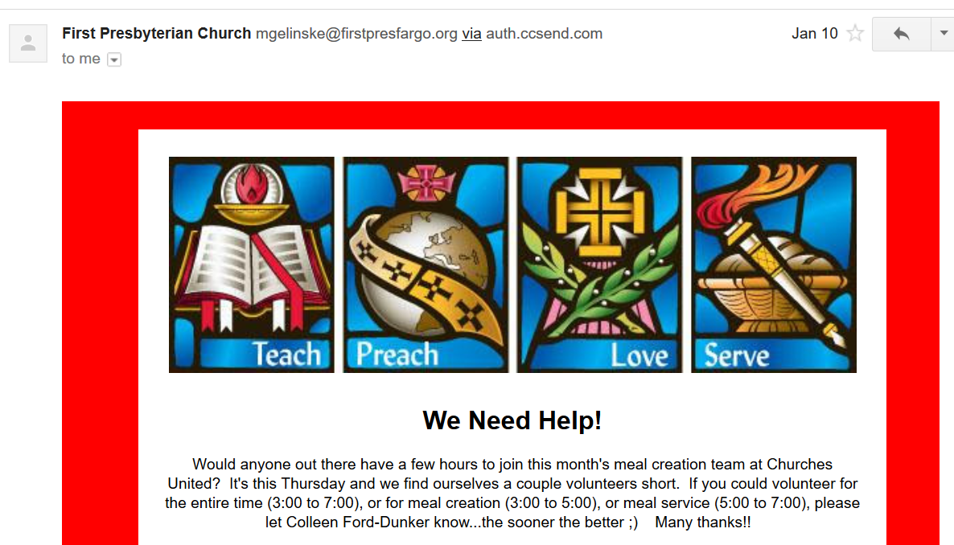
May need to expand:
Electronic/communications capabilities
Health activities
Outreach efforts
NDSU
Notes:
As you begin developing your plan, think about specific demands on your organization before or during an epidemic. These include but are not limited to:
• Expanded electronic and other communications capabilities to transform services and maintain contact with members. This might include websites; blogs; emails; podcasts; local newspaper, radio and television advertisements; and prerecorded widely distributed phone messages.
• Expanded health activities to extend timely and factual information on the epidemic to staff, members and people in the community. This includes plans to distribute materials with basic information about the epidemic, such as signs and symptoms, how it is spread, ways to protect yourself and your family, family preparedness plans and how to care for ill people at home. You also may want to identify healthcare professionals who are members of your group or community who could speak to your organization.
• Expanded outreach efforts to assist people with special needs, such as elderly, disabled and limited English speakers.

Slide 21
Developing an Epidemic Preparedness, Response and Recovery Plan for Your Community Organization
Notes:
Note to Instructor: There is a natural break between the last segment and this one. This would be a good place to ask for questions, take a break or divide this section into two sessions, especially if your time for each session is short.
We’ve discussed the possible impacts an epidemic might have on your organization. We now will walk through the parts of a plan for how to manage an outbreak and give you a chance to write various parts that will provide solid groundwork and direction for your planning team.
Our discussion will refer to the epidemic template and should be used however it best suits your organization. The purpose of this template is to organize a series of actions that your organization should take to prepare for an epidemic in your community.
Note to Instructor: Refer each participant to their copy of the Epidemic Preparedness, Response and Recovery Plan template on paper or on a computer, and ask that they follow along in the discussion and begin completing various sections.

Slide 22
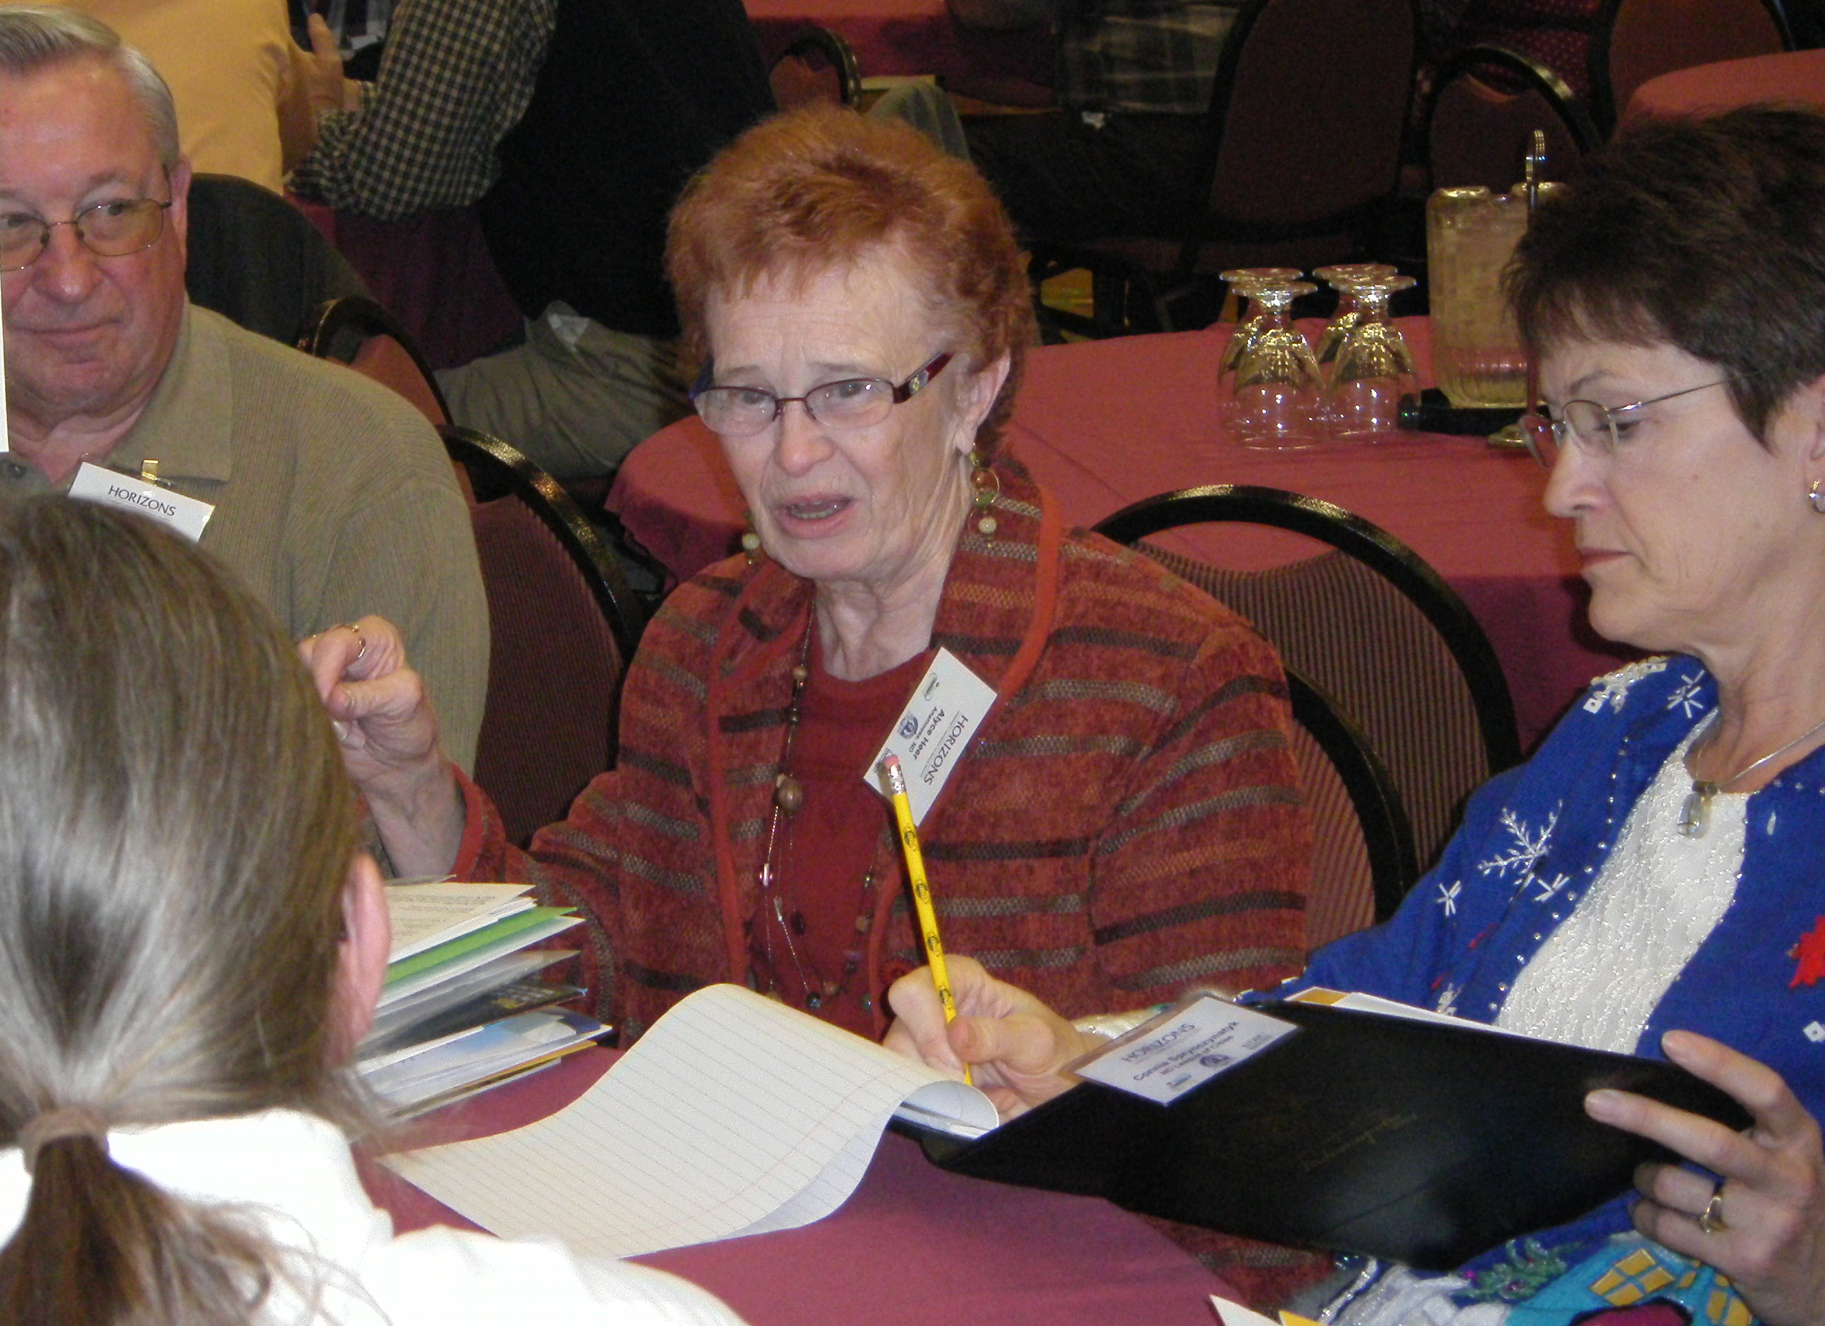
1. Establish a Planning Committee
Develop
Implement
Maintain
Revise
NDSU
Notes:
Note to Instructor: Refer participants to Step 1 of the Epidemic Preparedness, Response and Recovery Plan template.
The first step to developing your organization’s Epidemic Preparedness, Response and Recovery Plan is to establish a planning committee. The task of this planning committee is to develop, implement, maintain, and regularly review and revise your organization’s plan.

Slide 23
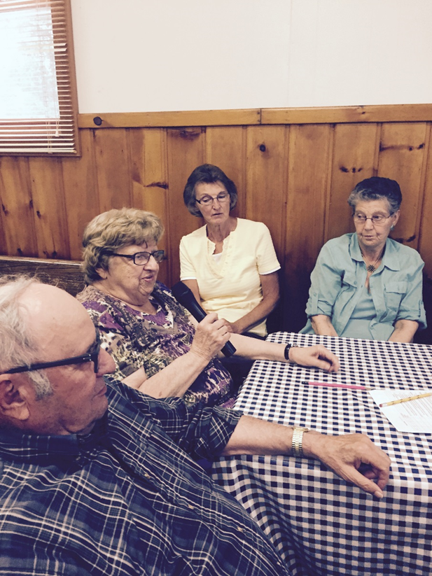
Committee Structure
Chair
Vice chair
Other members
NDSU
Notes:
Your organization’s committee should be made up of:
• A chair – who leads the planning committee. This individual could be a staff member, long-term volunteer or another individual who has an interest or expertise in this area.
• A vice chair – who provides leadership if the primary person is unable to serve in an epidemic event.
• Other planning committee members – who could be various administrative leaders, and members or volunteers from your organization with an interest or expertise in this area. The number of other committee members depends on your organization size and demands.

Slide 24
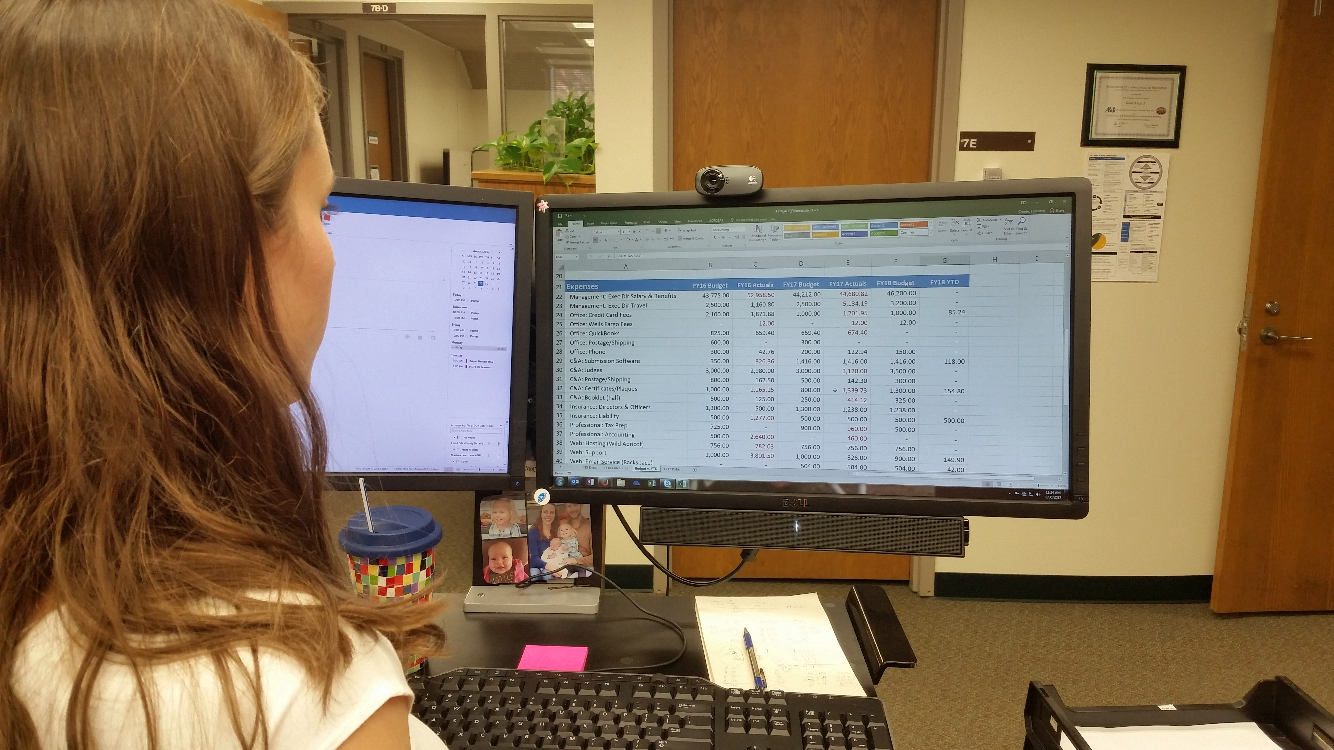
Committee Membership
Finances
Communications & technology
Volunteer base
Services
Local resources
NDSU
Notes:
To create the planning committee, develop a team based on individuals’ knowledge and competency in:
• Your organization’s finances
Your organization’s communications and technology resources
• Your organization’s volunteer base and its potential capabilities
• Your organization’s variety of services
• Local resources that could be relied upon, partnered with or helped during an epidemic. These might include emergency management, Red Cross, public health, other state and county organizations, and businesses.

Slide 25
Organize the Committee
Record & share contact info
Establish meeting schedule
Notes:
To build the planning committee:
• Record contact information for all committee members, including home, office and cell phone numbers; email addresses; and social media contact information. Share the list with all committee members.
Establish a meeting schedule, including times, locations and more details.

Slide 26
2. List Primary & Critical Functions
Primary
Critical
Worship Services
Youth Education
Counseling
Weddings
Funerals
Counseling
Notes:
Note to Instructor: Refer participants to Step 2 of the Epidemic Preparedness, Response and Recovery Plan template.
Based on what we discussed in the first half of this section, your goal is to consider the potential impact of an epidemic on your organization’s activities and services, so those functions should be defined.
First, list the primary functions performed by your organization that would be impacted if an epidemic occurred in your community. It may even be helpful to start out with a list of all functions your organization administers on a daily or weekly basis. From that general list, begin to weed it down into the primary functions, and then down into the critical functions.
Let’s use a faith-based organization as an example. Primary functions might include worship services, youth education, funerals, weddings and member counseling.
Once these functions have been listed, identify which ones are considered critical functions. Critical functions are those that must continue to be carried out, even in an epidemic. For a faith-based organization, this may include, for example, only counseling services – and even that may need to be done differently.
Note to Instructor: Brainstorm primary functions as a group, then give participants time to fill in the template with functions specific to their organization. Instruct them to star the functions that are critical. Together discuss the critical functions of the different groups. The discussion will help groups think of functions that are either primary or critical to their own organization.

Slide 27
3. Develop Contingency Plans
Name and description
List of people
Likely impacts
Needs and opportunities to cross-train
Alternative approaches
Notes:
Note to Instructor: Refer participants to Step 3 of the Epidemic Preparedness, Response and Recovery Plan template. Have each group choose one critical function (perhaps a small, uncomplicated one) and give them time to fill out a blank form for that function. Answer questions as they encounter problems. When the whole group gets back together, ask for comments and questions. What did they find easy to complete in this process, and what did they find difficult? What hurdles do they see in completing this process for all the critical functions of their organization?
The third step is to develop contingency plans for the critical functions you’ve identified. Depending on the number of critical functions, this could be a lengthy process. Approach the task systematically – one function at a time.
Using the template, include the following information for each critical function:
• Record the name and description of the critical function
• List people and backups who do this task and their contact information
• Describe how this critical function might be affected by local emergency recommendations. For example, how would collecting blood donations be affected when social distancing is recommended?
• Identify needs and opportunities to cross-train staff and volunteers to perform this critical function if neither the primary person nor his/her backup is able to serve.
• Analyze alternative ways to carry out this function during the epidemic. How could you alter normal practices to help reduce transmission of the sickness or comply with local emergency recommendations?
Note to Instructor: Remind participants to duplicate the blank form for each critical function they listed.

Slide 28
Additional Steps for Epidemic Preparedness
Develop a public information plan
Develop a crisis communication plan
Identify special needs
Coordinate with others
Share your plan
Notes:
The last five steps in developing your Epidemic Preparedness, Response and Recovery Plan involve communication in some way. A plan is not effective if no one knows about it or no one knows how to implement the plan in an emergency.
In this last segment, we will discuss:
Planning how to distribute timely and factual information
Planning how to communicate during the epidemic crisis
Identifying those in your organization with special needs who may need additional help or a different means of communication
Coordinating with other community-based organizations or others during an epidemic
Sharing the plan with your members

Slide 29
4. Distribute Information
Staff
Organizational members
People in the communities
Notes:
Note to Instructor: Refer participants to Step 4 of the Epidemic Preparedness, Response and Recovery Plan template.
Delegate the responsibility to develop a public information and distribution plan to an appropriate person or people. This person or people will provide timely and factual information to your staff, organizational members and people in your community (as appropriate).
This includes information from state and local health departments about signs and symptoms, how the disease is spread, how to protect yourself and more. Be sure to determine how the information will be delivered, such as through classes, social media posts, sermons or announcements.
Keep in mind that a plan to disseminate information should not necessarily be enacted at the time of an epidemic. Instead, begin sharing the message before an event ever takes place. For instance, place handwashing posters in your bathrooms before flu season every year.
Determine how your organization handles rumors, misinformation, fear and anxiety, and consider the various cultures that may exist within your organization and community. This, of course, can take place before or during an epidemic.
Discussion: More than likely, you have had to deal with rumors or misinformation in the past. Can you share what you found worked or what didn’t work in dealing with these miscommunications?

Slide 30
5. Develop Crisis Communication Plan
Identify key contacts
Develop chain of communications, including with supplier & customers
Track and communicate organization and employee status
Notes:
Note to Instructor: Refer students to Step 5 of the Epidemic Preparedness, Response and Recovery Plan template.
Next, establish a crisis communications plan and revise it periodically. This plan includes identification of key contacts (with backups) who are inside, and possibly outside, your organization; a chain of communications, including commonly used suppliers and customers who provide or use essential resources; and processes for tracking and communicating business and employee status.
Depending on your organization, Step 5 could become quite detailed – almost becoming a plan within a plan. The level of detail will be determined by your needs and priorities, the size of your organization and your role in the community.

Slide 31
Record Contact Information
Record contact info
Develop contact list for external contacts
Notes:
In the crisis communications plan:
• Record contact information for people in your organization. Record all types of contact information, including home and cell phone numbers and personal email addresses. During an epidemic, some forms of communication may be delayed. People may need to work from an off-site location.
• Develop contact information for key external contacts, including public health officials, emergency management agencies, Extension Service, key government agencies and others. They may be helpful in providing educational materials and emergency planning advice, or sharing tasks and duties when it comes to serving community members before, during or after an epidemic event.

Slide 32
Maintain Communication with:
Employees / Volunteers
Organization leaders
Organization members
Public
Government
Vendors
Notes:
A crisis communications plan will provide the ability to maintain continuous communication during an epidemic with:
Employees and Volunteers: Be prepared to provide them with information on if, when and how to report during an epidemic. Set up a telephone call or texting tree, password-protected page on the organization website, an email alert or a call-in voice recording to communicate. Be clear on how their jobs or tasks may be affected.

Slide 33
Maintain Communication with:
Employees / Volunteers
Organization leaders
Organization members
Public
Government
Vendors
Notes:
Organization Leaders: Equip organization leaders with information needed for the protection of employees, members, volunteers and vendors. This might include the location of temporary services, alternative contact information for staff or alternate ways of conducting business, such as a payroll or bookkeeping service.

Slide 34
Maintain Communication with:
Employees / Volunteers
Organization leaders
Organization members
Public
Government
Vendors
Notes:
Organization Members: Update your members on how regular services have been changed to accommodate the epidemic situation. Set up a list of local media contacts that could help you facilitate the delivery of important messages. If possible, set up a designated web page or social media account that would announce available or changed services and list ways members could help.

Slide 35
Maintain Communication with:
Employees / Volunteers
Organization leaders
Organization members
Public
Government
Vendors
Notes:
Public: It may be important for your organization to update the public, with calm assurance, that all resources are being used to protect staff, organizational members and the community. If applicable to your organization, clearly communicate the plans that are in place for assistance during an epidemic.

Slide 36
Maintain Communication with:
Employees / Volunteers
Organization leaders
Organization members
Public
Government
Vendors
Notes:
Government: Tell local officials what your organization is prepared to do to help in responding to an epidemic. Also, communicate with local, state and federal authorities about what emergency assistance is needed for you to continue essential daily activities and services.

Slide 37
Maintain Communication with:
Employees / Volunteers
Organization leaders
Organization members
Public
Government
Vendors
Notes:
Vendors: Contact any company with which you conduct regular business on how common activities may have to be changed. Maintain an up-to-date contact list for all vendors.

Slide 38
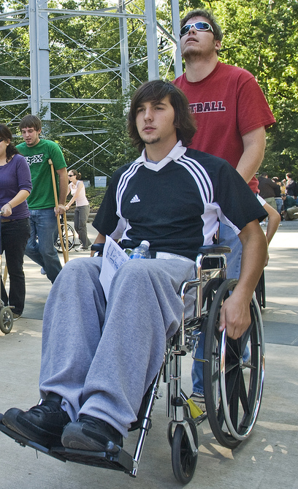
6. Identify Special Needs
Elderly
Disabled
Poor
Limited English speakers
Reading/Learning impaired
Flickr: Penn State
Notes:
Note to Instructor: Refer participants to Step 6 of the Epidemic Preparedness, Response and Recovery Plan template.
Identify people with special needs, such as elderly, disabled, homeless, low-income populations, limited English speakers or reading/learning impaired, and include their needs in your preparedness, response and recovery plans.
Using the template to collect individuals’ information, it may be possible to develop a community outreach program that includes:
• A list of people with special needs that your organization is prepared to assist during an epidemic.
• A list of volunteers who are willing to participate in this outreach initiative.
• Procedures and a protocol for volunteers to maintain contact with the special needs population during the outbreak, making sure that these people receive the information and assistance they need.

Slide 39
7. Coordinate with Others
Plans of other organizations
Use of your facilities
Your potential involvement
Notes:
Note to Instructor: Refer students to Step 7 of the Epidemic Preparedness, Response and Recovery Plan template.
Delegate to an appropriate person(s) the responsibility to contact other local government and/or service organizations to determine what plans they already have in place. This will help to understand others’ capabilities and coordinate your epidemic preparedness, response and recovery efforts during planning.
For example, your facilities may be needed as a vaccination clinic, a food pantry or perhaps even an overflow health care or hospital facility. Additionally, there may be needs and opportunities for expanded community outreach involvement using volunteers to serve the communities in a variety of different roles, such as the delivery of food and other essential supplies to flu-quarantined families.
But before exploring such needs and opportunities with external organizations and agencies, assess and define the scope and nature of your organization’s potential involvement in community outreach activities.

Slide 40
8. Share Your Plan
Staff
Members & volunteers
Other agencies & community organizations
Notes:
Note to Instructor: Refer students to Step 8 of the Epidemic Preparedness, Response and Recovery Plan template.
Share information about your epidemic preparedness, response and recovery plan with staff, organizational members and volunteers, and external agencies/organizations in the communities that you serve.
Some of you may have an established network among organizations in your community. If not, epidemic preparedness planning is an excellent activity to spur the creation of this type of network. Though many emergency response capabilities may be similar among community-based organizations, many are unique. For example, some organizations may focus on providing shelter or food. By sharing your plan with other community-based organizations, all of you will strengthen your response and aid to your community.
You may want to make copies of your plan to give to intended recipients or post it on your website and refer specified individuals to it.

Slide 41
Review & Revise Your Plan
Review twice a year
Practice
Date of change
Who made the change
Revise as needed
Notes:
Note to Instructor: Refer students to Record of Changes in the Epidemic Preparedness, Response and Recovery Plan template.
Your completed plan is not a stagnant document. It should be reviewed at least twice a year and updated with new information as it becomes available.
Set aside time to practice your plan. Making this effort will help identify where some weaknesses or flaws exist before an epidemic hits and efforts become critical. When changes are made, note the date of change and who made the change.
If an epidemic occurs in your community, it is especially important that afterwards your organization reviews and revises your plan. What went well? What could be done better? Putting your plan to the test is the best way to find areas for improvement.

Slide 42
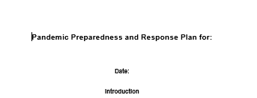
Building Hope
Notes:
At this point, developing an epidemic preparedness plan may seem like a daunting and impossible task. It is neither. Approach the process systematically and in small chunks. The hope is that you never have to use the plan, but the work you do now will be invaluable in the event of a widespread epidemic.

