Slide 1
Surviving a Disaster
Notes:
You’ve made your family home disaster supplies kit plus have similar kits in your car and at your office. You’ve written out your contacts, family meeting plans and home inventory. You’ve gathered and safely stored your important documents.
But when a disaster actually strikes, you’ll need to think about how to apply what you know to ensure your survival and comfort. This program will help you safely meet basic family needs: communication, shelter, water and food, sanitation, communication and supplies. Also, this program will tell you how to start the recovery process.

Slide 2
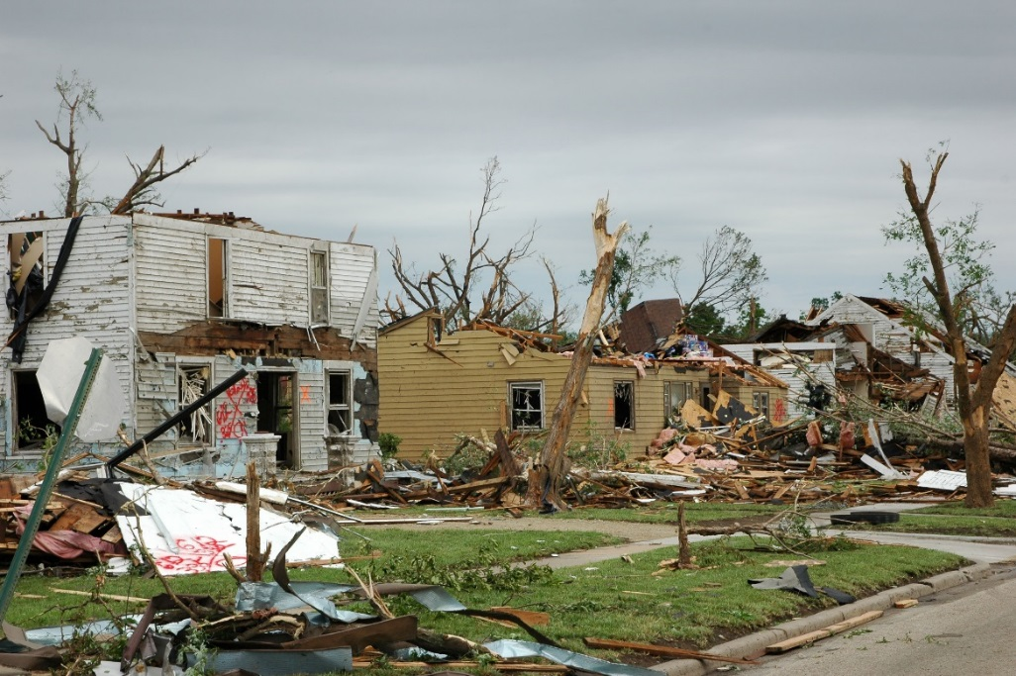

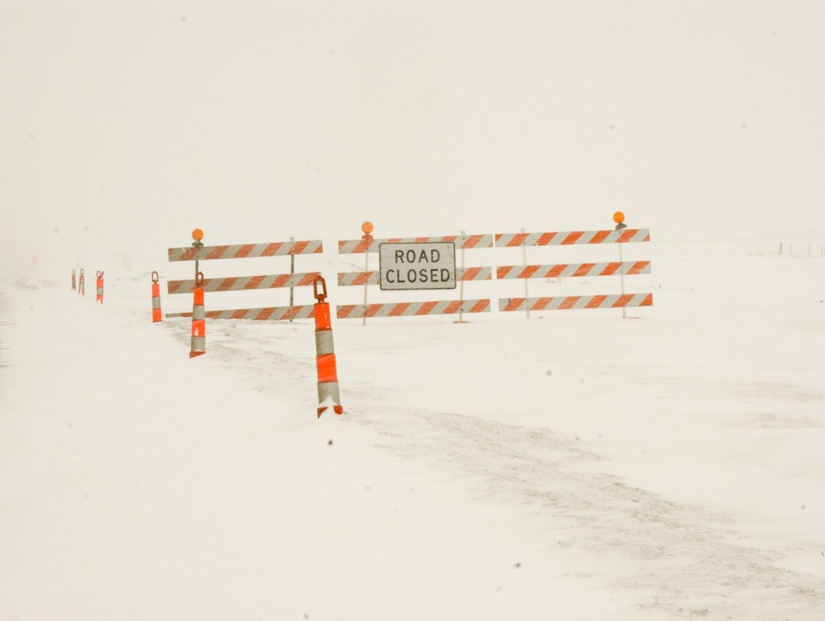
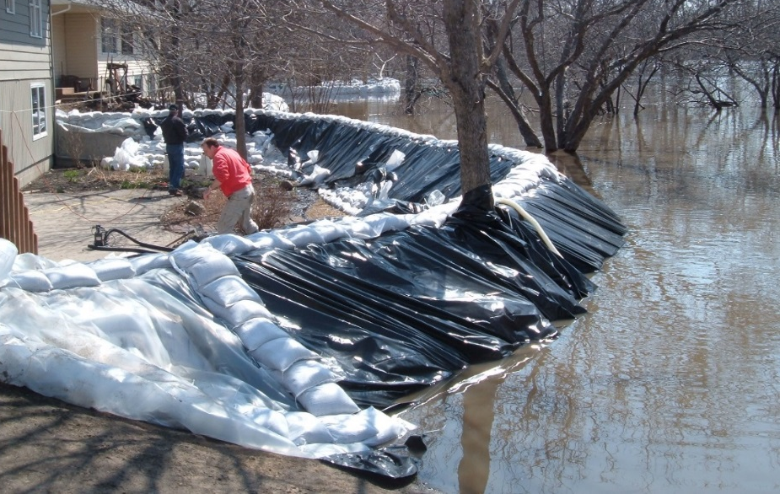
NSSL
Flickr: Ktinsd
NDSU
NDSU
Notes:
During or after an earthquake, flood, blizzard, tornado or severe storm, you may not have electricity for several days. You may be on your own – or at least without modern conveniences – for an extended time. This program teaches how to sustain yourself and your family in the immediate aftermath of disaster. More deaths occur following a disaster than during one. This program will help you stay safe during that time.

Slide 3
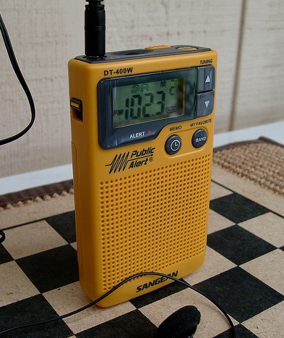
Communications: Checking In
Red Cross Safe & Well or Facebook Safety Check
Ham radio
Written notes at a predesignated place
Local media
NOAA radio
Check on elderly & disabled
Communicate with family
Flickr: James Case
Notes:
When disaster strikes, you’ll want to know the status of family members and co-workers. If you created a communications plan before the disaster, follow it, but remember to remain flexible. Try to get in touch with your out-of-state family emergency contact. Then, if possible, go to the American Red Cross Safe and Well website and Facebook Safety Check to register yourself as safe and well or to search for loved ones.
Ham radio operators will be able to communicate with each other, so if you have contacts, they may be able to put you in touch with family or emergency assistance. If family members might be returning home, leave written notes at your agreed-upon place. Continue to listen to local media on a battery or crank radio or NOAA weather radio or check apps or websites for updates or additional emergency alerts. If possible, check on your neighbors, especially the elderly and disabled. Try to communicate with family members, especially kids, to pass the time and to help calm nerves with open and honest information.

Slide 4
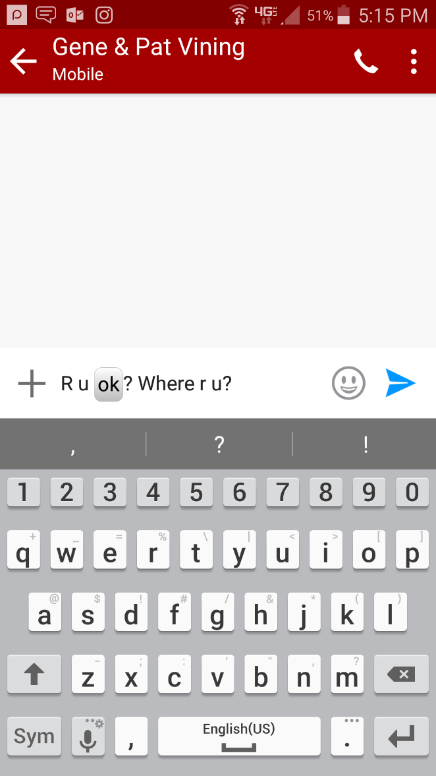
Communications: Cell Phones
Text instead of call
Out-of-state contact
Turn off extra apps that use power
Use solar and other chargers sparingly
NDSU
Notes:
Cell towers and phone lines may be down or overwhelmed. You may not be able make a phone call, but you might be able to text because texting doesn't require as strong of a signal. Also, sometimes calling or texting is easier out of your area code than locally, so all family members should check in with the predesignated out-of-state contact.
You’ll want to keep your cellphone charged as much as possible for emergency communications. Save cellphones for emergency uses. Turn off apps that aren’t needed and eat up battery power. If you have a solar or extra charger, use it sparingly, too.
You might want to refer to a local app or mobile website for emergency updates and information.

Slide 5
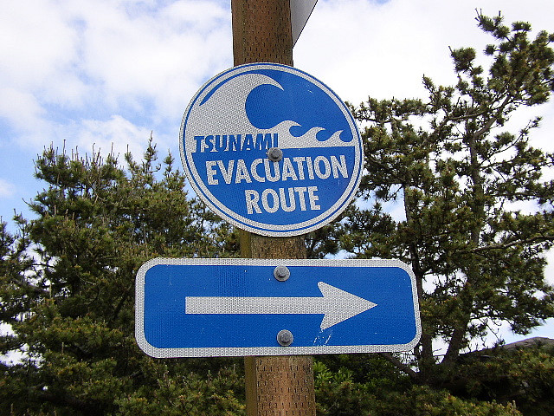
Shelter: Evacuation
Evacuation
  Staying with friends
  Hotel
  Community shelter
Shelter in place
Flickr: J
Notes:
Some disasters will require you to evacuate from your home. If this is the case, you most likely will find yourself staying with friends, at a hotel or at a community shelter. If you have time, grab your go-kits before evacuating. Depending on the situation, you may need to provide your own food, water, activities for kids and other supplies while evacuated. Remember to grab any prescription medications and important paperwork. However, depending on the disaster, you may be able to stay at your home. If this is the case, you’ll need to find ways to make your home livable without the usual amenities.

Slide 6
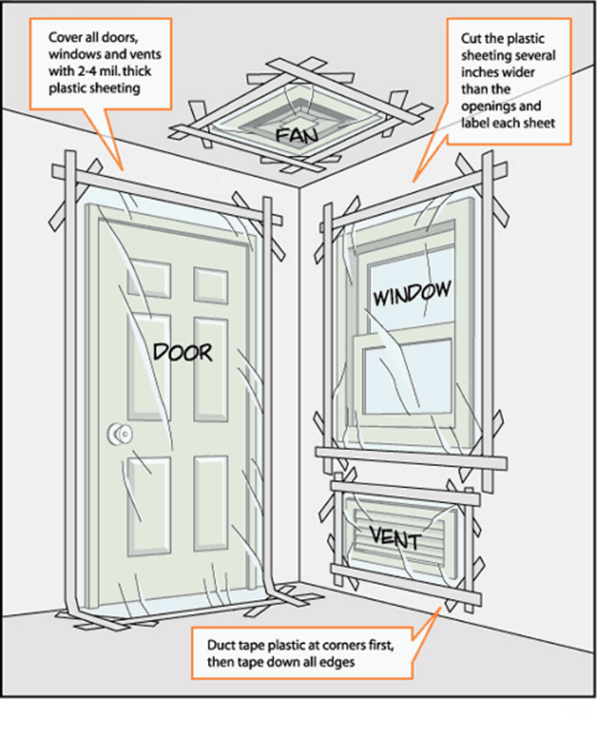
Shelter: Shelter in Place
Have:
Supplies kit
Radio or internet
Pre-cut plastic
Duct tape
Notes:
If a chemical, biological or radiological release occurs, shelter immediately in an interior room typically on the ground level but higher or lower if recommended by local authorities. If you have time, grab your supplies kit, turn off ventilation and heating systems, and close windows, vents, fireplace dampers, exhaust fans and clothes dryer vents. Use plastic sheeting and duct tape to seal vents, doors and windows to keep out contaminants.
However, the longer you and your family spend in a sealed environment, the less oxygen and the more carbon dioxide will be produced. Extended lack of oxygen and carbon dioxide exposure could cause illness or possibly death. In a sealed room, 10 square feet of floor space per person will provide sufficient air to prevent carbon dioxide buildup for up to five hours, assuming a normal breathing rate while resting. (FEMA “Are You Ready?”)
While sheltering in place, stay tuned to a local radio station or an official internet site for instructions.

Slide 7

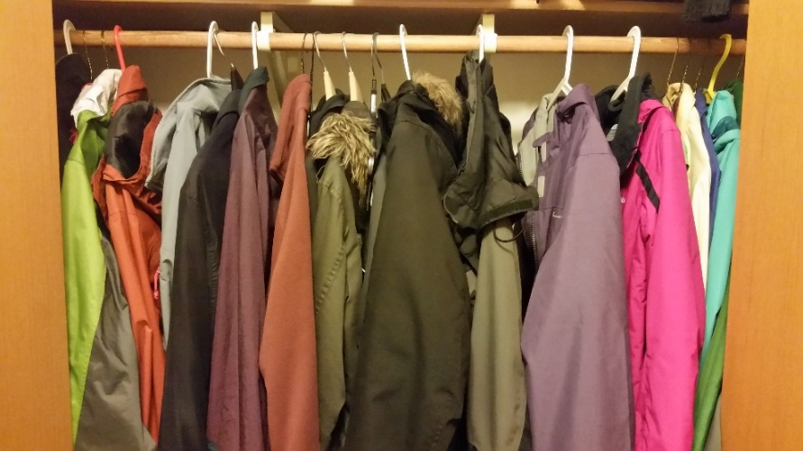
Shelter: Conserve Heat
Close off rooms
Cover windows except on sunny days
Dress warmly
NDSU
NDSU
Notes:
In all but extremely cold weather, you may be able to keep warm by simply conserving heat. Close off all but one room of your home. Place blankets on windows or close blinds and drapes to keep warm air in and reduce cold drafts. Stuff towels or small blankets into windowsills, doorframes and other areas where the heat is leaking out. Place rugs or heavy blankets on the floor to add another layer of insulation. But on sunny days, let the sunshine in to provide solar heat.
Dress warmly by wearing multiple layers, maybe including a hat and gloves. Also, keep warm blankets and sleeping bags available.

Slide 8
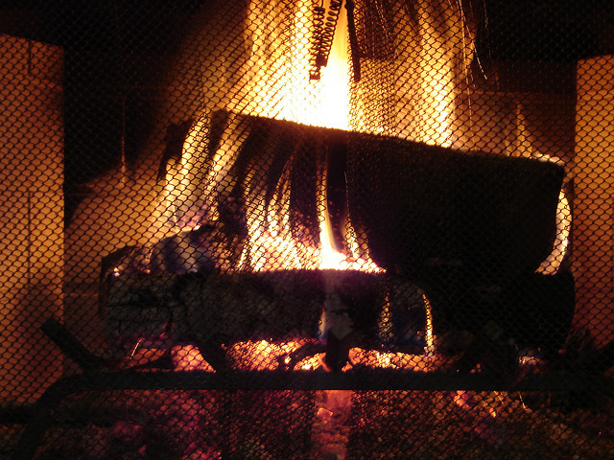
Shelter: Alternative Heat
Safety considerations
  Open flames
  Ventilation
Flickr: Matthew Hunt
Notes:
If you have no power, most alternative heat sources will have an open flame. These include wood stoves, fireplaces and pellet stoves. Take extreme caution to prevent a fire. Remember to keep all flammable materials far away from the flames and keep a fire extinguisher close by.
Ventilation also is important to prevent buildup of carbon monoxide and smoke. As part of your preparedness work, install a smoke detector and carbon monoxide detector with a battery or battery backup.
No matter what alternative heat source you use, always keep children and pets away, and place the heat source out of traffic areas.

Slide 9
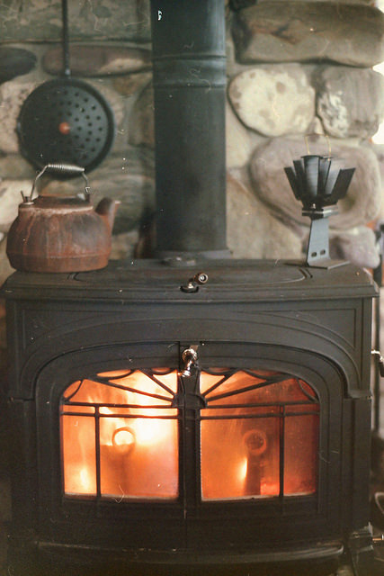
Shelter: Alternative Heat
Fireplace
Wood-burning stove
Do not use liquid fuels
Flickr: Colby Stopa
Notes:
If you haven’t regularly cleaned or maintained your chimney, you may not want to rely on your fireplace for heat. Otherwise, whether you are using your fireplace or woodstove, you will need to have a supply of seasoned firewood – or pellets for your pellet stove. Do not burn green wood because it will produce creosote and a lot of smoke.
Fire starters such as rolled-up newspaper or commercial fire logs may be helpful in starting your fire. Manufacturers produce several nontoxic fire starters. Products such as nuggets, pellets, fire-starting paste, sticks, flint, fire logs and instant fire starters will aid in building a fire. Some fire starters will burn for up to 10 minutes and reach temperatures of more than 350 degrees. Homemade fire starters can be made with dryer lint, paraffin wax, pine cones dipped in candle wax and other materials.
Do not use liquid fuels such as gasoline, kerosene or diesel to start your fire.
If using your fireplace, keep the fire screen in place to prevent sparks and embers from escaping.

Slide 10
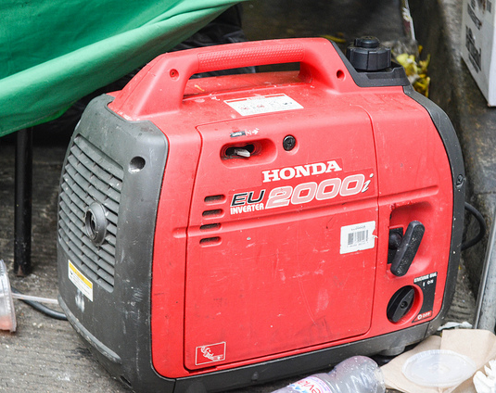
Shelter: Alternative Heat
Gas fireplace
Kerosene, oil and propane space heaters
Electric space heaters
Ventilate to avoid CO poisoning from a generator
Flickr: m01229
Notes:
If your gas service is still available, a gas fireplace is another option for emergency heat. A fresh air source is necessary to prevent carbon monoxide buildup in the house. Opening a window slightly will provide ventilation.
Kerosene, oil and propane space heaters also require a source of fresh air to prevent carbon monoxide buildup. Keep flammable materials away from the heaters and use the fuel your heater was designed to burn. Only use those heaters designed for home use.
An electric space heater can be an effective heat source if you have an electricity source, such as a generator. Use the generator safely to avoid carbon monoxide poisoning from the toxic engine exhaust, electric shock or electrocution, and fire. Never run the generator indoors. Keep the heater away from flammable items, and use newer models with Underwriters Laboratory (UL) labels that are thermostatically controlled and the proper size for the space you intend to heat.
Never leave an open fire or temporary heat source operating unattended or while you are sleeping.

Slide 11
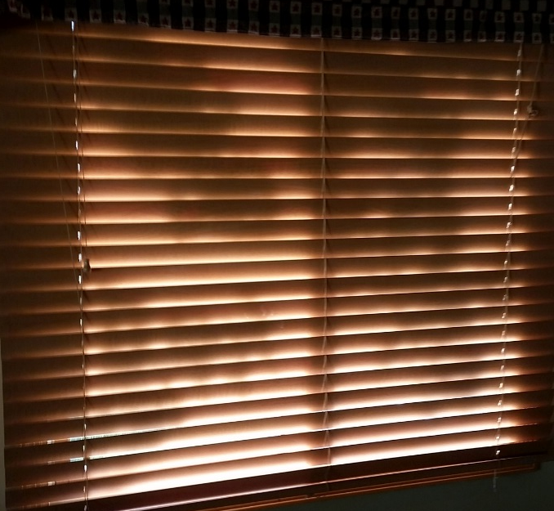
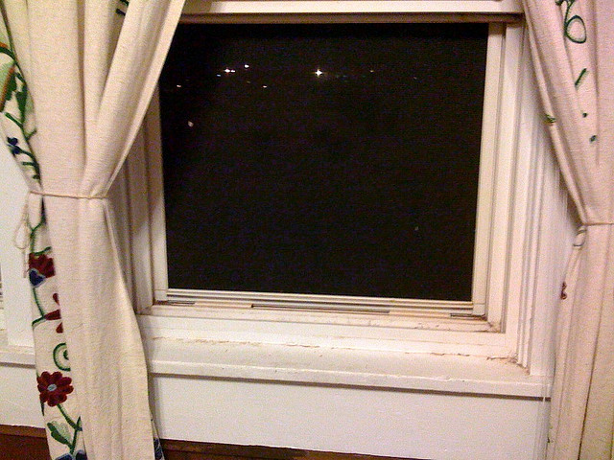
Shelter: Cooling
Cover windows on the sunny side of house
Open windows at night to cool house
Use battery-powered fans
Cool your neck
NDSU
Flickr: K. Latham
Notes:
If the disaster strikes during the summer or the disaster is a heat wave, keeping cool without air conditioning will be a challenge and hazardous to the health of those who are ill or older. You may need to seek shelter in a local cooling station or air-conditioned shelter.
To keep cool at home during the heat of the day, keep shades, curtains and drapes closed on the south and west sides of your house. You might add insulating panels or reflective aluminum foil. When the air is cooler outside than inside, usually at night, open all the windows to let the house cool off.
The best option is to have a battery- or solar-powered fan. If you have a generator, use an electric fan. If ice is available, putting it in front of the fan will cool the air. Once the ice has melted, reuse the water so it isn’t wasted.
Remember, the air may be cooler outside in the shade. If you don’t have a shady porch, trees or other shade, pull out your beach umbrella. Another great way to cool off is to go swimming, but if that’s not an option, neck coolers are a fun product that will help you feel more comfortable. They are filled with moisture beads that when wet make your neck feel cool. Or just use a wet bandana. Neck coolers and wet bandanas work because the neck is one of the cooling pulse points in the body. Cooling the neck cools the blood, which cools the body.

Slide 12
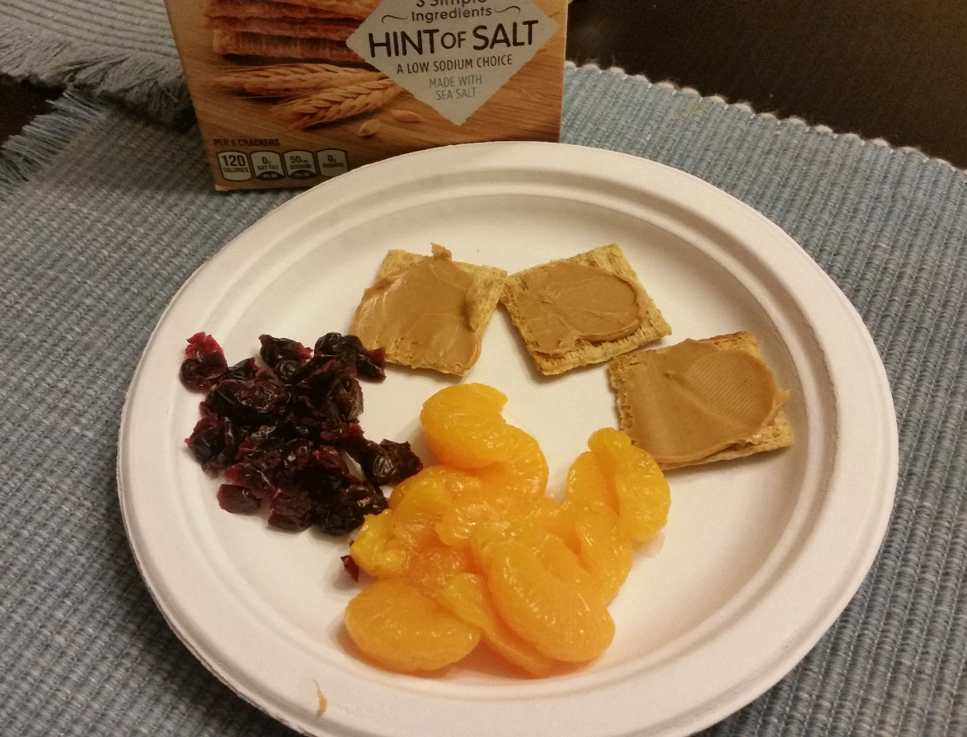
The Basics
Water
Food
Sanitation
NDSU
Notes:
Your family will require some basic necessities to survive a disaster. Plan ahead to figure out how you will meet your water, food and sanitation needs as soon as possible after a disaster.

Slide 13
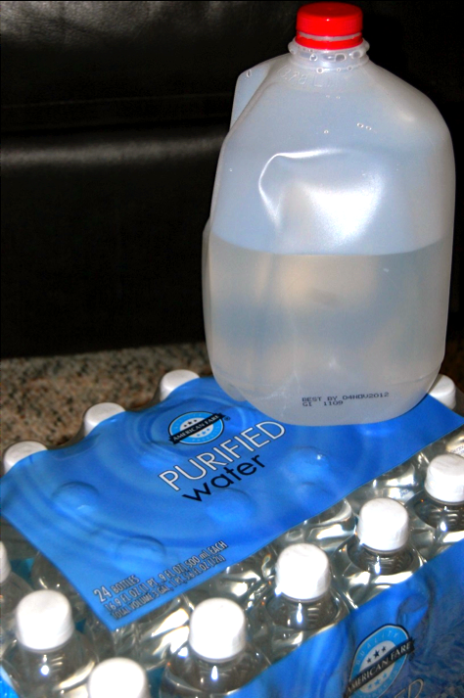
Water: How Much?
1 gallon per person per day for drinking and food preparation
1½ to 2 gallons per person per day for sanitation (brushing teeth, bathing, washing dishes)
1 gallon per day for most pets
NDSU
Notes:
Water needs will vary depending on the number of people, pets and your level of activity. Recommendations are to have a minimum of 1 gallon per person per day for drinking and food preparation and 1 1/2 to 2 gallons per person for sanitation, which includes brushing teeth, bathing and washing dishes.
Water needs vary with activity level. If you’re physically active, such as clearing debris and cleaning up, you’ll need to drink more than the minimum to stay hydrated.
Also, remember to store water for your pets. Consider an extra gallon per day per pet. (Humane Society of the U.S.)

Slide 14
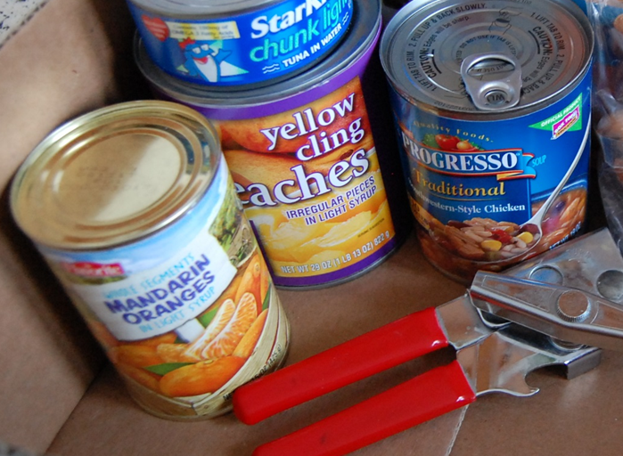
Water: Usage Management
Never ration water
Get liquids from moist foods
Wash hands to clean them
Sanitizer doesn’t clean dirty hands
NDSU
Notes:
Never ration your water. Drink the amount you need today and try to find more for tomorrow. Physical health requires your body to be adequately hydrated. If necessary, minimize the amount of water your body needs by being inactive and staying cool. Part of your liquid needs can come from canned fruit juices, soft fruits, and canned fruits and vegetables. Remember to save and reuse the liquids from your canned fruits and vegetables in your cooking. This will extend your water supply.
If water is limited, use an alcohol-based sanitizer to clean your hands. However, soap and water remains the best option for washing hands because alcohol isn’t efficient on soiled skin.

Slide 15
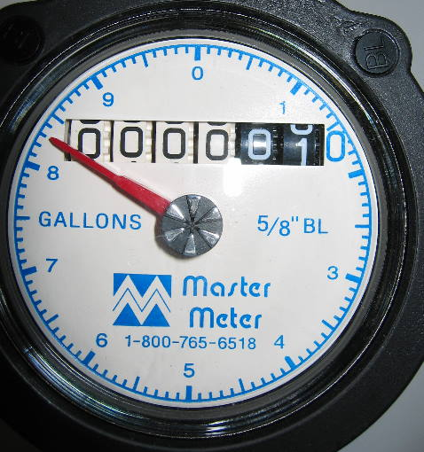
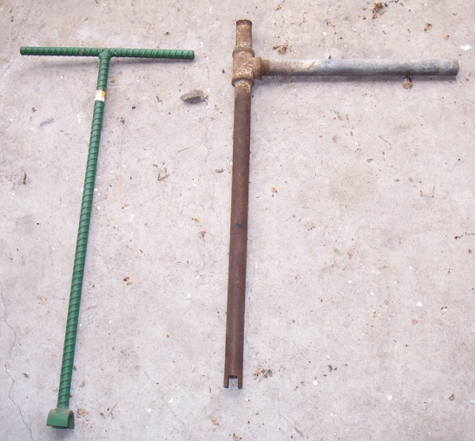
Water: Potable
Obey public announcements
Possibly shut off incoming water valve
Use only bottled or purified water
Wikipedia
Flickr: Seven Twenty Five
Notes:
Potable water is water that can be consumed. Non-potable water is water that has been contaminated to some degree that makes it unfit for drinking. Some non-potable water can be purified to make it drinkable. Do not purify water when it is dark, has an odor, has particles floating in it or is contaminated with chemicals such as oil and gas.
Obey public announcements about whether your tap water is safe to drink or to use for cooking and bathing. Shut off your incoming water valve if broken water or sewage lines are in your area to stop contaminated water from entering your home. If the water is unsafe, use only bottled water, or boil or disinfect your water for drinking, cooking, cleaning, bathing, washing dishes, brushing your teeth and washing your hands. If you have exhausted your stored water supply, disinfecting all water from other sources is a good idea during a disaster. Don’t assume the water is safe.

Slide 16
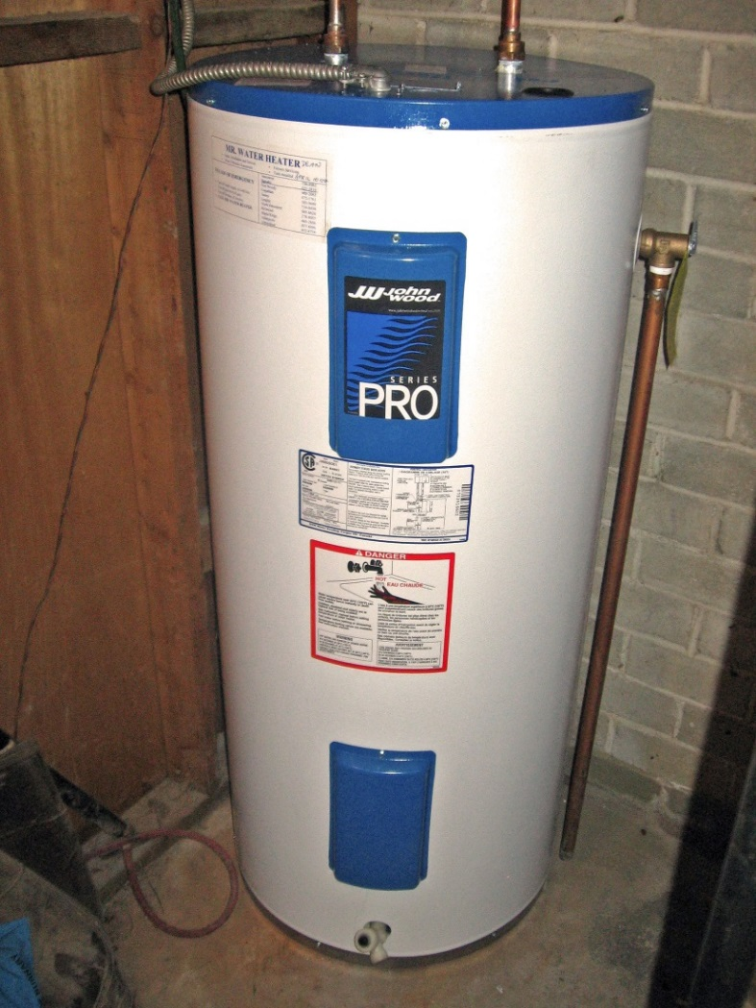
Water: Sources
Water heater
Toilet tank
Water pipes
Ice cubes
Outside
  Underground wells
  Surface water
    Creek, river, lake or pond
Flickr: I am I.A.M.
Notes:
If your local water supply is contaminated, turn it off where it enters your house so the water in your house doesn’t get contaminated. You may have alternatives if your main water source is not available and you have used your stored water supplies. These alternative sources should be purified to be safe.
To get water from your water heater, turn off the power that heats the tank and let the tank cool. Place a container under the tank and open the drain valve at the bottom. Or start the water flowing by turning off the water intake valve and turning on a hot-water faucet. Sediment often settles in the bottom of the tank, so let it run a few minutes until the water runs clear. Don’t turn the tank back on until utility services are restored.
The water in a toilet tank (not the bowl) is safe to drink unless chemical treatments have been added. If your water supply was turned off at the street or where it enters your house, you have water in the pipes that can come through faucets. Boil it just to be safe.
The ice in the freezer eventually will melt, allowing it to be used. Also, rainwater and water from coiled garden hoses can be used after it has been purified.
In an emergency, underground water, such as from wells or springs, is less likely to be contaminated than surface water. If underground water is unavailable, you may use surface water from a creek, river, lake or pond. Choose one in that order because running water usually is more pure than standing water. If possible, get the water upstream from inhabited areas and dip it from below the surface. Purify all underground and surface water before using for drinking, cooking or personal care.

Slide 17
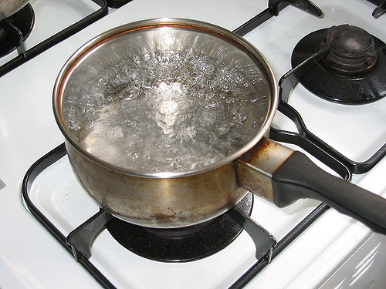
Water: How to Purify
Strain water first
Boil at least 1 minute
Add salt or aerate
Flickr: yuksing
Notes:
No matter which of the following methods you use to purify your water, first strain the water through a clean cloth, coffee filter or paper towel into a clean container to remove any sediment or floating matter.
If you can, the preferable method is to boil the water vigorously for at least one minute. The water is ready to use after it cools. To improve the taste, add a pinch of salt to each quart of boiled water or pour the water back and forth from one clean container to another several times.

Slide 18
Water: How to Purify
Read label directions
Chlorine % | Drops per gallon of filtered water
8.25% | 6
6.0% | 8
EPA
Notes:
If you’re unable to boil your water, purify it with regular, unscented liquid laundry bleach that has no added cleaners. Read the product label to find the percentage of chlorine and directions for emergency disinfection of drinking water. Most liquid chlorine bleach is concentrated to 8.25 percent, so use six drops per gallon for filtered water. (Environmental Protection Agency)
If the bottle of bleach is older than 4 months, it should not be used as a water purifying agent. Also, do not use swimming pool or hot tub chlorine.
Add the bleach to the water and stir or shake the container thoroughly. Let the water stand for 30 minutes. If you can smell a slight chlorine odor, the water should be safe. If you cannot smell a slight chlorine odor, repeat the dosage and let the water stand for 15 more minutes before using it.

Slide 19
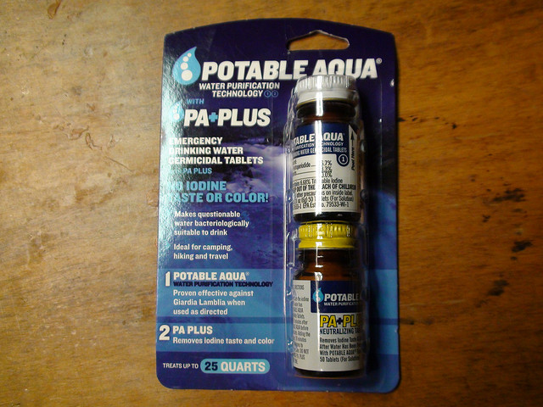
Water: How to Purify
Purifying tablets
Iodine
Filtration systems
Flickr: Jaroburn
Notes:
Another option is purification tablets that release chlorine or iodine. Follow the package directions. Usually one tablet is enough for 1 quart of water. Double the dose for cloudy water.
Another purification method is tincture of iodine, which is available at outdoor stores. For clear water, add five drops of iodine per quart of water. For cloudy water, add 10 drops of iodine per quart. Let the mixture stand for 30 minutes, then the water should be safe to use.
Commercial filtration systems that remove 99.9 percent of all contaminants from water are available, so you might want to purchase one before a disaster. These systems are available in a variety of individual or backpacking sizes and styles, as well as larger cylinders for the kitchen.

Slide 20
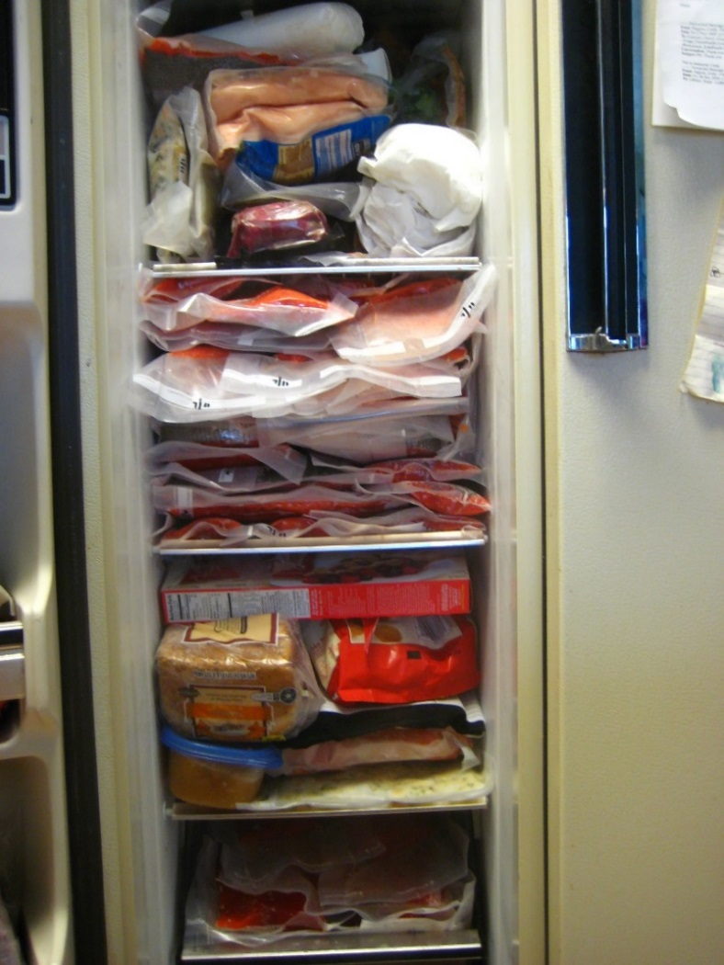
Food: Keeping it Safe
Limit opening
Load freezers from bottom
Foods thaw at different rates
Safe if ice crystals
If food has been at 40°F or higher for 2 hours or longer, throw it out
Flickr: mcav0y
Notes:
During a power outage, keep food safe in the refrigerator and freezer longer by opening them no more than once a day. Maintain food quality in the fridge and freezer by placing ice or dry ice in the lowest possible area, then moving the rest of the contents down to be near the ice. Again, open the fridge and freezer as little as possible. Add dry ice only after the power has gone out.
Cook and eat any seafood immediately because it will thaw quickly. Next, cook and eat ground meat because it will thaw quicker than other cuts of meat. Then plan menus around what foods are thawing; thinner cuts of meat will thaw before thicker cuts. Fruits and vegetables also will thaw quickly but can be eaten as long as they’re kept cold.
If food has been at a temperature of 40 degrees or higher for two hours or longer, it must be thrown out. Food that still has ice crystals is safe to eat or refreeze, though quality may suffer. Throw out leftovers, raw meats, seafood, and any kind of milk, soft cheese and refrigerator rolls that have been above 40 degrees for two hours or more.

Slide 21
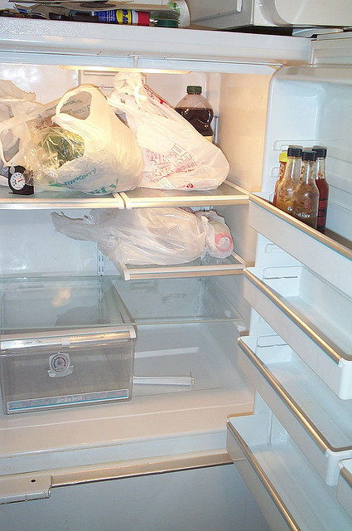
Food: Is it Safe?
Do not taste food to determine safety
Toss if it looks, smells or feels odd
Toss if damaged
www.foodsafety.gov
If in doubt; throw it out
Flickr: stu_spivak
Notes:
Do not taste food to determine its safety! Temperature is the only reliable judge of safety in foods, not taste or smell. Remember, you cannot cook the bad out of food.
Without ice or dry ice, highly perishable products such as milk, soft cheese, mayonnaise, mayonnaise-based salad dressings, meats and similar products have short non-refrigerated life spans. Ketchup, mustard, pickles, soy sauce and many other items usually stored in the fridge have a much longer shelf life.
Toss anything that looks, smells or feels odd. If in doubt, throw it out. Discard any food packaged in plastic, paper, cardboard or cloth that is water damaged.
Toss all cans that are open, dented, rusty, damaged or bulging. However, safe cans can be cleaned and disinfected. If cans have been in contact with floodwater or other contaminants, remove the labels and use a permanent marker to re-label each can immediately. Wash the cans in a strong detergent solution with a scrub brush to remove silt. Immerse the scrubbed containers for one minute in a lukewarm solution of 2 teaspoons of 8.25 percent chlorine bleach and 1 gallon of water. Remove containers from the chlorine solution and allow them to air-dry before opening. Re-label with the permanent marker, if necessary. Use as soon as possible because the containers may rust. See www.foodsafety.gov for more details.

Slide 22

Food: Preparation
Clean with warm, soapy water
Then sanitize:
  Spray with 1 teaspoon bleach per 1 quart warm water
  Immerse in 1 tablespoon bleach per gallon warm water
NDSU
Notes:
Food and water must be safe, but so must the dishes and utensils that touch them. First, to save water, scrape and wipe off food remnants from the dishes before washing. Next, scrub all surfaces, dishes, pots, pans and utensils with warm, soapy water. Food particles and dirt can harbor germs, so be sure to remove all food and dirt from kitchen surfaces and cookware. Plain dish soap and water is best. Then, use warm, running water to rinse away food particles, dirt and soapy residue. As you rinse away dirt and soap, germs also will be washed away.
Finally, use a sanitizing agent such as a chlorine bleach solution or an ammonia-based cleaner such as Lysol to sanitize. For surfaces such as counters and cutting boards, the bleach solution should be 1 teaspoon of 8.25 percent bleach per quart of warm water in a spray bottle. Allow the surfaces to air-dry. For dishes and utensils, mix 1 tablespoon of 8.25 percent bleach into a gallon of warm water and allow them to soak for two minutes, then air-dry. This sanitizing step will help kill any germs that might remain on a cleaned surface.

Slide 23
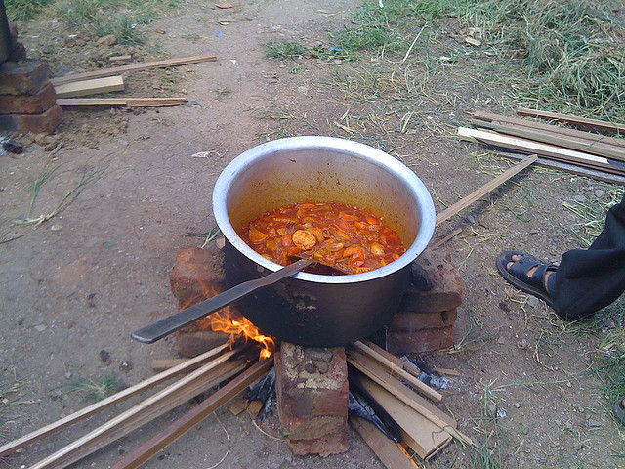
Food: Cooking Without Power
No Power?
No Problem!
Flickr: Senorhorst Jahnsen
Notes:
If you lose power, your family still needs to eat. By using some alternative cooking methods, you can survive on something besides cold meals for days.

Slide 24
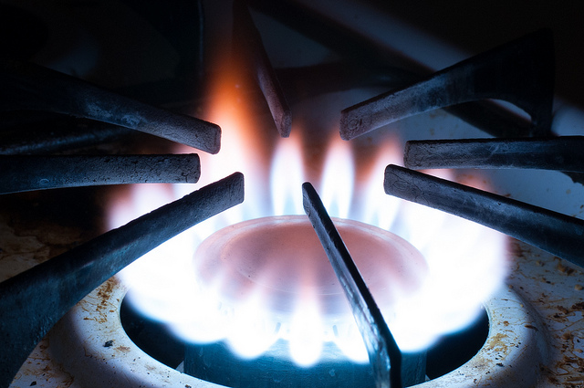
Food: Alternative Cooking Methods
Gas range
Wood-burning stove
Fireplace
Flickr: D Coetzee
Notes:
Several cooking methods do not require electricity, and some already may be available to you. For instance, do you have a gas range? If so, check your manual for information on usage during power outages. You may be able to ignite the pilot light manually. However, make sure your gas lines have not been affected by the disaster. Do you smell gas inside or outside your home? If so, you may have a gas leak. Do not light the stove or even turn on lights or anything else that might spark. Turn the gas off at the outdoor meter.
Do you have a wood-burning stove? Consider cooking on top of the stove. But unless it is designed as a wood cook stove, baking inside the box is not easy. However, you may be able to place saucepans on top of the stove. Also, depending on the design and surface area of your stove, a metal box oven designed for camping may be used for baking. Successful cooking on the surface of a wood stove takes practice due to the high and varying temperatures.
Using the fireplace is another option. Heavy pans, such as cast iron, work well for cooking in a fireplace. Also, food can be wrapped in aluminum foil, placed on skewers or set on a grill placed in the fireplace. However, do not use your fireplace or wood stove for cooking if regular cleaning and maintenance has not occurred. To do so is running a risk of causing a fire and/or carbon monoxide poisoning.

Slide 25
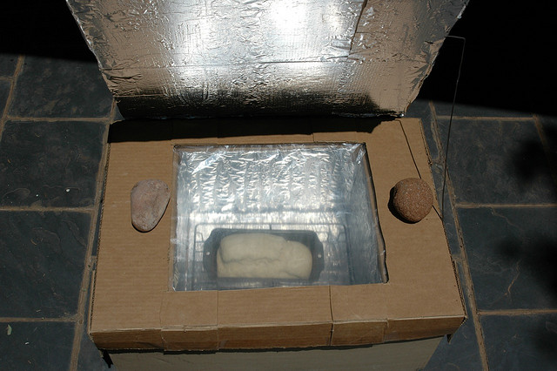
Food: Alternative Cooking Methods
Canned heat
Biomass, debris, hobo, can stove
Solar ovens
Flickr: Abri le Roux
Notes:
A variety of canned heat can be used indoors with adequate ventilation. The cans are filled with alcohol or gel and have a long shelf life. They produce an open flame and enough heat to warm food but not boil it. They are safe and lightweight, and store easily. Store away from heat sources and dispose of damaged or dented cans.
Biomass, debris, hobo or can stoves utilize scraps of flammable items, such as twigs, bark, pinecones, wood and nut shells. Debris stoves can create enough heat to reach the boiling point. Many of these stoves include a battery-powered fan, creating a forced ventilation system that provides intense heat and efficient burning. An internet search will result in a variety of suppliers, producers and styles for these small, efficient stoves.
You may wish to invest in a solar oven that captures the sun’s rays to cook. An internet search will reveal ovens you can purchase and plans for building them. The solar oven can reach temperatures of more than 400 degrees. They are portable, safe and easy to use. They are most efficient on clear, sunny days between 10 a.m. and 4 p.m. Start cooking early enough in the day to ensure enough sunlight to finish the dish.

Slide 26
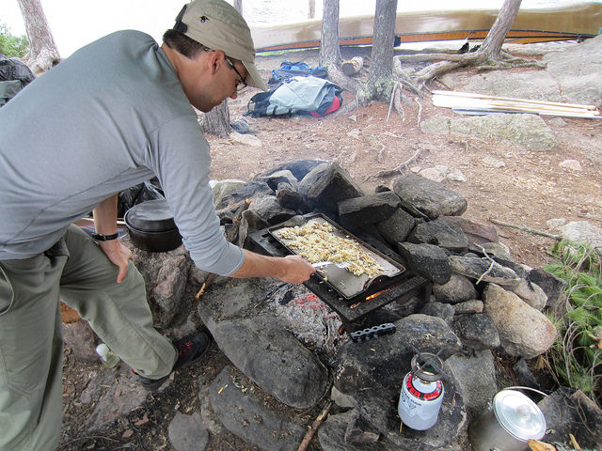
Food: Cooking Outdoors
Charcoal grills
Gas grills
Fire pits
Camp stoves
Flickr: lburiedpaul
Notes:
Many households have an outdoor barbecue that could serve as the main cooking appliance while the power is out. Remember never to use a charcoal grill in the house due to the release of carbon monoxide that leads to asphyxiation. Grills can be used for grilling food, cooking vegetables wrapped in foil, and baking bread, rolls and even pizzas. Some gas grills even have a side burner for extra versatility. Remember to move the grill away from the side of the house due to fire risk.
Charcoal briquettes keep indefinitely if they stay dry. Propane will store indefinitely, but the tank must be recertified. Store tanks out of the sun and away from the house.
Fire pits are a popular addition to households and can be used like an open fire for Dutch oven-type cooking. Several types of camp stoves that use a variety of fuel types may work for cooking food. Check the manufacturer’s recommendation on whether they must be used outdoors only. Propane and charcoal stoves must be used outdoors only.

Slide 27
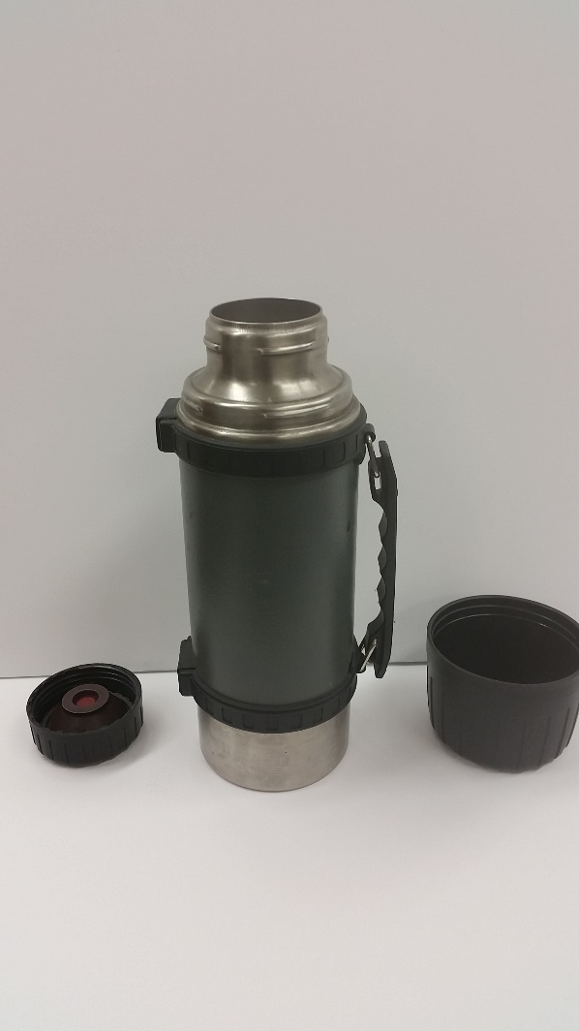
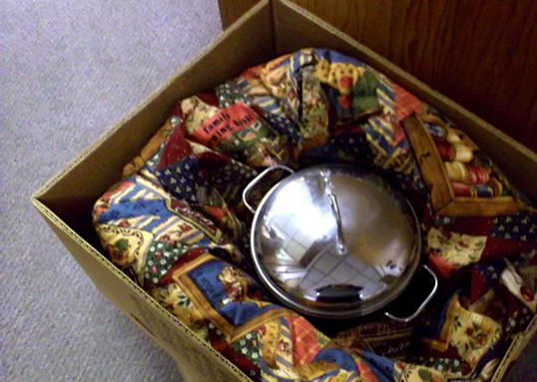
Food: Saving Fuel
Cooking in a Thermos
Insulated or Thermal Cooking
Christine Jensen
NDSU
Notes:
Since fuel resources may be limited during a disaster, consider alternative ways of cooking that require less fuel. A high-quality stainless steel thermos can be used as a cooking vessel. Preheat the thermos with boiling water. Remove the water and quickly add the appropriate amount of boiling water and the food, such as wheat, quinoa, oats, dehydrated soups and other dehydrated foods. Tighten the lid and let the thermos set for the time required to cook the food.
Insulated or thermal cooking retains heat already applied to the food and slowly finishes cooking. Foods are heated to the boiling point and then quickly insulated inside a container, such as a cooler. Use thick layers of non-conducting cloth material, batting, newspapers, hay or straw. This cooking method may require 2-3 times longer than simmering on the stove.

Slide 28

Food: Don’t Cook at All
Eat refrigerated foods first
Ready-to-eat foods
Use paper products
NDSU
Notes:
Without power, you still have many food choices. Use refrigerated foods first. Next, consider your ready-to-eat foods such as cereal, boxed foods, peanut butter and canned foods that do not require cooking. Keep a manual can opener on hand for an emergency. Many dried foods such as nuts, fruits, jerky and vegetables are excellent consumed in their dried state. Remember that water intake must increase if eating dehydrated foods. Also, using paper plates, plastic cups and utensils, and paper towels can help with water conservation.

Slide 29
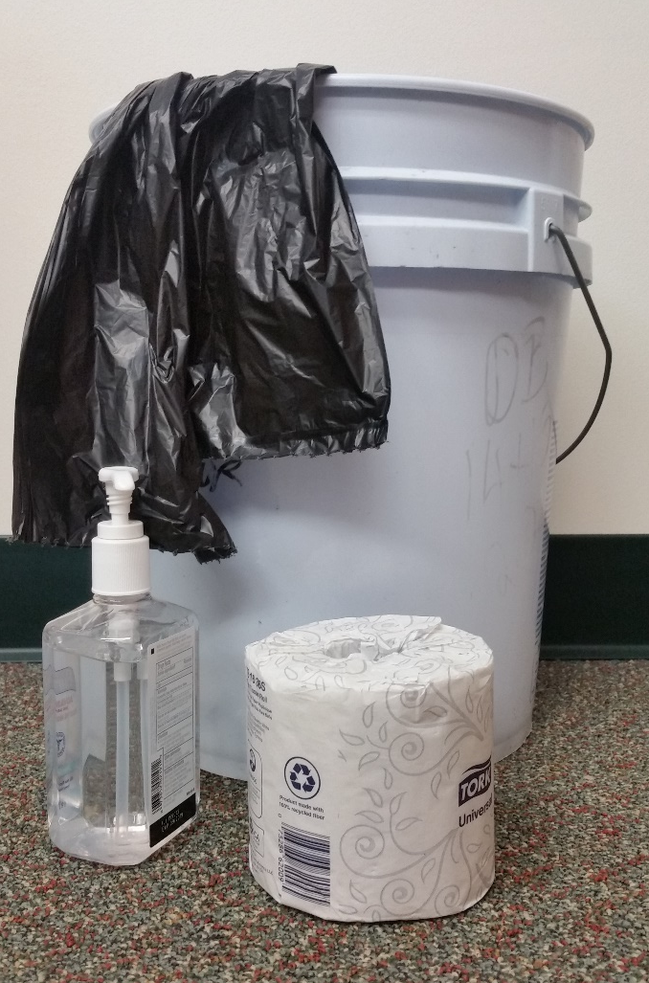
Sanitation: Make A Plan
Practice good sanitation
Sanitation kit
NDSU
Notes:
In a disaster, practice good sanitation. Creating and executing a good sanitation plan can help maintain good health and well-being. Pull out your basic sanitation kit that includes toilet paper, sanitizing chemicals, hand sanitizer, baby wipes, disposable gloves, duct tape, plastic buckets with lids, feminine products and garbage bags.

Slide 30
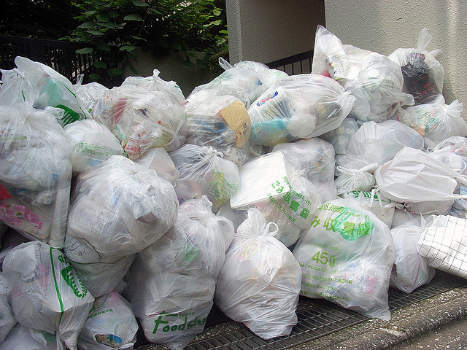
Sanitation: Waste Disposal
Garbage can pile up
Have a plan
Divide the refuse
  Burnable
  Compostable
  Waste
Flickr:sekihan
Notes:
A well thought-out waste disposal plan is crucial to good sanitation. Garbage may be managed by separating it into cans, glass, plastic, wet garbage and burnable items. Keep a large number of garbage bags to help with separation and storage. Shredded paper products, yard waste, kitchen scraps and cardboard can be composted, which is turning garbage into a rich soil loaded with nutrients that you can use for gardening. Burning or burying waste is not preferable but when necessary can be used to eliminate waste.

Slide 31
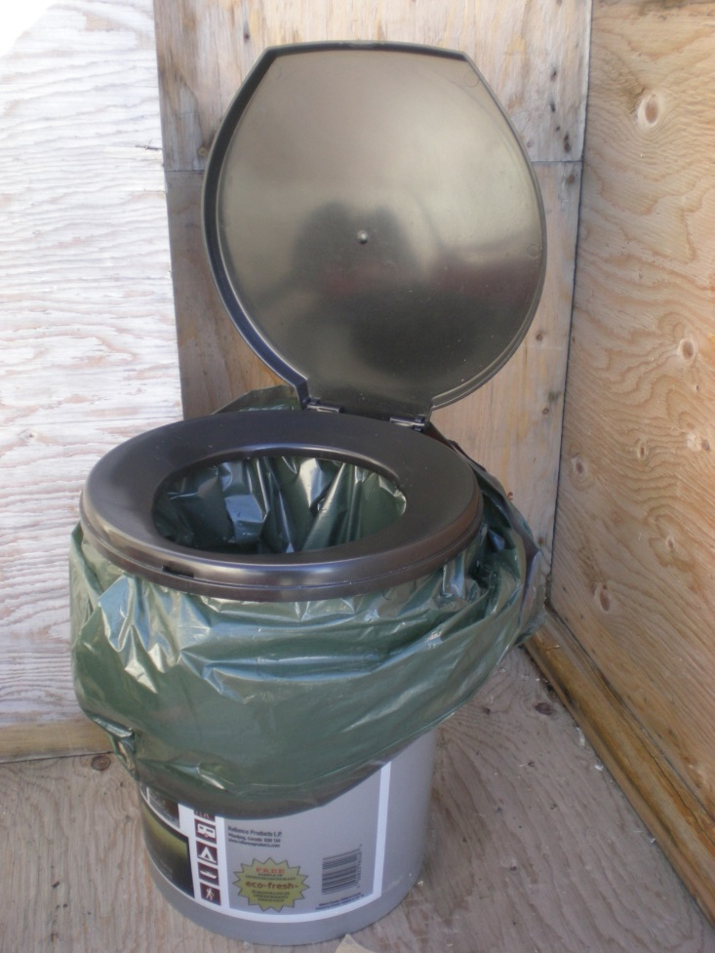
Sanitation: Human Waste Disposal
The home’s toilet
Port-a-potties
Buckets
Sanitation
Wikimedia Commons:
CambridgeBayWeather
Notes:
If not managed properly, human waste becomes a source of odor and possible water contamination and illness. If your power is out and you have a septic system, a regular toilet may be flushed using a bucket of water. Pool water and water recycled from washing, brushing teeth and other uses will work for manual flushing. Chemical toilets, composting toilets, and trench or pit latrines are viable alternatives. In a worst-case scenario, waste may be stored. Be sure to have buckets with tight fitting lids for short-term storage. Do not throw human waste on bare ground.
Consider a location for toilet placement that will be convenient, yet secluded. If you cannot dispose of garbage properly, bury human waste and biodegradable garbage to avoid the spread of disease by rats and insects. Dig a hole 12 to 18 inches deep and at least 50 feet but preferably 200 feet or more downhill and away from any water supply. Fill the hole with the refuse and cover with dirt.
Each time the toilet is used, some type of disinfectant should be sprinkled on top. This may be chlorinated lime, bleach, other disinfectants or plain baking soda. Cat litter also is an absorbent material that reduces liquids and smells in a portable toilet.
Remember to keep a “closed” toilet with some type of lid to prevent excess smell and spread of disease.
Stress the importance of keeping as clean as possible to your family members. Wash hands and use antibacterial wipes and hand sanitizers frequently. Advise them to not ignore any cuts, scrapes or sores, and to use precaution when drinking and eating out of unclean or common containers.

Slide 32
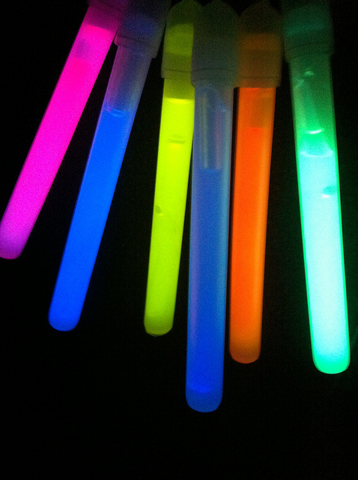
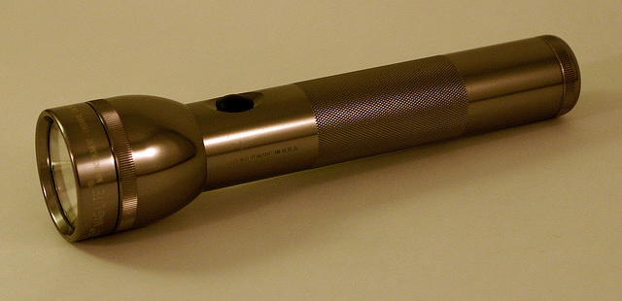
Supplies: Lighting
Flashlights of all types
Headlamp
Solar –powered lights
Glow Sticks
Flickr: Ben Esacove
Flickr: redjar
Notes:
After many major disasters, ordinary sources of lighting may not be available. Consider using alternative sources including a variety of flashlights, headlamps, emergency candles, lanterns, solar lights and glow sticks.
When you purchase flashlights, remember extra batteries. Also consider those that don’t require batteries, such as the crank and shake models, and choose those with LED light bulbs that are brighter and use less energy so extend the battery life. Have on hand one flashlight per person.
Solar-powered lights are a necessity for extended power outages. Many solar lights can produce light powerful enough to play games or read by. Solar-powered landscape lights also are useful. While these will not generate as much light, they can be used inside where low light is needed, such as illuminating the way to the bathroom or kitchen. Remember to put them outside during the day to recharge.
Glow sticks also are useful for adding low levels of light. Placing the stick in a clear container of water will refract the light, making the stick brighter and adding additional light.
These options are safer than open flames.

Slide 33
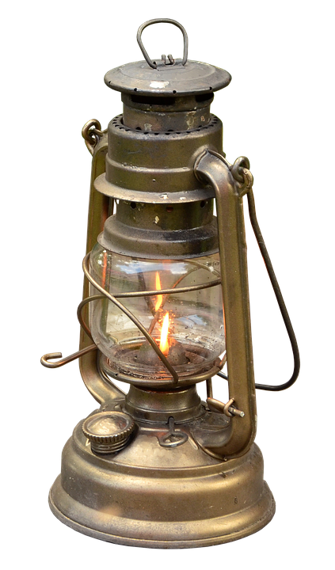
Supplies: Lighting Safety
Emergency candles
Lanterns
Pixabay: Momentmal
Notes:
But if you must use an open flame, be very careful. Never leave candles and lanterns unattended. Place them in sturdy and properly operating holders. All lighting sources should be placed where they will not be dropped or tipped over, causing damage to the device or allowing open flames to ignite nearby objects.
Many people prefer to use an oil lamp rather than emergency candles. Oil lamps are inexpensive, but they always should be used with the chimney and placed on a solid surface. The higher it’s placed, the wider the light is dispersed.

Slide 34
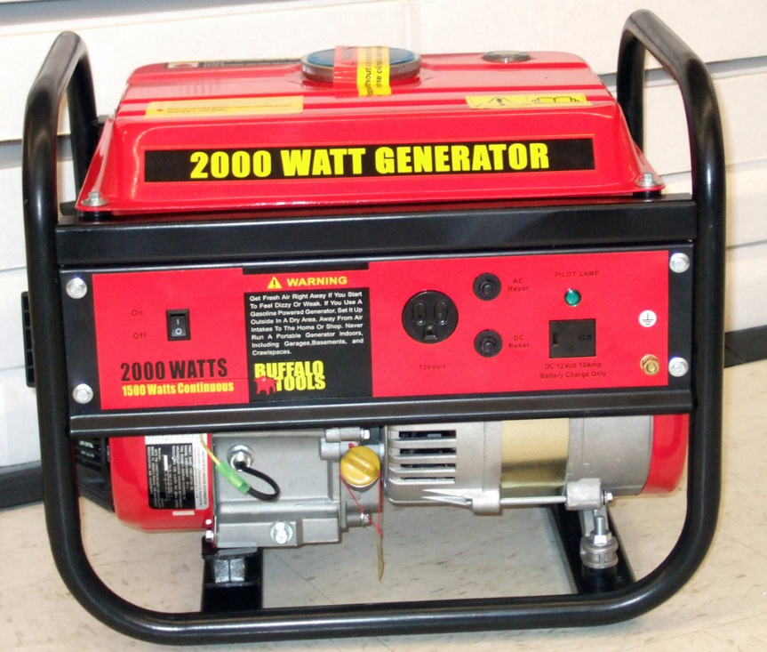
Supplies: Generator Safety
Always operate generators outdoors to prevent CO poisoning
Operate on a dry surface with dry hands
Use heavy-duty/outdoor extension cords
Flickr: Marion Doss
Notes:
If you use a generator, never operate it indoors or in partially closed areas, such as a garage or porch, even if you think there is enough ventilation to prevent carbon monoxide poisoning. Opening windows and doors will not prevent carbon monoxide from building to dangerous levels. Place the generator outdoors and away from windows, doors and vents where CO gas can enter the home.
Keep the generator dry. Do not expose it to rain or place it on a wet surface. Operate it on a dry surface under an open, canopy-like cover. If anyone in the area where a generator is being used develops a headache, lethargy, weakness, nausea or muscle aches, get medical help immediately.
To reduce the risk of electrical shock, dry your hands before touching the generator. Plug appliances directly into the generator or use a heavy-duty extension cord that is rated for outdoor use. Make sure the extension cord is also rated (in watts or amps) at least equal to the sum of the connected load. Be sure the cord has no cuts or tears and that the plug has three prongs with a grounding pin. Never plug the generator into a wall outlet in a house or other circuit. This could electrocute utility workers or neighbors who might be servicing the electrical system.
Keep generator fuel out of your home and away from fuel-burning appliances. Turn off the generator and let it cool before refueling. A fuel spill on hot engine parts could cause a fire. Always keep a fire extinguisher near the generator. Never attempt to repair a generator. Only a qualified technician should perform repairs. Do not remove or tamper with safety devices, and do not touch hot engine parts. Keep children away from the generator and the fuel containers.

Slide 35
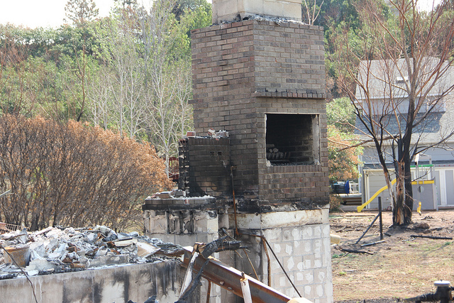
Starting Recovery
Contact insurance company
Take photos of damage before cleanup
Locate important documents
Flickr: Barbara Samuels
Notes:
The sooner you start the recovery process, the sooner you can get back to normal. As soon as possible after a disaster, contact your insurance company to get that process started and to see what information they will need to process your claim. Before doing any cleanup, take photos of the damage to your home and other property for your insurance company and possibly FEMA and create an inventory of what has been damaged. You should also start to locate and gather important documents that you will need during the recovery process.

Slide 36

Summary
Communication
Shelter
Water
Food
Sanitation
Supplies
Notes:
Hopefully you’ll never experience a disaster that leaves you and your family on your own, but with this information, you should be able to meet your basic family needs for communication, shelter, water, food, sanitation and supplies. Hopefully you’ve prepared for all of these needs in advance of a disaster. Even if you have, there is still a degree of flexibility required. Remember to be resourceful and safe to help you survive a disaster.

